Slide 1
Event Recap: Google Cloud Next – August 2023
Bradley Shimmin
Chief Analyst, AI platforms, analytics and data management
askananalyst@omdia.com

Slide 2
Contents
Show overview 4
Top stories 7
Key takeaway 15
Appendix 16

Slide 3
Seven top trends
01
Dancing a Duet Google begins rolling out Duet AI across its portfolio
02
Embeddings afoot New vector database tools target semantic search and LLMs
03
Fresh from the garden The Google Vertex AI Model Garden picks up several new LLMs
04
Solid foundations Google beefs up its flagship LLM with languages and context
05
Notebooks get real Google’s free Colab notebook finally reaches the enterprise
06
Big data & big models New LLMs and new tools now native to Google BigQuery
07
LLMOps in overdrive New measures for honesty, helpfulness, and harmlessness abound

Slide 4
Show overview

Slide 5
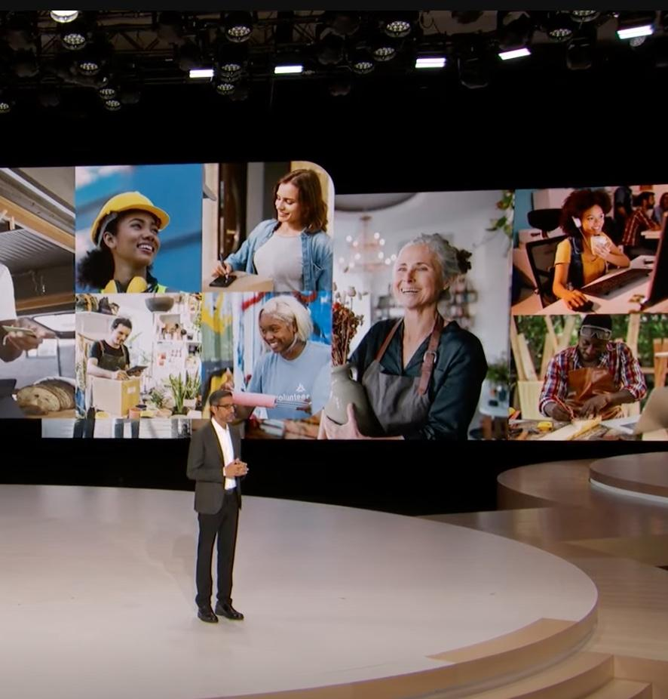
Show overview: “The old way is getting old.” – Sundar Pichai
Google and Alphabet CEO Sundar Pichai on stage
To open Google Cloud Next 2023 show, CEO of Google and Alphabet, Sundar Pichai, took to the stage and straight away emphasized the fact that Google Cloud has been taking an AI-first approach to creating its products for the past seven years.
This statement is crucial, as it takes direct aim at recent market criticism that despite inventing the concept of transformer models, the very technology that powers today’s wildly popular large language models (LLMs), the company has lost its position as a first mover in pioneering AI.
As a proof point, Mr. Pichai noted that during Google Cloud Next 2023 the company was rolling several generative AI (GenAI) solutions that had only been announced a few months ago at Google I/O 2023, led by Duet AI – an augmentative GenAI-powered collaborator assistant that Google intends to interweave across its entire Google Cloud portfolio.
Furthering this desire to be associated with innovation, Mr. Pichai went so far as to claim that 70% of all GenAI Unicorns (startups worth more than $1B dollars) were Google Cloud customers. That influential list includes A21 Labs and Anthropic, both of which figure heavily in Google’s emerging GenAI ecosystem.
This focus extended offstage as well. In meeting with several Google product leaders, Omdia noted this abiding sense of acceleration with one individual happily stating that it feels currently as though Google feels once again like a start up in diving headlong into GenAI.
Source: Google Cloud Next 2023 keynote

Slide 6
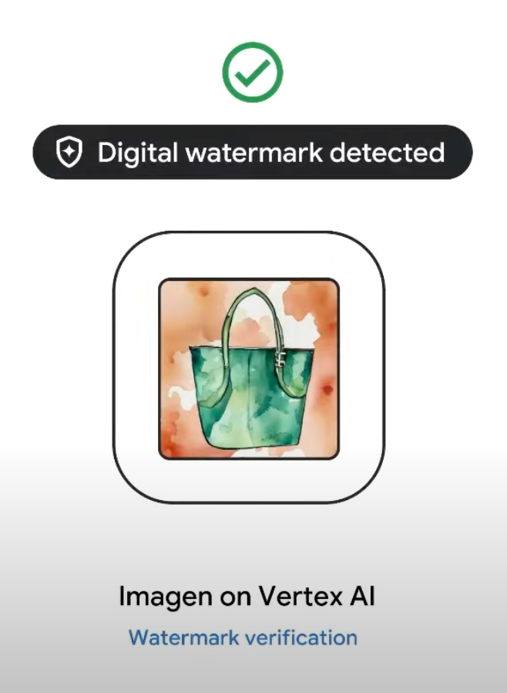
Show overview: “The old way is getting old.” – Sundar Pichai
Addressing copyright protections in GenAI output
Throughout the keynote and across the entire event, Google emphasized the fact that it remains a key player in the AI marketplace and how its investments in AI have made the Google Cloud platform a future-forward investment for enterprises looking to successfully ride the current wave of interest in generative AI. Some of the more impactful announcements made by Google follow:
Google called attention to the differentiating nature of its in-house tensor processing units (TPUs), further bolstered by its continuing partnership with GPU-powerhouse NVIDIA. This will be covered separately by Omdia’s Data Center and Applied Intelligence research groups.
In terms of software (the focus of this report), Google accelerated and further solidified its generative AI capabilities, for example, rolling out its AI-assisted user experience, Google Duet AI.
The vendor also introduced a comprehensive set of operational tools supporting the development of LLM-based solutions, focusing on responsible AI concerns such as model grounding through semantic search, data availability/quality capabilities, and even digital watermarking for images.
Importantly, Google enhanced its catalogue of natively supported LLMs with several updates to its own models as well as the addition of Meta’s newly released Llama family of open source models.
Source: Google Cloud Next 2023 keynote

Slide 7
Top stories

Slide 8
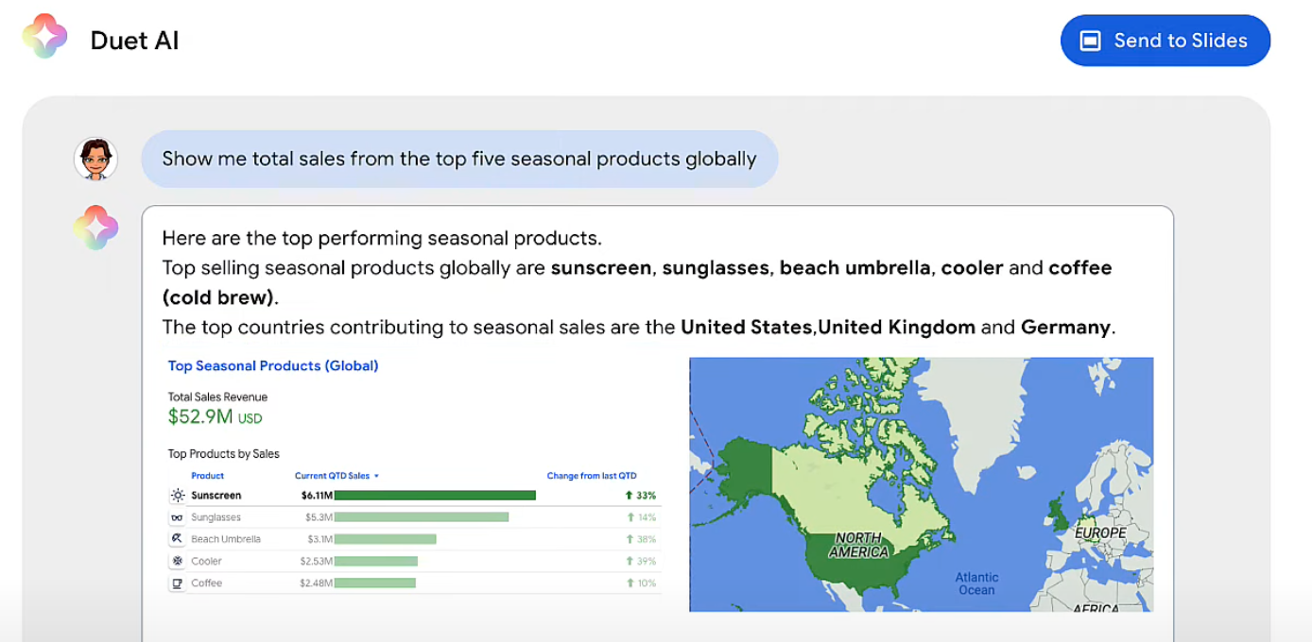
Dancing a duet
Announcement
A few short months after introducing Google Duet AI, an always-on collaborator integrated across Google Cloud services, the company announced the general availability of Duet AI within Google Cloud Workspaces. The vendor also announced a definitive release plan and several new capabilities for Duet AI within Google Cloud itself, expanding the scope of this AI augmented copilot for developers, systems operators, data professionals, and even cybersecurity practitioners.
Duet AI for data exploration
Assessment
Much more than a mere GenAI collaborator, Duet AI for Google Cloud will be tightly interwoven within several tools like Google Cloud console, Cloud Workstations, and Cloud Shell Editor. For software developers, this means they’ll be able to gain assistance with difficult tasks like code refactoring without having to switch context. This ability to generate code in context is key as it allows the collaborator to generate code that’s specific to the project at hand, drawing from the language, libraries, data models, etc. that are in use at that time in that workspace.
Notes: Using Duet AI to generate visualizations with natural language in Google Looker
Source: Google

Slide 9
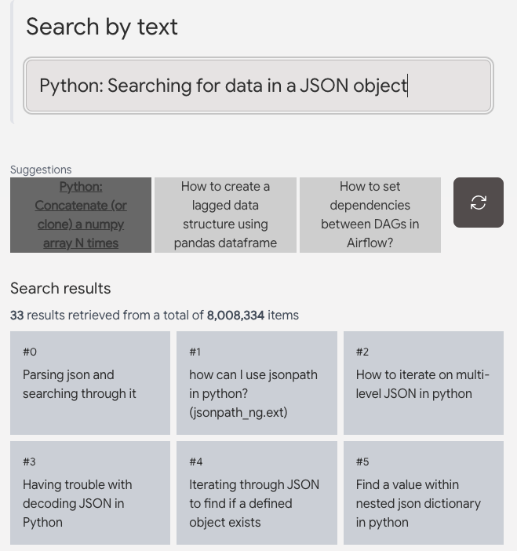
Embeddings afoot
Google Vertex AI Embeddings API + Matching Engine demo
Announcement
Following what is now a well-worn path, Google announced several points of support for vector stores/databases within Google Cloud. The company announced, for example, a new feature of AlloyDB called AlloyDB AI, which features pgvector-compatible vector search that’s purported to be up to 10 times faster than regular vector-enabled PostgreSQL.
Assessment
Certainly, every vendor with a database by now has announced or will soon announce vector store capabilities, particularly in support of retrieval augmented generation (RAG) use cases. Google is no different, announcing several vector store options at the show. AlloyDB AI is important because it seeks to unite vectors, models, and data, all within one familiar database.
Related, Google announced a migration tool built specifically to bring Oracle MySQL users over to AlloyDB. Given Oracle’s recent work to blend analytics and operational data with Oracle MySQL HeatWave, there’s a battle brewing here between the two vendors.
Notes: Google demo of semantic search on 8 million Stack Overflow questions, returning relevant results in milliseconds.
Source: Google

Slide 10
Fresh from the garden
Announcement
Google announced several new additions to Vertex AI Model Garden, adding Meta’s popular Llama 2 and very recently released Code Llama. The company also added support for Technology Innovation Institute’s Falcon LLM. And the company pre-announced support for Anthropic’s Claude 2.
Assessment
Like its main competitors (AWS, Microsoft, IBM, and Salesforce), the addition of native support for not just first party (e.g., Google PaLM 2), but also for open source and third party models like Llama 2 and Falcon will serve as literal jet fuel for the company’s AI development platform, Vertex AI. As early adopters have already discovered, implementing GenAI solutions is an engineering problem that often involves highly iterative and deeply comparative looks at the way different models behave opposite one another with different prompt engineering and fine-tuning methodologies.
Google’s first-party foundation models
PaLM for Text
PaLM for Chat
Imagen for text-to-image
Codey for code completion
Chirp for speech-to-text

Slide 11
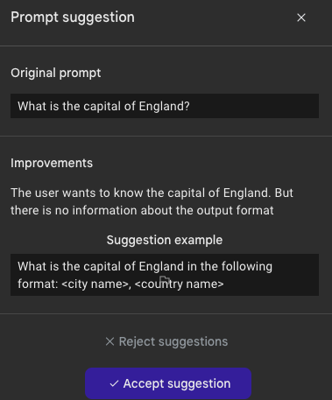
Solid foundations
Announcement
During the show, Google announced updates to its core LLM, Google PaLM 2, adding releasing support for 38 languages and extending the model’s context window to a whopping 32,000-tokens, which will enable the model to ingest much larger documents and software. The company also announced several updates to its code generation model, Codey, as well as its image generation model, Imagen.
Assessment
It’s important to note that Google is not sitting on its DeepMind technical laurels in plying its first-party, flagship GenAI models. Beyond expanding the basics for PaLM 2 (e.g., context window expansion), the vendor announced that it’s HIPAA-compliant Med-PaLM 2 model will be available in preview. And it introduced what appears to be one of the first instances of digital watermarking to Imagen. Powered by Google DeepMind’s SynthID technology, Imagen can now provide companies with assurance that AI-generated artwork is authentic and free of potential copyright concerns.
Prompt engineering augmented support
Notes: Automated prompt engineering suggestion in Google MakerSuite.
Source: Google

Slide 12

Notebooks get real
Announcement
Google announced Google Colab Enterprise, a new offering based on its well-regarded but prosumer-oriented data science notebook experience, Google Colab. Available in preview today with general availability planned for later in September, this new version of Colab will integrate with Vertex AI and other Google Cloud services.
Assessment
A move that has been coming for some time, the introduction of Colab Enterprise comes as no surprise. However, it is tremendously important to the vendor, as Colab can now serve as a direct, consistent path between enterprise students/enthusiasts and enterprise practitioners.
This is also a big deal because it enables Google to directly integrate Colab within its numerous AI, data, and analytics solutions. Already, for example, the company announced that BigQuery Studio would work directly with Colab Enterprise, extending enterprise security and compliance support to Colab notebooks.
Duet AI within Google Colab
Notes: Here, the user need only type “import p” to initiate a Duet AI completion recommendation.
Source: Google

Slide 13

Big data and big models
Announcement
Beyond introducing AlloyDB AI, Google made several database-related announcements, bringing Duet AI directly into Google Cloud Spanner (AlloyDB and Cloud SQL will follow shortly). The vendor also added new opportunities for customers to meld transactional and analytical data via Cloud Spanner Data Boost, which lets users analyze Cloud Spanner data in BigQuery and other tools without impacting performance.
Assessment
The importance of fielding GenAI augmentative capabilities within and across Google’s wide portfolio of data and analytics tools cannot be overstated. Omdia foresees a rapid shift toward GenAI-assisted code generation, product navigation, and management tasks. With Duet AI in Cloud Spanner, for example, data professionals can generate code to structure, modify, or query data in a purely declarative manner, using only natural language.
It’s also interesting to see Google put Duet AI to use well beyond basic augmentation to also encapsulate automation. The company, for instance, is putting Duet AI to work in automating complex tasks like migrating Oracle customers to Google Cloud PostgreSQL (now in GA) and eventually AlloyDB.
Source: Google Duet AI

Slide 14
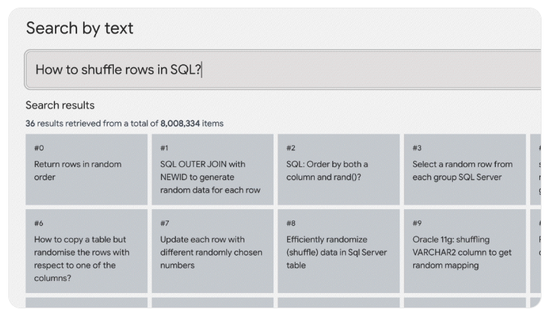
LLMOps in overdrive
Announcement
Lastly, Google announced a wide array of innovations, all taking aim at operationalizing LLMs (referred to as LLMOps). For example, the company introduced Automatic Side by Side and Automatic Metrics features within Vertex AI, which lets practitioners test and compare several LLMs against a ground truth reference dataset. Google also updated Vertex AI Feature Store, building it directly into BigQuery.
Assessment
It is important to note that these together with Google’s early noted announcements surrounding vector embeddings and API-level grounding for PaLM (in private preview) will work across all models within the company’s Model Garden through Google Vertex AI. This includes both text and image embeddings. Going further, when these embeddings are coupled with Google’s Matching Engine (Google’s vector search service), customers can ground their model output against business data in tabular format. This is crucial for Google because it opens up the ability for customers to work synchronously between 3rd party, open source, and first party models, all using the same responsible AI tooling.
Semantic search for grounding LLMs
Notes: A demonstration showing search results across 8 million Stack Overflow questions
Source: Google

Slide 15
Key takeaway

Slide 16

Key takeaway from Google Cloud Next 2023
Google is currently operating in “startup” mode, accelerating time to market for key GenAI capabilities like Duet AI in Google Cloud, AlloyDB AI, Grounding in Vertex AI, PaLM 2 enhancements, et al.
At a high level, this will help the vendor overcome market perception that it been too conservative relative to rivals Microsoft and OpenAI.
In looking at the announcement in detail, however, Google is not trying to recapture market momentum.
Rather, the vendor is assembling the infrastructure necessary to operationalize GenAI solutions in the enterprise at scale with full control over Responsible AI H3 concerns (model helpfulness, harmlessness, and honesty).
Taking this a step further, Google intends to help customers do so no matter which models they select, be those first-party, third-party, or open source models. With more than 100 models available in Vertex AI Model Garden, the company is well on its way in this regard.
Bradley Shimmin
Chief Analyst, AI Platforms, analytics and data management

Slide 18
Appendix
Further reading
AWS extends generative AI platform capabilities with autonomous agents, (August 2023)
Technology Analysis: Responsible LLM Tools and Practices, (August 2023)
Google Cloud Next 2023 Keynote
Google Cloud Next 2023 Keynote on Duet AI in GCP analytics tools
Google Vertex AI Model Garden
Author
Bradley Shimmin, Chief Analyst, AI platforms, analytics and data management
  askananalyst@omdia.com
  Omdia Consulting
  We hope that this analysis will help you make informed and imaginative business decisions. If you have further requirements, Omdia’s consulting team may be able to help you. For more information about Omdia’s consulting capabilities, please contact us directly at consulting@omdia.com.
  Citation Policy
  Request external citation and usage of Omdia research and data via citations@omdia.com.

