Slide 1
Smartphone Need-To-Know – November 2023
  Jusy Hong, Senior Research Manager, Components & Devices – Mobile Handsets
  Zaker Li, Principal Analyst, Components & Devices – Mobile Handsets
  Aaron West, Senior Analyst, Components & Devices – Mobile Handsets
  askananalyst@omdia.com

Slide 2
Contents
Global smartphone shipment decline slows as many manufacturers see a return to growth 3
Snapdragon unveils 8 Gen 3 chip at its annual summit 5
As new threats loom over iPhones’ iMessage exclusivity, Apple announces RCS support 7
The vivo X100 series is the first with MediaTek Dimensity 9300 SoC 9
Appendix 11

Slide 3
Global smartphone shipment decline slows as many manufacturers see a return to growth
Global smartphone shipments totaled 301.6 million units in 3Q23, a 0.7% decrease compared to 3Q22. However, it is a 13.4% increase compared to the previous quarter. For the first time this year, half of the top ten major smartphone set OEMs, including Apple, Xiaomi, Transsion Holdings Group, Honor, and Huawei, saw growth. The other half includes Samsung, vivo, and Realme, which all saw large declines.
This marks the ninth consecutive quarter of year-on-year (YoY) declines in overall smartphone shipments, coming after the period of strong smartphone demand seen over the COVID-19 pandemic between 4Q20 and 3Q21. The market has not been able to keep pace with that expansion as a range of challenges have rocked the industry and global economy, from production problems in China to high inflation and shrinking consumer confidence and demand.
Huawei has seen a boost in its smartphone shipments. In 3Q23, it recorded 10.7 million shipments, a 24.4% increase YoY. This edges it slightly ahead of Realme this quarter, making Huawei the ninth-largest smartphone OEM this quarter, following a long stint in the 10th position. Overall, Huawei has performed well against very tough market conditions to claw back market share from its domestic competitors. It is in a strong place to end the year on a high note, following the successful launch of its new phones.
Quarterly results, 3Q23 (millions of units)
Rank | OEM | 3Q23 |  | 2Q23 |  | 3Q22 |  | QoQ | YoY
 |  | Shipment | M/S | Shipment | M/S | Shipment | M/S
1 | Samsung | 58.8 | 19% | 53.3 | 20% | 64.1 | 21% | 10.3% | -8.2%
2 | Apple | 53.4 | 18% | 43.2 | 16% | 52.2 | 17% | 23.6% | 2.3%
3 | Xiaomi | 41.5 | 14% | 33.2 | 12% | 40.5 | 13% | 25.0% | 2.5%
4 | OPPO Group | 26.6 | 9% | 25.0 | 9% | 29.1 | 10% | 6.6% | -8.6%
5 | Transsion | 26.3 | 9% | 24.5 | 9% | 17.7 | 6% | 7.3% | 48.6%
6 | vivo | 22.6 | 7% | 22.3 | 8% | 25.3 | 8% | 1.3% | -10.7%
7 | Honor | 15.8 | 5% | 14.1 | 5% | 14.2 | 5% | 12.1% | 11.3%
8 | Motorola | 11.2 | 4% | 10.4 | 4% | 11.4 | 4% | 7.7% | -1.8%
9 | Huawei | 10.7 | 4% | 7.4 | 3% | 8.6 | 3% | 44.6% | 24.4%
10 | Realme | 10.6 | 4% | 10.1 | 4% | 13.6 | 4% | 5.0% | -22.1%
 | Others | 24.1 | 8% | 22.5 | 8% | 26.9 | 9% | 7.2% | -10.5%
 | Total | 301.6 | 100% | 265.9 | 100% | 303.6 | 100% | 13.4% | -0.7%
Notes: M/S stands for market share. OPPO Group includes OPPO and OnePlus. Transsion includes Tecno, itel, and Infinix. Source: Omdia, Global Smartphone Shipment Preliminary Result – 3Q23 |  |  |  |  |  |  |  | © 2023 Omdia

Slide 4
“Half of all major brands saw increased shipments compared to the past year, with Transsion, Honor, and Huawei particularly exceeding. Therefore, it is clear that the problems that faced the smartphone industry in 2023 are coming to an end. Inflation is slowing globally—with which consumers’ confidence is also growing. The whole market is down 7.5% so far in 2023 compared to the first three quarters of 2022, meaning the final 2023 total is likely to be below that of 2022. However, there are signals that a slow recovery is already underway.”
Jusy Hong
Senior Research Manager,
Consumer Devices

Slide 5
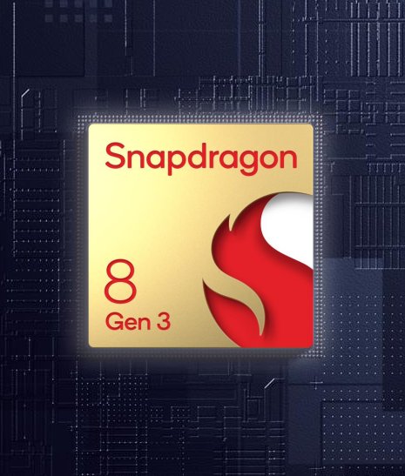
Snapdragon unveils 8 Gen 3 chip at its annual summit
The annual Snapdragon Summit in Huawei included a number of big announcements from the premium phone chipset maker.
A heavy focus was on generative artificial intelligence (GenAI), which would be on-device, pervasive, and always-on to understand user habits and needs.
Key new chip announcements include the following:
  Qualcomm Oryon CPU
  Snapdragon X Elite, the new most advanced platform for notebook PCs
  Snapdragon 8 Gen 3, the new most premium smartphone platform
The 8 Gen 3 will take over from the 8 Gen 2 as the premium chipset favored by many Android brands and will likely be seen on upcoming flagship phones, such as the Samsung Galaxy S24 range set to release in January. Xiaomi was at the event to debut its flagship Xiaomi 14 series, which will be the first to have the 8 Gen 3 chip.
The 8 Gen 3 is reported to have the most advanced GenAI capabilities ever seen on a phone, all of which would be private and secure as it is processed on-device. Possible new features proposed include a zoom-out feature, which would allow you to use GenAI to create new imagery around a photo, giving the effect of zooming out.
Source: Snapdragon

Slide 6
“Hot on the tail of Google’s announcement of its Tensor G3 chip’s GenAI powers, Snapdragon has shown that AI is here to stay. The new 8 Gen 3 chip will power the most advanced Android smartphones, enabling image creation and manipulation and supporting more conversational personal assistants. It is becoming increasingly clear that the true obstacle for embedding AI into the next-gen smartphone experience is no longer the limits of hardware but the OS and app developers’ ability to create seamless use cases for consumers.”
Aaron West
Senior Smartphone Analyst, Consumer Devices

Slide 7

As new threats loom over iMessage exclusivity, Apple announces RCS support
The “green bubble” vs. “blue bubble” debate has been going on for over 10 years now as Apple’s lack of Google’s rich communication services (RCS) support has limited features between Android and iOS users. This is particularly an issue in the US market, where third-party messaging apps such as WhatsApp or Telegram are not popular.
Nothing Phone 2 is getting a new messaging app called Nothing Chats (seen right), which offers “blue” iMessage compatibility, including full group chat, live typing indicators, and full-resolution media sharing.
  This works through a patented process by Sunbird, which creates and validates an Apple ID on an Apple device to convey messages to the Nothing Phone 2 without storing them on the Sunbird servers. Sunbird has an undisclosed number of Mac computers in Europe and North America for this.
Source: Nothing
Google also recently drew support from major European mobile carriers to ask the European Commission to designate Apple’s iMessage as a “core platform service.” If successful, this would have forced Apple to make iMessage compatible with RCS.
  Previously, the EU tried to regulate large platforms in the digital market with over 45 million active users in the EU and generate €7.5bn in annual revenue, aiming to increase competition. Apple argued that it does not have 45 million users in the EU and, therefore, does not have to comply. This is currently being investigated by the EU’s regulatory authority, with a decision expected in February 2024.
It appears sustained pressure from Google (for years), possible upcoming EU regulation, and the announcement from Nothing just days ago have pushed Apple to announce plans to adopt RCS next year. This would allow group chats, read receipts, large media sharing, message reactions, and more between iPhones and Android phones, natively through iMessage and their respective texting apps. One key thing has not yet been confirmed, though: Apple could decide to still color messages from Android phones as green, simply to continue the iPhone-to-iPhone privilege of having blue bubbles.

Slide 8
“Fear of the ‘green bubble’ stigma has long-effected Android users. Wanting to feel included, many have adopted iPhones simply for blue bubbles. However, that could soon be coming to an end as other developers find loopholes and even exercise regulation as a weapon against Apple. From USB-C to security update transparency, it is clear that regulation is the only way to control and steer the juggernaut that is Apple. Does its adoption of RCS truly mean an end to the green bubble debate? We do not yet know—so we can all look forward to more debate on green and blue bubbles for years to come.”
Aaron West
Senior Smartphone Analyst, Consumer Devices

Slide 9
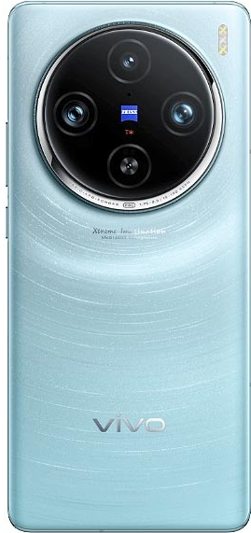
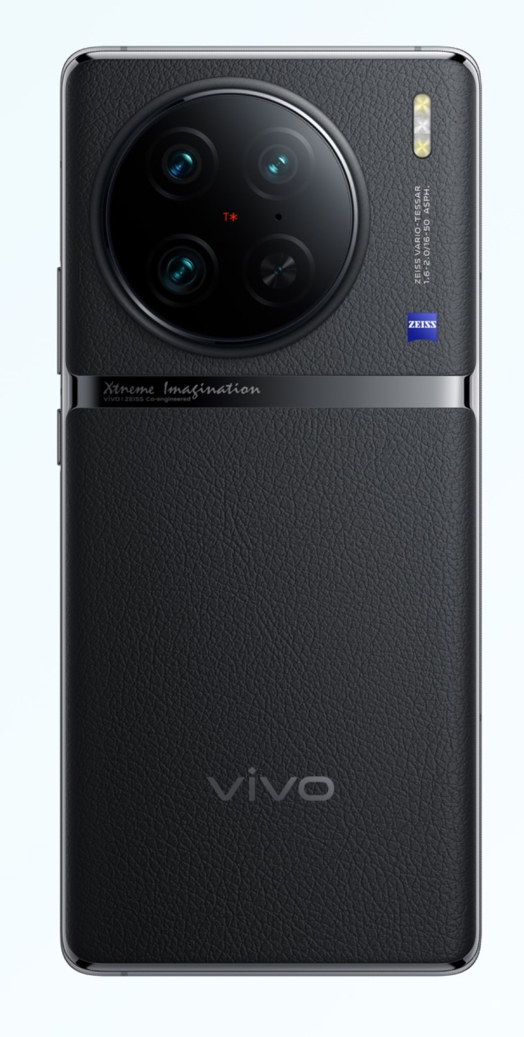
The vivo X100 series is the first with MediaTek Dimensity 9300 SoC
The latest flagship phones from Chinese brand vivo feature the newest flagship chipset from MediaTek, its rival to the Snapdragon 8 Gen 3, the Dimensity 9300.
  MediaTek claims the new Dimensity 9300 gives a 40% improvement in peak performance compared its predecessor, last year’s Dimensity 9200, while using 33% less power.
The X100 Pro also gets a ZEISS co-engineered APO 100m-equivalent periscope camera with a ZEISS lens capable of 4.3x optical zoom.
  The main 50MP camera also has a 1-inch type Sony IMX989 sensor.
  All three cameras have a T* coating, which vivo claims reduces reflectivity by 50% compared to the vivo X90 predecessors.
Both have new LTPO (low-temperature polycrystalline silicon) AMOLED displays capable of variable 1–120Hz refresh rate.
Both will also feature the latest OriginOS 4 skin on Android 14.
Both were released in China on November 21, starting at the same price as their predecessors—CNY 3,999 ($548) for the X100 and from CNY 4,999 ($685) for the X100 Pro.
Source: vivo
Feature | Aspect | vivo X100 Pro | vivo X90 Pro
Display | Screen size and type | 6.78-inch LTPO AMOLED | 6.78-inch LTPO AMOLED
 | Resolution and refresh rate | 1260x2800 120Hz 3000 nits peak brightness | 1260x2800 120Hz 1300 nits peak brightness
Chipset |  | MediaTek Dimensity 9300 | MediaTek Dimensity 9200
Memory |  | 12GB – 16GB RAM 256GB – 1TB storage | 8GB – 12GB RAM 256GB – 512GB storage
Camera |  | 50MP wide OIS, 50MP telephoto, OIS, 4.3x zoom, 50MP ultrawide | 50.3MP wide OIS, 50MP telephoto, OIS, 2x zoom, 12MP ultrawide
Battery | Capacity | 5,260 or 5,400 mAh | 4,870 mAh
 | Charging speed | 100W wired, 50W wireless | 120W wired, 50W wireless
Price at launch |  | From CNY 4,999 ($685) | From CNY 4,999 ($685)
Source: vivo and Omdia
© 2023 Omdia

Slide 10
“The vivo X100s launched at the same starting price as the Xiaomi Mi 14 but with a bigger RAM. They are also the first smartphones to use the new MediaTek 9300 series, which was jointly developed by vivo and MediaTek. New ISP chipsets on the X100s and continuously deepening its cooperation with Zeiss have also improved image capture and processing. The vivo X100 Pro features an impressive 1-inch Sony IMX989 sensor, newly upgraded Zeiss T * lens coating, and an exclusive self-developed new anti-shake system.”
Zaker Li
Principle Smartphone Analyst,
Consumer Devices

Slide 11
Appendix

Slide 12
Appendix
Further reading
“Omdia: Global smartphone shipment decline slows as many manufacturers see a return to growth” (November 2023)
Global Smartphone Shipment Preliminary Result – 3Q23 (November 2023)
Authors
  Jusy Hong, Senior Research Manager, Components & Devices – Wireless Devices
  Zaker Li, Principal Analyst, Components & Devices – Mobile Handsets
  Aaron West, Senior Analyst, Components & Devices – Mobile Handsets
  askananalyst@omdia.com
  Omdia Consulting
  We hope that this analysis will help you make informed and imaginative business decisions. If you have further requirements, Omdia's consulting team may be able to help you. For more information about Omdia's consulting capabilities, please contact us directly at consulting@omdia.com.
  Citation Policy
  Request external citation and usage of Omdia research and data via citations@omdia.com.

