Slide 1
Event Recap: Channel Futures Leadership Summit (CFLS) – 2023
Event Date: October 30–November 2, 2023
Devan Adams
Principal Analyst, Channel Research & Consulting
askananalyst@omdia.com

Slide 2


Channel Futures Leadership Summit – 2023: Omdia team at the event
Omdia’s Channel Research and Consulting Practice team
Debbie Kane
Principal Consultant​
Omdia Channel Research ​
& Consulting Practice
Devan Adams
Principal Analyst
Omdia Channel Research ​
& Consulting Practice

Slide 3
Contents
Show overview 05
Top stories 08
Key takeaways 10
  Inspirational leadership 11
  IT industry outlook 12
  State of the technology agent/advisor (TA) market 13
  Market development funds (MDFs)/co-op funds 14
  Marketplaces 15
  Next-gen talent 16
  Mergers & acquisitions (M&A) 17
  Artificial intelligence 18
  Cybersecurity 19
Final recommendations 20
Appendix 23

Slide 4
Key topics and channel trends
01
Inspirational leadership True leadership is defined by influence, not titles
02
IT industry outlook Channel is at the center of every IT market
03
State of the technology agent/ advisor (TA) market Opportunities and challenges are plentiful
04
Market development funds (MDFs)/co-op funds Don’t be afraid to ask
05
Marketplaces $300bn untapped
06
Next-gen talent Generative AI won’t replace current employees; new employees who are good at it will
07
Mergers & acquisitions (M&A) If you fail to plan (for M&A), then plan to fail
08
Artificial intelligence AI is not a product, it’s a feature
09
Cybersecurity Use good AI for cybersecurity to fight bad AI threat actors

Slide 5
Show overview

Slide 6

Show overview: The new style of leadership – theme
Background: The Channel Partners Conference & Expo/MSP Summit (Leadership Summit) is the number one leadership event for the entire channel ecosystem, bringing together a wide range of partners.
Theme: This year’s theme was The New Style of Leadership.
Attendees and exhibitors: Organizations from both sides of the aisle attended the event.
  Channel partners: agents, value-added resellers (VARs), managed service providers (MSPs)/managed security service providers (MSSPs), systems integrators, technology services distributors, consultants, and other partners that sell/work directly with end-user customers.
  Suppliers: cloud/hosting providers, hardware vendors, software vendors, telecom carriers, and service providers (such as ISPS, conferencing, etc.)
  There were 100+ sponsors and exhibitors, 50+ speakers, and nearly 2,000 attendees. (For more details, see the infographic on next slide.

Slide 7
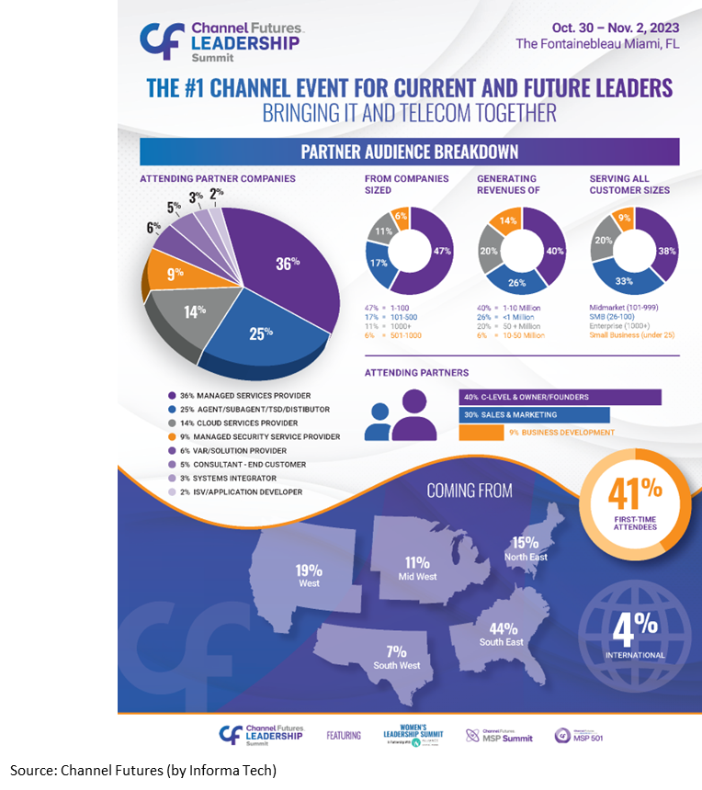
Show overview: Audience breakdown
Partner audience (pre-show infographic)
Partner audience
  The Channel Futures Leadership Summit is a vendor-neutral event that offers networking, insights, and education opportunities for all attendees.
  The event caters to the whole channel by offering content and activities for channel partners and vendors of all sizes from various geographic locations, which serve all customer bases.
  The content at the event is pertinent to employees from the C-level to sales and marketing to individual contributors.

Slide 8
Top stories

Slide 9

Top stories
IT industry outlook
Artificial intelligence (AI)
Cybersecurity
IT industry businesses, especially channel partners, achieved great results in 2023, according to data shared by Canalys, despite macro-economic headwinds like inflation and high interest rates, and the momentum is expected to continue.
The growth and success of the channel bodes well for vendors looking to expand their channel partnership to sell into new industries, access new customer bases, leverage industry specialists, reduce operating expenses, etc.
There are vast opportunities in the channel for vendors to capitalize and those that do will be set up for success in 2024 and beyond.
Every person in a developed country will interact with AI daily by 2030, according to comments from AWS.
This is massive for partners and vendors; yet many are in different AI adoption phases:
  Late adopters are still testing the waters and only experimenting with AI in limited use cases
  Majorities have some AI investments and are using it internally and deploying it for clients
  Early-adopters have made AI a core part of their offering and are seeing noticeable returns.
It will be important for vendors seeking AI partnerships to thoroughly assess partners’ AI readiness during their evaluation.
Cybersecurity remains top of mind and that trend is expected to continue in 2024 and going forward.
Cybersecurity is no longer an option, it has become table stakes for every channel partner, from MSPs, to resellers, and technology agents.
Vendors must continue working with their partners to deliver best-in-class cybersecurity solutions, as threats from bad actors using AI and other advanced tactics to steal company’s data or create ransomware will only increase going forward.

Slide 10
Key takeaways

Slide 11

Inspirational leadership: True leadership is defined by influence, not titles
Key takeaways
Keynote: Eric Boles​ is president and founder of The Game Changers Inc, a leadership development firm. He is also a motivational speaker, leadership coach,​ consultant, and former National Football League (NFL) player.
Eric gave a very powerful speech titled “Moving to Great,” which discussed what it means to be true leader, not just by title alone.
    How does someone know if they are a true leader – by asking themselves: “if your title were removed, how many would still listen to you?”
He highlighted some key attributes of true leadership in work and in life:
  Ability to inspire others to do work by aligning it with a goal/ purpose, not because it is an assigned task
  Effectively use what they have, not focusing on what they’re missing, and optimizing the results; i.e., “game changers can properly repurpose current resources and maximize them to meet the goal”
  Understand that real growth starts beneath the surface, not externally, and only true leaders can envision this growth potential before it fully develops
  Realize the essentiality of clarity in communications: “confusion diminishes effectiveness, but clarity strengthens it.”
Source: Channel Futures Leadership Summit presentation by Eric Boles

Slide 12
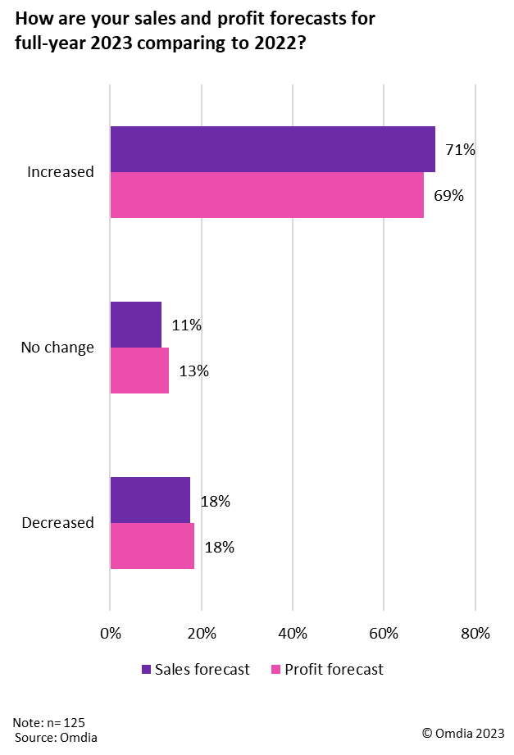
IT industry outlook: Channel is at the center of every IT market
Key takeaways
Keynote: The IT channel is an evolving industry constantly impacted by activities like M&As, macro-economic conditions (inflation and unemployment), and technology trends (cybersecurity, AI, cloud, etc.). Yet, it is also resilient and IT services remains one of the fastest growing sections of the IT industry.
According to research from Canalys (an Informa Tech company) chief analyst, Jay McBain:
    The total addressable IT market in 2023 is estimated as $4.7tn, with 73% of IT services expected to be delivered via channel partners.
  Managed services will represent around $488m (or 1/10,000 of total IT dollars spent). And there are around 335,000 managed service partners globally: 43,000 pureplay (>50% of revenue from managed services) and over 292,000 that include systems integrators, resellers, service providers, telcos, and consultants
  A typical IT customer journey involves six stages of service interactions: advise, design, procure, build, adopt, and manage (based on the Canalys Partner Ecosystem Multiplier – PEM – Flywheel). This provides a great deal of opportunity for channel partners to engage with customers at each stage.
  82% of tech buyers will outsource some or all of IT, which will fuel future growth. Correspondingly, Omdia’s Quarterly Market Outlook Survey Insights – 2Q23 shows that 71% of MSPs are projecting an increase in full-year sales and 69% expect to increase full-year profits in 2023 versus 2022 (see opposite).

Slide 13



State of the technology agent/advisor (TA) market: Opportunities and challenges are plentiful
Key takeaways
Keynote: James Anderson​, Senior News Editor​ at Channel Futures, led the “State of the Agent Market”​ presentation, where he shared information and his insights on the activities most significantly impacting the TA market, which is a very unique segment.
Despite the commoditization challenges the telco channel is facing, plenty of opportunities exist for carriers and partners alike. To capitalize on these opportunities, many telcos are reducing their direct salesforces and increasing channel sales through technology distributors and TAs to save time and money.
  The key activities affecting TAs in the channel today are as follows:
      Vendor resource reallocation is creating opportunities and challenges
      Consolidation is reshaping distribution models
      Partner hiring is changing the overall market landscape
      Cross-selling opportunities and complexities are constantly arising.
Anderson also shared insights from Omdia’s Quarterly Market Outlook Survey Insights – 2Q23 regarding the top challenges, threats, and resources required by TAs (see below).
Top challenges
Top threats
Top resource needs
Recruiting and retaining talent (44%)
Managing vendor relationships (34%)
Customer retention (28%)
Pace of tech advancement (28%)
Vendors’ salesforces (48%)
Other tech advisors (27%)
Tech resellers (21%)
Value-added resellers (18%)
Marketplaces (18%)
Lead generation (44%)
Marketing development funds (14%)
Enhanced training in marketing and sales (11%)
Business development funds (6%)

Slide 14
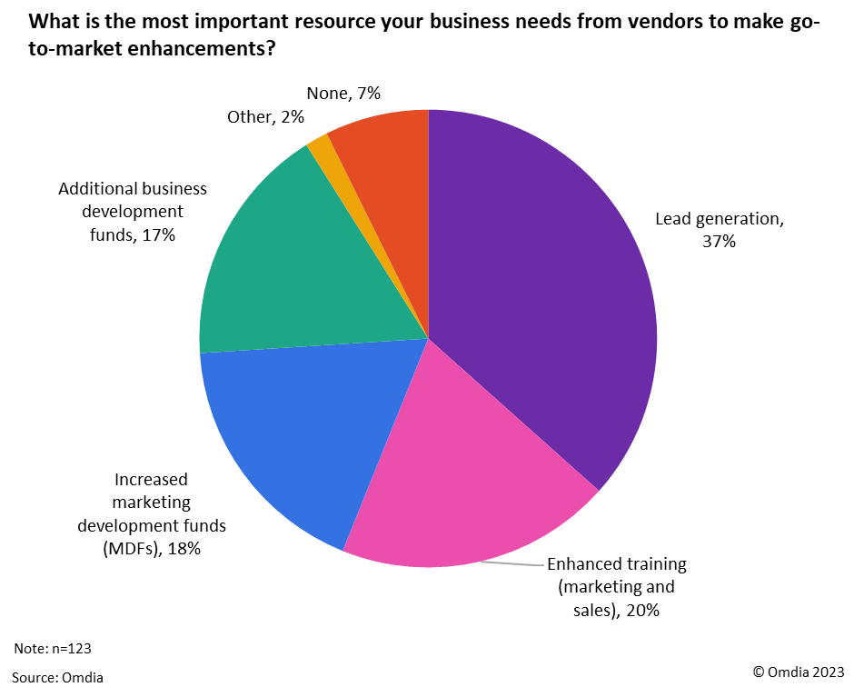
MDFs/co-op funds: Don’t be afraid to ask
Key takeaways
Session: “Get the Most Out of MDF/Co-op Funds to Advance Your Business,” moderated by Debbie Kane, Principal Consultant​ for Omdia Channel, included a panel of prominent channel players​ from SonicWall​, Marketopia, Techmedics​, and Stronghold Data​.
The panel recommended ways for vendors and partners to optimize funding* dollars:
  Vendors: Perform an assessment of partners to understand the resources they need (i.e., marketing, lead gen, events, etc.) to effectively sell their products, especially given that many partners are primarily referral based.
  Partners: Plan in advance, at least one year, to identify how much funding is needed and how they will be used, then present the plan to vendors. Afterwards, document all actions taken where funds were used.
  Both: Make creating a partnership the main goal for giving and receiving MDF/co-op funds; don’t focus solely on the results of activities (lead-gen, sales, and marketing).
  In Omdia’s Quarterly Market Outlook Survey Insights – 2Q23, lead generation (37%) was the top resource MSPs need from vendors to make go-to-market enhancements (see opposite), while increased funding from market development funds (MDFs) and business development funds (combined 35%) were also notable resource needs.
*Note: See Appendix for formal definitions of MDFs and co-op funds.

Slide 15
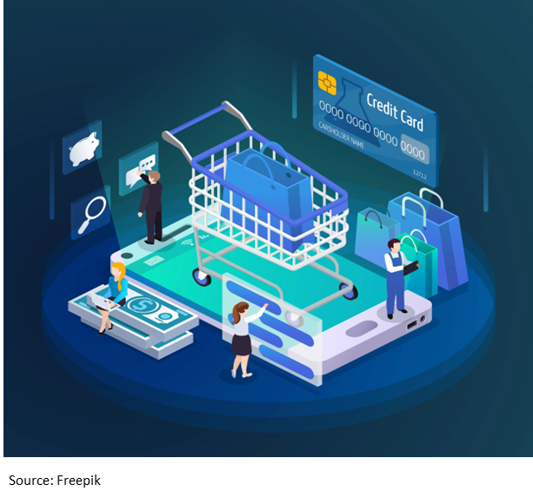
Marketplaces – $300bn untapped
Key takeaways
Keynote: “Market Makers: Tap into the Massive Channel Opportunity with Marketplaces​​” was presented by Vince Menzione​, CEO​ of Ultimate Partner.
During his presentation, Menzione provided details regarding the marketplaces phenomenon, including what’s fueling its fast adoption.
  Vendors focused on “doing more with less” and optimizing their resources through partnership tiering, status, and support.
  $300bn cloud budgets available for partners to leverage as an incentive for them to build on their marketplace platform.
      The enormous amount of unused money signals that clients are facing challenges with their planned cloud deployments. This is a great opportunity for channel partners to help clients with their deployments, and because cloud providers are depending on clients to ultimately spend the unused money, they are incentivizing channel partners that can provide clients with the support they need to do so.
  An expected $45bn (84% five-year CAGR by the end of 2025) of third-party vendor software and services sales will happen through the cloud marketplace.*
      Of that $45bn, roughly 80% is expected to go through the marketplaces of the big three hyperscalers: AWS, Microsoft Azure, and Google Cloud.*
*Data source: Canalys (an Informa Tech company)

Slide 16

Next-gen talent: Generative AI won’t replace current employees; new employees who are good at it will
Key takeaways
Keynote: “Unlocking the Secrets of the Next Generation of Talent in the Channel​” was presented by JSG. It provided ideas for businesses to recruit and retain the next generation of talent in the channel.
  75% of Gen Z and millennials are in the workforce and they are usually more risk-taking and adventurous.
  Most next-gen talent values appreciation and mentorship more than money.
  Lack of advanced technology or tools can deter the next generation from accepting offers or make them resign.
  The next generation prefers to work with leaders that think outside the box and use different techniques.
Session: “Creating Belonging for your Multigenerational Workforce”​ included a panel from Zoom, Fusion Connect, Keystone Solutions, and Channel Maven, which shared their ideas on fostering an inclusive workforce.
  Employees are invested in the company, so companies must reinvest in their growth and development.
  Find out where top prospects spend their time (i.e., social media) and where they can be solicited with job postings.
  Understand an employee’s reason for accepting a job may be more valuable than their salary request.
  Flexibility (in-office, hybrid, and fully remote) is critical for hiring, especially younger employees.

Slide 17
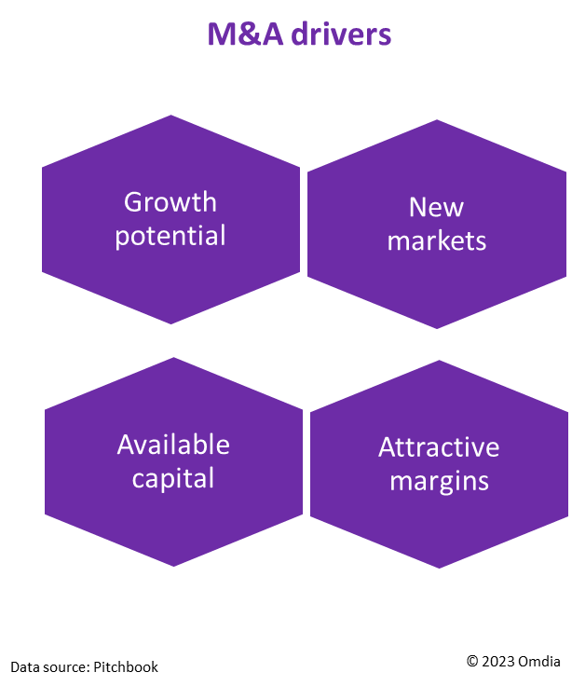
Mergers and acquisitions (M&A): If you fail to plan (for M&A), then plan to fail
Key takeaways
Session: “Preparing for the Sale of your Agent/Tech Advisor Business” was led by Tim Mueller, President of Martinwolf M&A Advisors. He suggested performing a readiness assessment before engaging in M&A (five steps) and provided information on what is affecting M&A activity in the IT industry.
  Identify potential concerns: Financial irregularities, customer inconsistencies, intellectual property issues, or regulatory compliance problems. ​
  Develop realistic valuations based on financial performance, growth potential, market conditions, etc.​
  Prepare for due diligence requests, the M&A process, and risks that could derail a sale. ​
  Address tough questions about the reasons for, and timing of, the sale. ​
  Provide buyer/seller confidence.
  IT industry M&A drivers:
    Strong growth potential, attractive margins, and resilience to economic downturns.​
    Cross-border acquisitions enable access to new markets, technologies, and talent.​
    Large sums of uncommitted capital available to private equity firms for investment.
  IT industry M&A detractors: Ongoing wars (i.e., Ukraine and the Middle East), rising inflation, and supply chain disruptions.

Slide 18
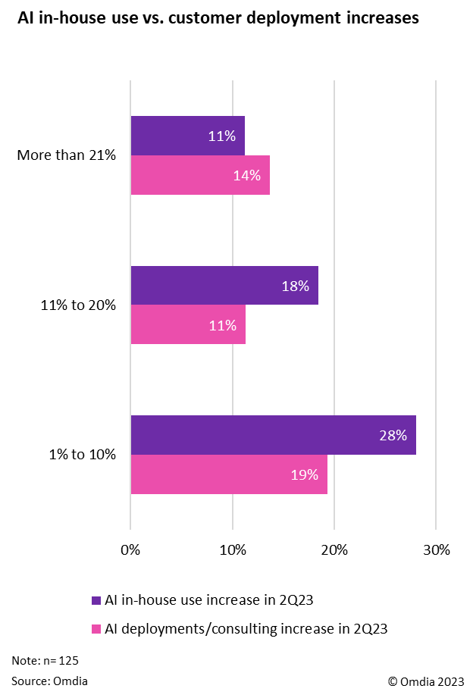
Artificial intelligence (AI): AI is not a product, it’s a feature
Key takeaways
Keynote: “AI Isn't Going to Destroy the World: It's an Opportunity for Every Channel Partner​” included a panel from AWS, Vonage, and Canalys, which shared their ideas on how partners can optimize their AI use.
  Specialize by investing and integrating AI into your primary focus area.
  Understand the various AI models available, then choose the right fit.
  Build internally first to better understand how AI is used and can help external customers.
  Engage early on with customers to realize their specific business use-case needs.
  Target line-of-business managers as the main AI sales decision-makers; 75% of software is sold through them.
Session: “Enhancing Channel Marketing Through AI: Strategy and Benefits​” was led by marketing leaders from Bergamo Marketing Group​ and channelWise, which offered advise on how partners should effectively deploy AI.
  Identify how it can enable data-driven decisions and increase return on investment (ROI).
  Establish AI use policies and data governance guidelines company-wide.
  Start with small and simple implementations before large-scale deployments.
  Create a formal AI strategy that includes defining a goal, outlining expected outcomes, identifying key users, formulating a budget, and defining an execution timeline.
In Omdia’s Quarterly Market Outlook Survey Insights – 2Q23 report, more MSPs (57%) are increasing their AI use in-house, than using AI in consulting/deployments for customers (44%) – see opposite.
© 2023 Omdia

Slide 19

Cybersecurity: Use good AI for cybersecurity to fight bad AI threat actors
Key takeaways
Session: “Gaining an Edge in Cybersecurity with AI: A Channel Partner’s Playbook,” moderated by Sam Ruggeri, VP Business Development &​ Strategic Partnership​ at Lincoln IT​, included a panel of channel players​ from Virtual Armora​, Entara, Akati Sekurity, and Thrive.
The panel highlighted how AI has helped increase productivity, morale, and automation for the cybersecurity segment, and recommended how vendors and partners can use it appropriately and effectively:
  Establishing a formal “use” policy to prevent use of private data in public environments (i.e., ChatGPT) that may expose sensitive data and create security issues
  Labor-intensive and redundant cybersecurity tasks are key targets to automate using AI
  AI is created by humans and is not perfect due to inherited biases; therefore, apply supervised AI techniques for cybersecurity solutions to actively monitor, audit, and improve performance to remove errors and bias
  Avoid lock-in by using multi-vendor platforms to increase layers of cybersecurity and reduce reliance on one vendor
  Stay abreast of the latest government laws and policies regarding AI regulation as they may have a significant impact on the cybersecurity market, especially pertaining to data privacy.

Slide 20
Final recommendations

Slide 21
Final recommendations
MSPs
Vendors/suppliers
Optimize partnerships
Evaluate the features available in each partner program (marketing, training, lead generation, etc.) and use them to grow your business. Be proactive in requesting MDFs/co-op funds and properly plan how they will be used, then document those actions for reimbursement.
Tailor programs to partners’ needs
Understand partners’ capacities and recognize their weaknesses, then equip them with the resources required for them to excel in marketing, selling, and supporting your solutions. Don’t overlook the intangible aspects of channel partnerships by prioritizing the creation of a healthy partner relationship based on reciprocity and win-win situations.
01
01
Adapt to the evolving landscape
Capitalize on key trends like new technologies or marketplaces and devise ways to overcome obstacles. Cybersecurity and AI are two of the fastest growing areas in the MSP market segment. TAs feel most threatened by vendors’ salesforces. M&A activity is occurring at a rapid pace, so prepare for the impact accordingly.
Support partner growth strategies
Understand the market trends like M&A and technologies delivering the most growth for partners. Obtain feedback from partners to identify the biggest opportunities based on end-user surveys, then use the insights for product development decisions; e.g., AI for in-house use and solutions deployed to customers increased for 57% and 44% of MSPs, respectively.
02
02
Invest in talent
Covet true leaders that can optimize the current talent base by helping employees realize, develop, and perform to their potential. Recognize the value of a diverse workforce and the need for highly skilled young talent, then invest in the resources required to recruit and retain them.
Be gap fillers
Offer a dedicated channel support team to assist partners in addressing any gaps they have such as skilled talent. Provide joint-selling opportunities for partners, especially those that have small workforces and lack the in-house skills. TAs noted recruiting and retaining talent as their biggest challenge.
03
03

Slide 22
“True channel leaders are just as invested in the growth and development of their employees as they are in their own.”
Devan Adams
Senior Principal Analyst,
Channel Research and Consulting Practice

Slide 24
Appendix
Key definitions
  Market development funds (MDF): Vendor/supplier-designated funds that require channel partners to meet certain qualifications to receiving funds, primarily designed to be used for marketing.
  Co-op funds (also referred to as rebates or incentives): Commission-earned funds by channel partners for product/service sales reimbursed by vendors.

Slide 25
Appendix
Further reading
Managed Service Provider (MSP) 501 Survey Insights – 2023 (August 2023)
Fastest-Growing Managed Service Providers (MSPs) Survey Insights – 2023 (August 2023)
Quarterly Market Outlook Survey Insights – 2Q23 (September 2023)
“Haven’t Drunk the Cloud Marketplaces Kool-Aid? It’s About Time You Did” (September 2023)
“How a Co-Security Approach Can Improve Vendor-Partner Relationships” (September 2023)
“Gaining an Edge: Using AI to Thwart Cybercriminals with AI-Facilitated Attacks” (October 2023)
“What to Consider If You Want to Grow by Acquisition” (October 2023)
“Partners Must Embrace Cloud Marketplaces for Future Prosperity” (November 2023)
Author
  Devan Adams, Senior Principal Analyst – Informa Tech, Omdia Channel Research and Consulting Practice
  askananalyst@omdia.com
  Omdia Consulting
  We hope that this analysis will help you make informed and imaginative business decisions. If you have further requirements, Omdia’s consulting team may be able to help you. For more information about Omdia’s consulting capabilities, please contact us directly at consulting@omdia.com.
  Citation Policy
  Request external citation and usage of Omdia research and data via citations@omdia.com.

