Slide 1
Smartphone Need-To-Know – January 2024
  Jusy Hong, Senior Research Manager, Components & Devices – Mobile Handsets
  Zaker Li, Principal Analyst, Components & Devices – Mobile Handsets
  Aaron West, Senior Analyst, Components & Devices – Mobile Handsets
  askananalyst@omdia.com

Slide 2
Contents
Samsung announces its latest S24 phones, with a big focus on new AI features as hardware upgrades are limited 3
CES 2024 saw flashy concept phones and new announcements from Realme, ROG and TCL 5
Honor unveil its new MagicOS 8.0 with ‘intent-based’ user interface and platform AI alongside new Magic6 series smartphones 7
OPPO Find X7 Ultra is first flagship phone with dual-periscope cameras 9
Appendix 11

Slide 3
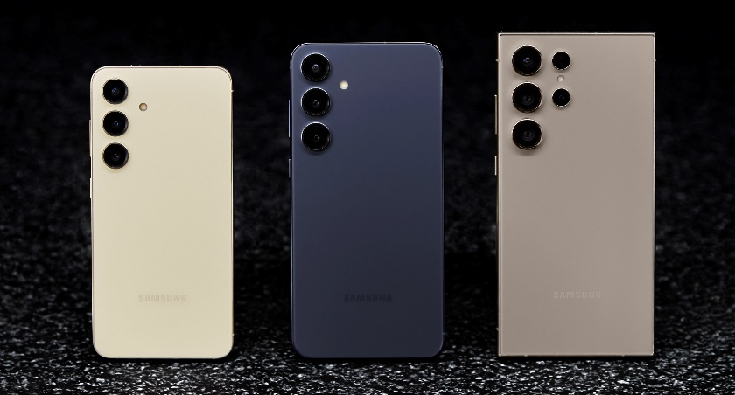
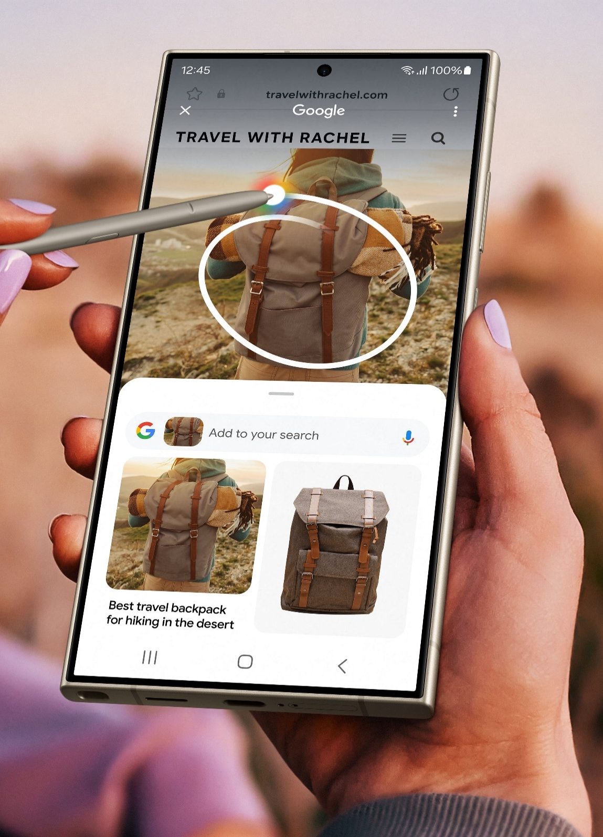
Samsung announces its latest S24 phones, with a big focus on new AI features as hardware upgrades are limited
Samsung announced its new S24 series smartphones on January 17, which will be launched on February 1. The new Galaxy S24, S24+, and S24 Ultra phones are packed with new artificial intelligence (AI) features but are light on physical changes from their predecessors.
New AI features include:
  Photo editing to move objects and remove reflections
  Slowed-down videos not recorded in slow-motion
  Live-translating calls between two languages
  A chat assistant that suggests changes to text
  “Circle to search” image Google searching similar to Google Lens
Hardware changes are limited to a new flat AMOLED display for the Ultra model with a higher peak brightness of 2,600 nits, as well as an upgraded Snapdragon Gen 3 chipset, which reportedly improves ray-tracing performance by 50%, allowing for an improvement in gaming graphics.
The Samsung S24 Ultra will also have a new titanium body, very similar to the iPhone 15 Pro and Pro Max.
Notably, all S24 series phones will get seven generations of OS and security updates, which should be roughly seven years of support. This matches Google’s Pixel 8 support, which was industry-leading.
Samsung Galaxy S24 in amber yellow, S24+ in cobalt violet, S24 Ultra in titanium gray
Source: Samsung
Samsung ‘Circle to Search’ new feature
Source: Samsung
Image source: Samsung
Note: Samsung ‘Circle to Search’ new feature

Slide 4
“It’s becoming increasingly clear that smartphones are as good as they can get; it is a struggle to see differences from their predecessor. Phone makers cannot improve hardware dramatically like they once could—from the display to the camera to the battery—so it is no surprise that they are turning to AI to excite people. It’s still too early to tell if enough will be driven to buy a new phone by this, but I suspect that AI will be the buzzword of the 2020s, and we will be seeing it in almost every new phone announcement for many years to come.”
Aaron West
Senior Smartphone Analyst, Consumer Devices

Slide 5
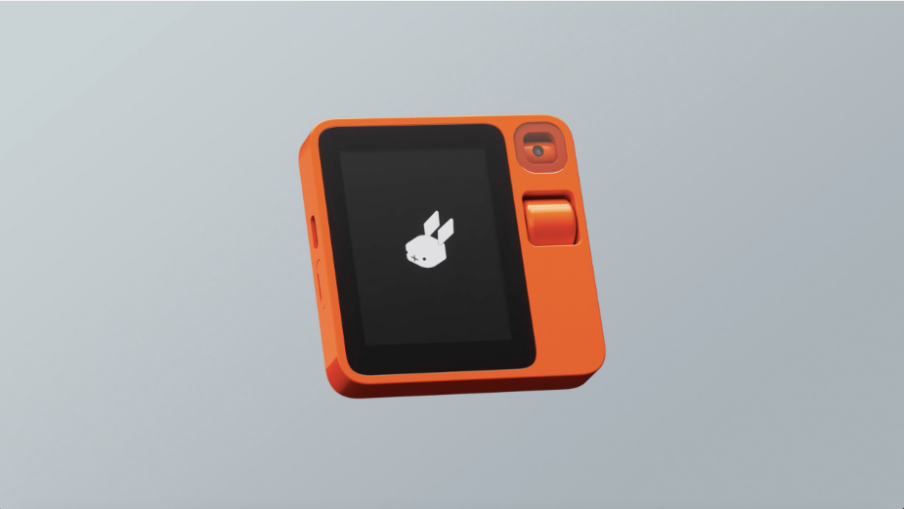
CES 2024 saw flashy concept phones and new announcements from Realme, ROG, and TCL
Samsung displayed a Flex In & Out concept phone, similar to the Z Flip 5, which you can fold in both directions.
The Rabbit R1 takes the trend of AI up a notch, with no actual apps, instead relying on a personal voice assistant to do everything on your behalf—from playing music to booking a taxi. It has just a small 2.88-inch display, a 360°-rotating webcam-like camera, 128GB of storage, and 4GB of RAM, all relying on the MediaTek 2.3GHz Helios P35 processor. It is expected to launch in late March.
Realme was also one of the only Chinese smartphone brands present in Las Vegas (although not at CES), using the event to launch its new 12 Pro+ smartphone. Realme emphasized a focus on younger consumers but did not unveil the price of the new phone.
Asus ROG Phone 8 was displayed with top flagship-level specifications, including a Snapdragon 8 Gen 3 and up to 24GB of RAM and 1TB of storage. It also has an ultrafast, gaming-ready 165Hz refresh rate screen and a 5,500mAh battery. It starts at $1,100 and is expected to be released in 1Q24 in the US.
TCL announced their new 50 series, which included two new NxtPaper display phones—a unique technology which allows the screen to appear paper-like to ease the strain on your eyes.
Rabbit R1’s AI assistant personal device
Source: Rabbit R1

Slide 6
“CES is not normally where you see big smartphone announcements, and 2024 is no different. However, CES is where you see the newest eye-catching, idea-inspiring technology. This year, more foldable smartphones will be introduced to global audiences, especially from Chinese brands. Samsung has been struggling to grow its foldables’ market, which is expected to expand as a result of Chinese brands joining the competition. New foldable display concepts from display manufacturers (such as Samsung’s Flex In & Out) will diversify the market by ‘opening up’ new foldable form factors.”
Jusy Hong
Senior Research Manager,
Consumer Devices

Slide 7
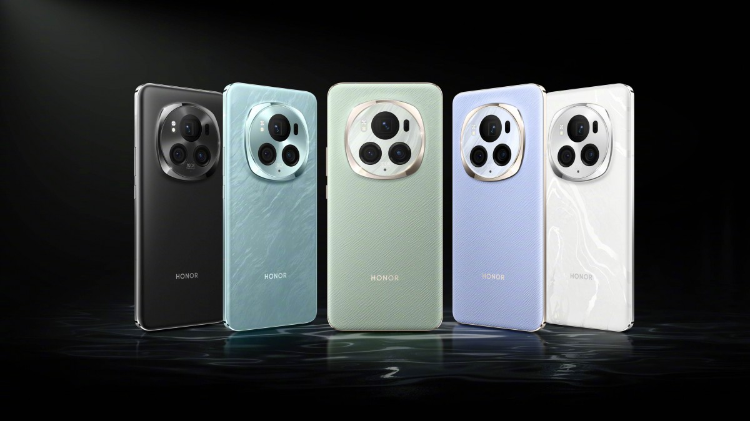
Honor unveils its new MagicOS 8.0 with “intent-based” user interface and platform AI alongside the new Magic6 series smartphones
The new MagicOS 8.0 is based on Android 14 and has reportedly an intent-based user interface, which should suggest services and apps based on your activity patterns.
A feature called Magic Portal also uses Honor’s own large language models to give app shortcuts via a side swipe, all based on the context—for example, dragging a text to your notes app or a location in an email into a maps app.
  This reportedly also supports images, allowing users to drag images to search on a variety of apps, such as clothes to search fashion apps.
It will be launched alongside the Honor Magic6 series, which was announced on January 11.
  The new Magic6 and Magic6 Pro feature the Snapdragon 8 Gen 3 chipset and a 6.8-inch curved LTPO AMOLED display with 1264x2800 resolution and 1–120Hz variable refresh rate.
  They also both support Wi-Fi 7 and Bluetooth 5.3, with the Pro also having satellite connectivity in China.
  The Magic6 has a 5,450mAh battery, while the Pro has a 5,600mAh battery.
Honor Magic6 smartphones in a variety of colors
Source: Honor

Slide 8
“Honor has had consistent growth in the Chinese market since its start in 2021. In 3Q23, it recorded the most shipments of any OEM in China. With further advancements in its operating system and flagship phone hardware, it will be trying to retain its market share as Huawei grows back. Western Europe is now Honor’s second largest market, particularly making inroads in the premium segment in 2023.”
Zaker Li
Principal Smartphone Analyst, Consumer Devices

Slide 9
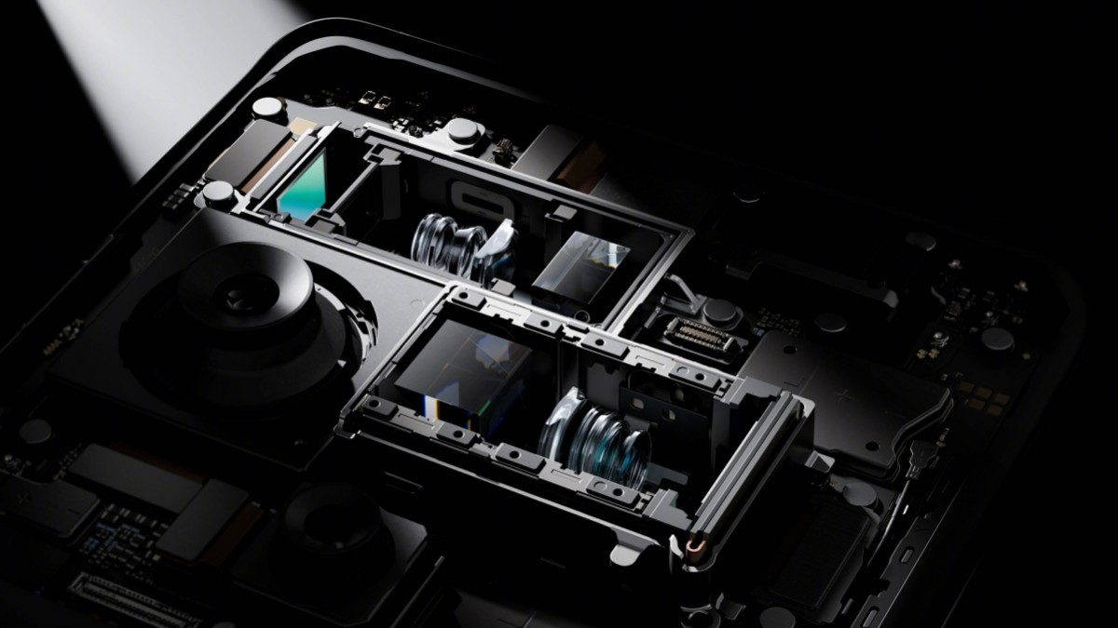
OPPO Find X7 Ultra is the first flagship phone with dual-periscope cameras
OPPO announced on January 8 its new top-of-the-line flagship Find X7 Ultra smartphone.
It includes the world’s first dual-periscope telephoto cameras.
  One periscope is a 65mm 3x zoom camera with a 1/1.56” Sony IMX890 and OIS.
  The second periscope is a 135mm 6x telephoto camera with a 1/2.51” Sony IMX858, which also has OIS.
The main camera is a 1-inch type LYT-900 sensor with a f/1.8 aperture and OIS. The ultrawide camera is also a LYT-900 sensor, but with a 1/1.95” size and is capable of f/2.0 and autofocus, allowing for photography as close as 4cm.
All four cameras are 50MP and will use a new HyperTone engine, which will reportedly keep photos looking natural, in a continued partnership with Swedish-brand Hasselblad.
It has a 120Hz 6.82-inch LTPO OLED with QHD+ resolution and up to 4,500 nits of peak brightness.
It uses a Qualcomm Snapdragon 8 Gen 3 SoC with up to 16GB RAM and 512 GB of storage.
Oppo Find X7 Ultra dual-periscope camera system
Source: OPPO

Slide 10
“With one of the most impressive camera systems on any phone and the Hasselblad partnership, the OPPO Find X7 Ultra will appeal to smartphone photography enthusiasts. It has a Master Mode, where you can fine-tune all camera parameters and shoot in RAW file formatting. It is still too early to see in-depth camera reviews and side-by-side comparisons, but I would not be surprised if it starts showing up in ‘best smartphone camera’ shortlists.”
Zaker Li
Principal Smartphone Analyst, Consumer Devices

Slide 11
Appendix

Slide 12
Appendix
Authors
  Jusy Hong, Senior Research Manager, Components & Devices – Wireless Devices
  Zaker Li, Principal Analyst, Components & Devices – Mobile Handsets
  Aaron West, Senior Analyst, Components & Devices – Mobile Handsets
  askananalyst@omdia.com
  Omdia Consulting
  We hope that this analysis will help you make informed and imaginative business decisions. If you have further requirements, Omdia's consulting team may be able to help you. For more information about Omdia's consulting capabilities, please contact us directly at consulting@omdia.com.
  Citation Policy
  Request external citation and usage of Omdia research and data via citations@omdia.com.

