Slide 1
Smartphone Need-To-Know – April 2024
Jusy Hong, Senior Research Manager, Components & Devices – Mobile Handsets
Zaker Li, Principal Analyst, Components & Devices – Mobile Handsets
Aaron West, Senior Analyst, Components & Devices – Mobile Handsets
askananalyst@omdia.com

Slide 2
Contents
The latest long-term Omdia smartphone forecast shows steady growth after a tumultuous past few years 3
AI features are expanding to more midrange phones and older devices 5
ZTE Nubia enters new South-Eastern Asian and Oceanian markets, including Australia and Thailand 7
Huawei releases new Pura 70 phones, rebranding the long-standing P series 9
Appendix 11

Slide 3
The latest long-term Omdia smartphone forecast shows steady growth after a tumultuous past few years
Since 2019, the smartphone industry has been experiencing unusually rapid growths and declines because a series of events have rocked the global economy and supply chain. These events include pandemic restrictions in 2020 and 2021, supply chain issues in 2022 (particularly for Chinese manufacturing), and high inflation reducing consumer demand in 2023.
With smartphone shipments reaching their lowest point in several years in 2023 (totaling 1.165 billion), Omdia forecasts that the smartphone market will rebound slightly in 2024 to 1.228 billion global shipments. This is still below the total shipments recorded in 2022 and earlier but is the start of steady growth for several years.
The growth rate will remain initially higher (around 3%) as the economy recovers. This will last until 2026; slow growth will then continue.
The five-year compound annual growth rate (CAGR) from 2023 to 2029 is 2.1%, increasing to 1.319 billion global annual shipments in 2029.
  This is above the shipments recorded in 2020 but below 2021, 2019, and pre–COVID-19 totals.

Slide 4
“The increasing demand for refurbished and used smartphones, the expansion of replacement cycles, and macroeconomic uncertainty still have a negative impact on new demand. Despite this, a growing global population, emerging markets, and replacement demand for AI features are key driving factors that outweigh the aforementioned negative factors. As such, Omdia expects the smartphone market to grow steadily until 2029 after transitioning to growth, starting in 2024.”
Jusy Hong
Senior Research Manager, Components & Devices

Slide 5
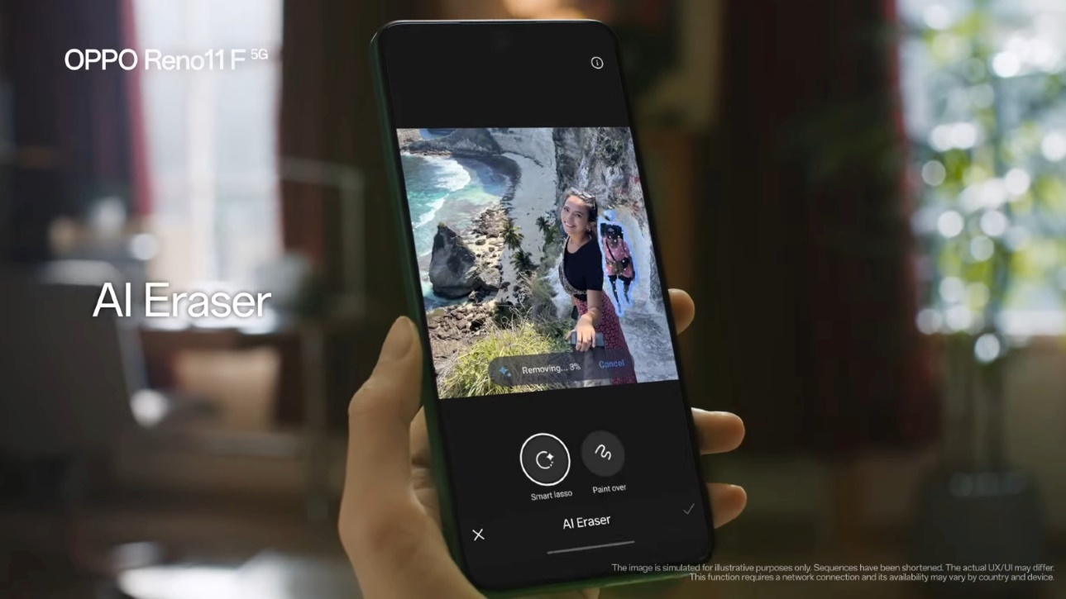
AI features are expanding to more midrange phones and older devices
Shortly after the Samsung Galaxy S24 series launched with Galaxy AI, Samsung announced that it would extend Galaxy AI into the older 2023 S23 series. On April 15, 2024, Samsung confirmed that the 2022 flagship devices (including the S22 series, foldables, and tablets) will also be getting Galaxy AI in the next update to OneUI (6.1) in early May.
  Recipients of Galaxy AI include Samsung Galaxy Z Fold4 and Z Flip4 as well as Galaxy Tab S8, S8+, and S8 Ultra.
  Galaxy AI’s features include Circle to Search (searches on Google), Chat Assist, Interpreter, Live Translate, Note Assist, Transcript Assist, Browsing Assist, Generative Edit, Edit Suggestion, and AI-Generated Wallpapers.
  For now, Galaxy AI features are confirmed to be free to use until 2025, but it is unclear whether this will continue or if Samsung will adopt a subscription model.
OPPO also announced that it was bringing its AI Eraser tool to the Reno11 series (including Reno 11 5G, Pro 5G, and F 5G). This adds AI features to a more affordable phone than previously available, with the Reno11 F 5G model available at around $299.
At a launch event in India, Motorola announced its new Edge 50 Pro with a large emphasis on the brand’s increased focus on AI, called MotoAI. This includes AI-enhanced photo processing to improve stabilization, improve long exposures, and auto-focus tracking.
  Motorola users will also have access to the generative AI features on Google Photos starting from May 8, 2024, including Magic Editor, Magic Eraser, and Photo Unblur.
OPPO’s AI eraser feature on the OPPO Reno11 F 5G
Source: OPPO

Slide 6
“Generative AI features and on-device AI are rapidly expanding beyond just the latest flagship phones. This time six months ago, Google was just introducing new AI features to its Pixel 8 series. Now, most smartphone OEMs are introducing AI to their premium and even midrange phones. However, I remain wary. Samsung’s promise to keep Galaxy AI free until 2025 suggests that AI could go the way of other tech services, such as Uber, and assume a premium subscription model, locking some features behind a paywall or introducing advertising.”
Aaron West
Senior Analyst, Components & Devices

Slide 7
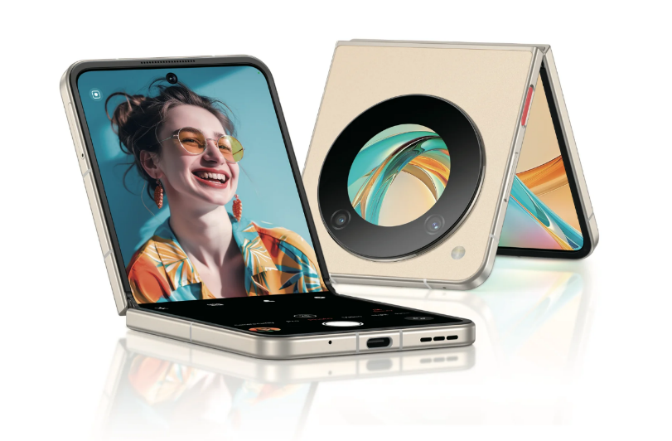
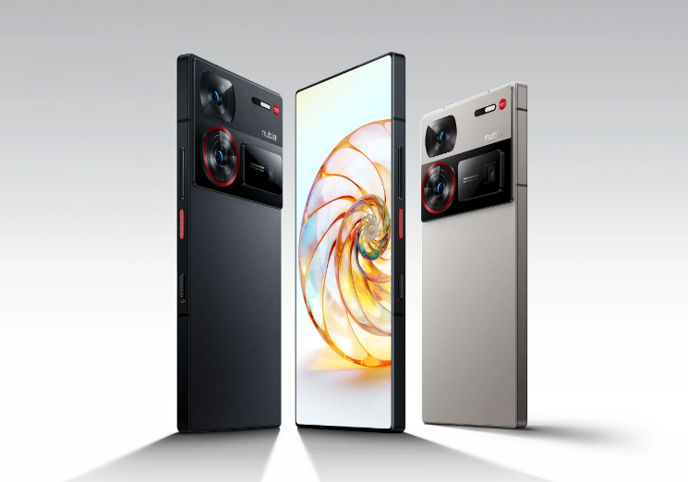
ZTE Nubia enters new South-Eastern Asian and Oceanian markets, including Australia and Thailand
The Nubia brand, part of ZTE, announced a range of new products at MWC 2024, including the world’s cheapest flip-style foldable phone (the Nubia Flip 5G, for around $499) and a new premium flagship model (the Z60 Ultra, for around $800 to $900).
It has announced that these devices will be available internationally, expanding into six new markets (Australia, Laos, Malaysia, New Zealand, Thailand, and Vietnam) on top of the existing markets that they already export to.
Historically, Samsung, OPPO, and Xiaomi dominate the South-Eastern Asian markets. ZTE hopes that its affordable devices can rival these brands in the established midrange market in this region.
Conversely, the Australian and New Zealand markets are much more like Western Europe or North America in that Apple and Samsung dominate them. Also, they are primarily a premium phone device market.
The Nubia Flip 5G foldable smartphone
The Nubia Z60 Ultra flagship phone
Source: ZTE Nubia
Source: ZTE Nubia

Slide 8
“As ZTE enters new markets with Nubia, it is likely to have more success in the South-Eastern Asian markets, such as Thailand, rather than Australia and New Zealand. Apple and Samsung are the predominant smartphone brands in these markets, with most consumers buying premium devices. Establishing the Nubia name as a premium brand will be ZTE’s biggest challenge in this new expansion.”
Aaron West
Senior Analyst, Components & Devices

Slide 9
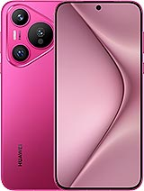
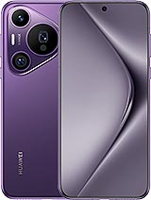
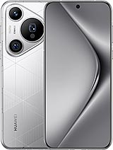
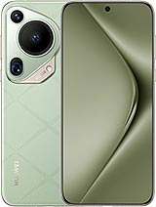
Huawei releases new Pura 70 phones, rebranding the long-standing P series
To mark the 12th anniversary of the P series, Huawei surprise-dropped three new phones without a large launch event. The new Pura 70 phones also mark a naming convention change for the P series and include
  Huawei Pura 70
  Huawei Pura 70 Pro
  Huawei Pura 70 Pro+
  Huawei Pura 70 Ultra
This “Pura” branding is new for Huawei and could mean a permanent name change for future P-series releases. This is the first time Huawei introduced an Ultra model to the P series, and it is the only one with Huawei’s XMAGE photography branding on its camera module.
Following the scrutiny Huawei experienced for the Mate 60 series in September 2023, some questions have been raised on what chipset the Pura 70 series will use in addition to the source. China’s SMIC reportedly manufactures the Kirin 9000 series of chips, but Huawei has declined to comment on the source.
  This is after the US government began a review of the chipset; it stated last month that SMIC might have violated US export rules.
Model | Pura 70 | Pura 70 Pro | Pura 70 Pro+ | Pura 70 Ultra
Display | 6.6 inches, 1256x2760, 120Hz LTPO OLED, 2,500 nits peak brightness | 6.8 inches, 1260x2844, 120Hz LTPO OLED, 2,500 nits peak brightness | 6.8 inches, 1260x2844, 120Hz LTPO OLED, 2,500 nits peak brightness | 6.8 inches, 1260x2844, 120Hz LTPO OLED, 2,500 nits peak brightness
Chipset | Kirin 9010 (7nm) | Kirin 9010 (7nm) | Kirin 9010 (7nm) | Kirin 9010 (7nm)
Memory | 256GB–1TB ROM, 12GB RAM | 256GB–1TB ROM, 12GB RAM | 512GB–1TB ROM, 16GB RAM | 512GB–1TB ROM, 16GB RAM
Main camera | 50MP wide OIS 12MP 5x periscope OIS 13MP ultrawide | 50MP wide OIS 48MP 3.5x telephoto OIS 12.5MP ultrawide | 50MP wide OIS 48MP 3.5x telephoto OIS 12.5MP ultrawide | 50MP wide 1-inch sensor OIS 50MP 3.5x telephoto OIS 40MP ultrawide
Front camera | 13MP ultrawide | 13MP ultrawide | 13MP ultrawide | 13MP ultrawide
Battery | 4900mAh with 66W wired and 50W wireless charging | 5050mAh with 100W wired and 80W wireless charging | 5050mAh with 100W wired and 80W wireless charging | 5200mAh with 100W wired and 80W wireless charging
Launch price | ¥5,499 (~$760) | ¥6,499 (~$900) | ¥8,099 (~$1,120) | ¥9,999 (~$1,380)
Source: Huawei and Omdia
© 2024 Omdia

Slide 10
“Huawei continues to demonstrate a high level of brand confidence by launching Pura 70 without an official launch event. Pura is a new brand name for the Huawei P series that places greater emphasis on image capability and aesthetic design rather than hardware parameters. In terms of hardware, the most attractive upgrade is to the main camera of the Ultra model: a rear 50-megapixel main camera with a 1-inch sensor, f/1.6-f/4.0 variable aperture, and sensor-shift optical image stabilization.”
Zaker Li
Principal Analyst, Components & Devices

Slide 12
Appendix
Authors
  Jusy Hong, Senior Research Manager, Components & Devices – Wireless Devices
  Zaker Li, Principal Analyst, Components & Devices – Mobile Handsets
  Aaron West, Senior Analyst, Components & Devices – Mobile Handsets
  askananalyst@omdia.com
  Omdia Consulting
  We hope that this analysis will help you make informed and imaginative business decisions. If you have further requirements, Omdia's consulting team may be able to help you. For more information about Omdia's consulting capabilities, please contact us directly at consulting@omdia.com.
  Citation Policy
  Request external citation and usage of Omdia research and data via citations@omdia.com.

