Slide 1
Smartphone Need-To-Know – May 2024
  Jusy Hong, Senior Research Manager, Components & Devices – Mobile Handsets
  Zaker Li, Principal Analyst, Components & Devices – Mobile Handsets
  Aaron West, Senior Analyst, Components & Devices – Mobile Handsets
  askananalyst@omdia.com

Slide 2
Contents
Initial smartphone shipment data for 2024 shows industry recovery 3
Google launches the Pixel 8a early to dedicate entire I/O event to AI 5
HMD launching a remake of the classic Nokia 3210 feature phone, as well as the first own-brand HMD Pulse smartphones 7
Vivo launches X100 Ultra with a 200MP periscope camera and X100s with the latest MediaTek Dimensity 9300+ chipset 9
Appendix 11

Slide 3
Initial smartphone shipment data for 2024 shows industry recovery
Smartphone shipments totaled 300.4 million units, an 11.6% increase compared to 1Q23. This marks the second consecutive quarter of year-on-year (YoY) increase after a prolonged period of market stagnation and decline from 2Q21 to 4Q23, suggesting that the industry is stabilizing after a period of turbulence.
Many OEMs, including Xiaomi, Honor, Motorola, and Realme, recorded large double-digit YoY growth, with Transsion and Huawei seeing triple-digit growth. Both Apple and OPPO saw a YoY decline.
Apple’s shipments surged in 4Q23 after the release of the iPhone 15 series but decreased to 50.7 million units in 1Q24, marking a decline compared to the previous year. The YoY decrease in 1Q24 can be attributed to delayed production and shipments from 4Q22 to 1Q23, which resulted in higher-than-usual shipments in 1Q23. Given Apple’s successful performance in 4Q23, a decline in 1Q24 should not be unexpected or alarming.
China is an important market for Apple with the second largest shipment volume after the US. However, Apple has been facing severe competition with Huawei in the premium segment in the Chinese local market since the second half of last year, which is another reason for disappointing iPhone shipments in the first quarter. Performance in the Chinese market will be an important factor in determining Apple’s overall shipments this year.
Quarterly results, 1Q24 (millions of units)
Rank | OEM | 1Q24 |  | 4Q23 |  | 1Q23 |  | QoQ | YoY
 |  | Shipments | M/S | Shipments | M/S | Shipments | M/S
1 | Samsung | 60.4 | 20% | 53.2 | 16% | 60.3 | 22% | 13.5% | 0.2%
2 | Apple | 50.7 | 17% | 78.7 | 24% | 57.3 | 21% | -35.6% | -11.5%
3 | Xiaomi | 40.8 | 14% | 41.2 | 13% | 30.5 | 11% | -1.0% | 33.8%
4 | Transsion | 27.5 | 9% | 30.1 | 9% | 13.0 | 5% | -8.6% | 111.5%
5 | OPPO Group | 25.0 | 8% | 24.4 | 7% | 26.5 | 10% | 2.5% | -5.7%
6 | vivo | 23.0 | 8% | 24.0 | 7% | 21.4 | 8% | -4.2% | 7.5%
7 | Honor | 16.5 | 5% | 16.0 | 5% | 11.2 | 4% | 3.1% | 47.3%
8 | Huawei | 13.1 | 4% | 12.3 | 4% | 6.4 | 2% | 6.5% | 104.7%
9 | Motorola | 13.0 | 4% | 12.5 | 4% | 10.5 | 4% | 4.0% | 23.8%
10 | Realme | 10.1 | 3% | 12.1 | 4% | 8.2 | 3% | -16.5% | 23.2%
 | Others | 20.3 | 7% | 23.5 | 7% | 23.8 | 9% | -13.4% | -14.7%
 | Total | 300.4 | 100% | 328.0 | 100% | 269.1 | 100% | -8.4% | 11.6%
Notes: M/S stands for market share. OPPO Group includes OPPO and OnePlus. Transsion includes Tecno, itel, and Infinix. Source: Omdia |  |  |  |  |  |  |  | © 2024 Omdia

Slide 4
“The smartphone market is polarized into low-end and premium smartphones, which is the most noticeable trend. This has disproportionately benefited Apple and Huawei, while other brands focusing on mid-priced phones, such as Samsung, OPPO, and Realme, have faced challenges. As we move through 2024, the global market is expected to grow YoY, particularly in the first half. However, the smartphone market polarization will continue to affect which OEMs will benefit the most from this growth.”
Jusy Hong
Senior Research Manager,
Components & Devices

Slide 5


Google launches the Pixel 8a early to dedicate entire I/O event to AI
Google launched its new affordable midrange smartphone, the Pixel 8a, on May 7, 2024, instead of the expected announcement date of May 14 at Google’s I/O event. It features the latest Tensor G3 chipset from Google, which is also on the Pixel 8 and Pixel 8 Pro and will receive the same seven years of OS and security support.
The most significant upgrade compared with the previous Pixel 7a is the new chipset, with other improvements being minimal. It has a higher 120Hz display refresh rate and a higher peak brightness of 2000 nits. The battery also has a slightly larger capacity, and the phone has a more rounded design, bringing it closer to the Pixel 8.
On May 14, Google hosted its annual I/O event, unveiling and demonstrating new artificial intelligence (AI) work and generative features. These include collaborative generative AI (GenAI) audio, Music AI Sandbox, the new video generator Veo, and an improved AI overview when searching (coming to the US market first), which can make a shopping list, meal plan, travel agenda, and more. The features also include a search with video, a Gmail email summarizer, suggested tasks, and task and bookkeeping automation.
Google unveiled a key technical development by extending the long context window to 2 million tokens later this year.
Android-specific AI advancements include the following:
  Improved Google’s “Circle To Search,” allowing students to scan questions for help
  Aiming to double the number of active phones with access to Circle To Search from 100 million to 200 million by the end of the year
  Embedding Google Gemini as the new personal assistant, allowing for it to anticipate your needs more, with more context awareness to understand YouTube videos and PDFs for quick answers
  More on-device Gemini Nano AI, starting with Pixel phones later this year. This includes accessibility features that provide more understanding and awareness of what is said in calls to stop scam calls. All of this is done on-device, ensuring total security and privacy.
Source: Google
Source: Google
Model | Pixel 8a | Pixel 7a
Display | 6.1 Inches, 1080x2400, 120Hz OLED, 2000 nits peak brightness | 6.1 Inches, 1080x2400, 90Hz OLED, 1000 nits peak brightness
Chipset | Google Tensor G3 (4nm) | Google Tensor G2 (5nm)
Memory | 128–256GB ROM, 8GB RAM | 128GB ROM, 8GB RAM
Main camera | 64MP wide OIS 13MP ultrawide | 64MP wide OIS 13MP ultrawide
Front camera | 13MP ultrawide | 13MP ultrawide
Battery | 4492mAh with 18W wired and 7.5W wireless charging | 4385mAh with 18W wired and 7.5W wireless charging
Launch price | $499 | $499
© 2024 Omdia
Source: Omdia

Slide 6
“Google first started adding GenAI features into phones with the launch of the Pixel 8 just nine months ago. It is clear from Google’s latest I/O event that AI is rapidly developing and being layered into Android OS. Just three months ago, AI was seen as a premium-only feature, but with the Pixel 8a and other midrange devices getting GenAI features and Google Gemini AI being added to the Google voice assistant, this expansion is happening faster than many anticipated.”
Aaron West
Senior Smartphone Analyst, Components & Devices

Slide 7
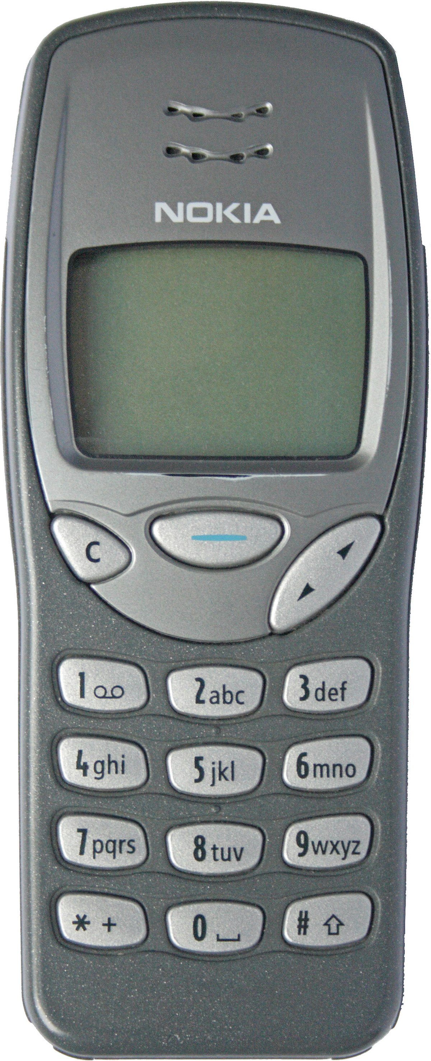
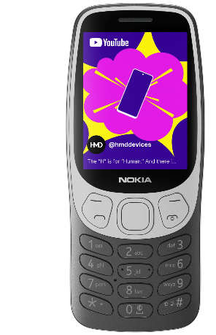
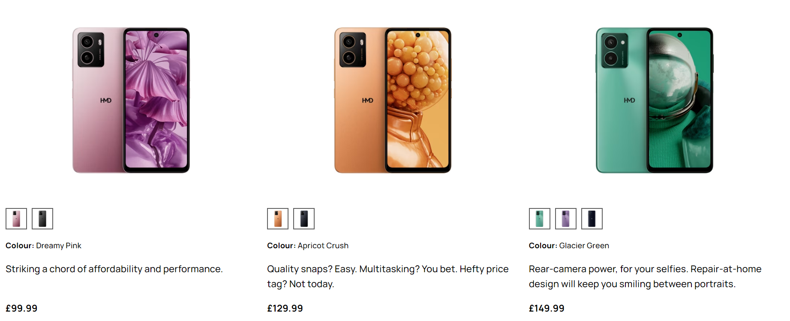
HMD launching a remake of the classic Nokia 3210 feature phone, as well as the first own-brand HMD Pulse smartphones
Following on from teasing the return of a “classic,” HMD has unveiled that it is bringing the iconic Nokia 3210 back with a modern redesign for its 25th birthday. It features a redesigned exterior, a larger display (with a preinstalled game of Snake), Bluetooth 5.0, a USB-C connector, and 4G networking. It is available for £74.99 or €74.90.
HMD also unveiled its first smartphones without Nokia branding, relying on the HMD brand instead, with the Pulse, Pulse+, and Pulse Pro. All three are low-end smartphones ranging from €140/£100 for the Pulse to €180/£149.99. All three use the same Unisoc T606 chipset and 6.65-inch LCD 720p+ 90Hz display. The biggest distinguishing factor between the three is the camera, with the base model Pulse having a 13MP back camera, a depth sensor, and an 8MP front camera. The Pulse+ has a 50MP main camera and the same front camera. The Pulse Pro has the same 50MP main camera and an upgraded 50MP front camera.
According to HMD, the battery on all three phones has a 5,000mAh capacity and is “QuickFix replaceable.” This means that it can be replaced at home in five minutes with simple tools. The phones are also IP52-rated, meaning they are dust-protected but not totally dustproof and safe from light water drops. This is good, considering the price and ease of repair, but HMD does note that to maintain the IP52 rating when replacing the battery, you must follow the instructions carefully.
Nokia 3210 classic and new version side by side
HMD Pulse, Pulse+, and Pulse Pro
Source: HMD Global
Source: HMD Global

Slide 8
“Bringing back the classic Nokia 3210 is all part of HMD’s multi-brand strategy: leveraging the iconic Nokia name for its feature phones while also creating own-branded smartphones to cultivate the HMD image of a modern, fresh, fun company. Part of the brand’s unique selling point (USP) is creating repairable phones, which HMD is continuing to commit to, as well as offering consumers a way of ‘digital detoxing’ through its range of feature phones.”
Aaron West
Senior Smartphone Analyst, Components & Devices

Slide 9
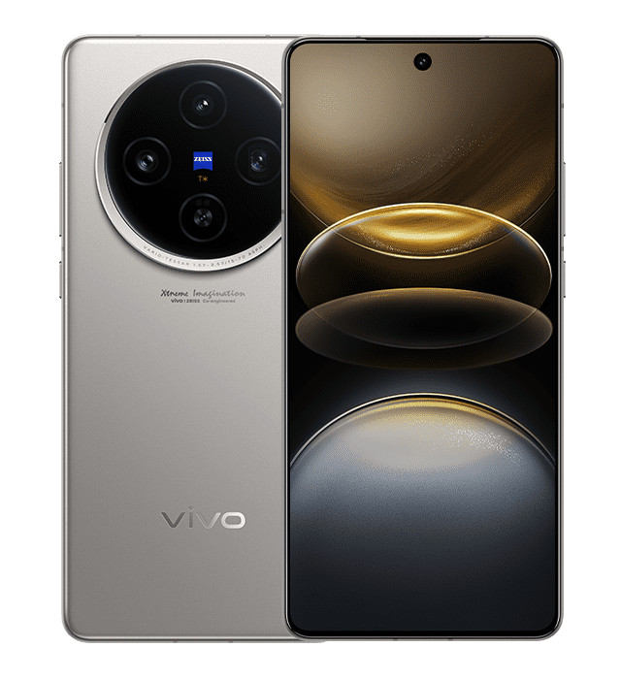
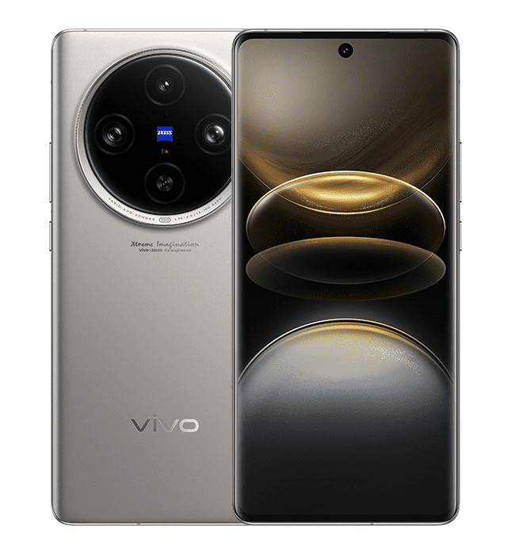
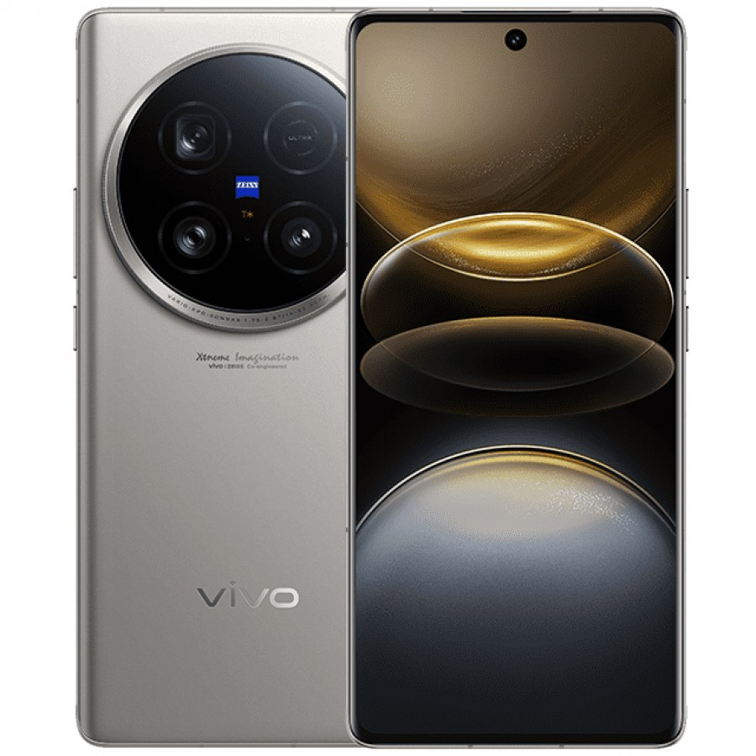
Vivo launches X100 Ultra with a 200MP periscope camera and X100s with the latest MediaTek Dimensity 9300+ chipset
On May 13, vivo unveiled its latest X100 series phones, including a new X100 Ultra, which follows a similar trend to the Xiaomi 14 Ultra with top-tier specifications, particularly with the camera.
  The X100 Ultra has a 1-inch main camera sensor capable of 50MP with gimbal OIS and laser autofocus, as well as a 200MP periscope camera with OIS capable of 3.7x optical zoom.
  With a 1/1.4-inch sensor on the periscope camera, this is the largest telephoto sensor on a smartphone.
  It has a 6.78-inch low-temperature polycrystalline oxide (LTPO) AMOLED display with 1440x3200 resolution, 120Hz refresh rate, and 3000 nits peak brightness.
  It is equipped with the latest Snapdragon 8 Gen 3 and has a huge 5,500mAh battery.
  It has been reported to remain exclusive to the domestic Chinese market.
The company also launched a refresh of the standard new X100 and X100 Pro, with two new phones called the X100s and X100s Pro.
  Each has MediaTek’s latest Dimensity 9300+ chipset, improving on previous versions.
  The X100s model also improves on the X100 by being 0.7mm thinner, at 7.8mm thick compared to 8.5mm.
New vivo phones, in order left to right: X100s, X100s Pro, X100 Ultra
Source: vivo

Slide 10
“vivo’s release of a super-premium flagship phone follows the same trend as Xiaomi’s 14 Ultra and OPPO’s Find X7 Ultra—even following the same ‘Ultra’ moniker. All three have top-of-the-line specs and push the envelope of camera specs available in smartphones. However, so far, the only one to be brought to the international market is Xiaomi, with OPPO and vivo remaining exclusive to the Chinese market. Regardless, the positive reviews and media coverage of their phones will improve brand recognition in international markets.”
Zaker Li
Principal Smartphone Analyst, Components & Devices

Slide 11
Appendix

Slide 12
Appendix
Further reading
Global Smartphone Shipment Preliminary Result – 1Q24 (May 2024)
Authors
  Jusy Hong, Senior Research Manager, Components & Devices – Wireless Devices
  Zaker Li, Principal Analyst, Components & Devices – Mobile Handsets
  Aaron West, Senior Analyst, Components & Devices – Mobile Handsets
  askananalyst@omdia.com
  Omdia Consulting
  We hope that this analysis will help you make informed and imaginative business decisions. If you have further requirements, Omdia's consulting team may be able to help you. For more information about Omdia's consulting capabilities, please contact us directly at consulting@omdia.com.
  Citation Policy
  Request external citation and usage of Omdia research and data via citations@omdia.com.

