Slide 1
Smartphone Need-To-Know – June 2024
  Jusy Hong, Senior Research Manager, Components & Devices – Mobile Handsets
  Zaker Li, Principal Analyst, Components & Devices – Mobile Handsets
  Aaron West, Senior Analyst, Components & Devices – Mobile Handsets
  askananalyst@omdia.com

Slide 2
Contents
Apple introduces AI features as “Apple Intelligence” at WWDC and announces partnership with OpenAI’s ChatGPT 3
Honor launches 200 and 200 Pro phones globally, introduces its first flip-type foldable, and announces a hybrid AI strategy 5
OPPO unveils AI strategy to add GenAI to mid-end A and F Series devices 7
Appendix 10

Slide 3
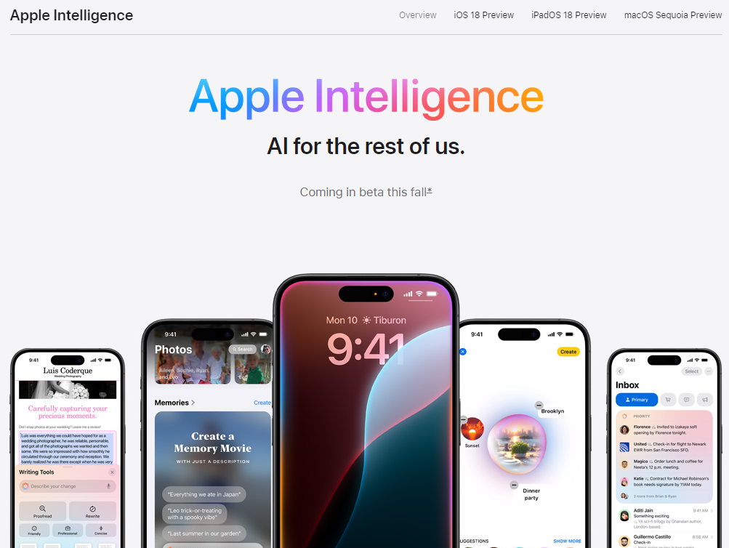
Apple introduces AI features as “Apple Intelligence” at WWDC and announce partnership with OpenAI’s ChatGPT
On June 10, at Apple’s Annual Worldwide Developers Conference (WWDC), the company announced the introduction of “Apple Intelligence,” its version of AI.
Apple Intelligence will launch in beta with iOS 18 in September but will only be available on the iPhone 15 Pro and Pro Max. We assume that Apple Intelligence will also be available on the upcoming iPhone 16 Pro and Pro Max though we are uncertain whether it will be available on the standard iPhone 16 and iPhone 16 Plus.
These features include generative AI (GenAI) image editing and emoji creation, which have been observed in other companies. There are also include improvements to Siri that integrate AI into the personal assistant.
These functions require the AI model to have access to users’ personal data, such as iMessage, contacts, emails, notes, fitness data, and more. Embedding AI in this way into the operating system (OS) is currently possible only for Apple or Google, the developers of their respective OS.
It is not yet clear when, or even if, third-party apps will be integrated into Apple Intelligence’s Siri improvements.
Apple also emphasized its commitment to privacy, explaining that for simple requests, the AI will use a large language model (LLM) that runs on-device, meaning data is not shared. For more complex requests, user data could be shared with cloud models in partnership with ChatGPT. Apple launched Private Cloud Compute to ensure that user data sent into these cloud servers is not accessible to anyone—not even Apple—but the user.
The home page for Apple Intelligence
Source: Apple

Slide 4
“Much of Apple Intelligence looks similar to the GenAI and on-device AI functions already announced by various companies. Improvements to Siri, which can dramatically enhance user convenience, is the exception here. A key question remains: When will these AI Siri features go beyond Apple’s first-party apps and include select third-party applications? Expanding Siri’s capabilities and intelligence could change how users interact with their smartphones and fuel replacement demand. Omdia forecasts that full-scale AI smartphone market growth will begin in 2026.”
Jusy Hong
Senior Research Manager,
Consumer Devices

Slide 5
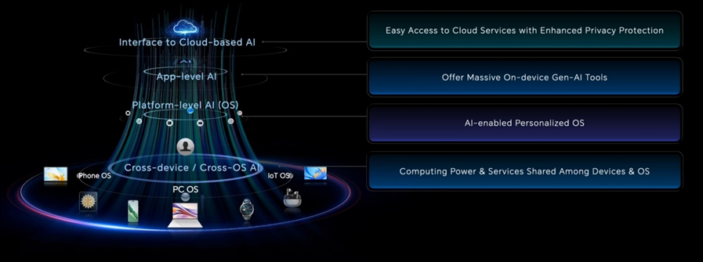


Honor launches 200 and 200 Pro phones globally, introduces its first flip-type foldable, and announces a hybrid AI strategy
Honor had a very busy May and June, starting with a keynote event at VivaTech 2024 in Paris, France, on May 22. Honor CEO George Zhao unveiled its four-layer hybrid AI architecture comprising cross-device, platform-level, app-level, and cloud AI. The small on-device AI model will enable intuitive user interfaces and GenAI on premium devices, while larger tasks will use cloud models.
For the cloud-based AI at the top layer, George Zhao said, “We are also delighted to forge ahead with Google Cloud, leveraging our combined expertise to unlock the potential of this hybrid approach and deliver even more seamless AI experiences to our users.”
Honor launched the Honor 200 and 200 Pro in Paris on June 12, with a global release date of June 26. The 200 Pro uses a Snapdragon 8s Gen 3 chipset and 12GB RAM to enable new AI features, including an AI portrait engine developed in partnership with the renowned photography studio in Paris, Studio Harcourt. The function is supported by three 50MP cameras (wide, zoom, and selfie) and a 12MP ultrawide camera.
On June 13, at the 2024 Technology Fashion Show in Shanghai, China, Honor launched its first flip foldable phone, the Honor Magic V Flip. This model will initially be exclusive to China, like many of Honor’s foldable phones. The most noticeable innovation is its edge-to-edge 4-inch LTPO OLED cover screen with two large camera cutouts. It will also feature a 6.8-inch LTPO OLED inner screen in a 21:9 aspect ratio, a Snapdragon 8+ Gen 1 chipset, a 50MP main camera, and a 4,800 mAh battery capacity. The model with 12GB RAM and 256GB ROM is priced at ¥4,999 ($690/€640).
Honor four-layer AI architecture
Source: Honor
Honor 200 Pro with Studio Harcourt partnership
Honor Magic V Flip
Source: Honor
Source: Honor

Slide 6
“It is likely that Honor’s hybrid AI strategy is the direction the overall smartphone industry will follow because it allows for the expansion of AI features in more mid- and low-end devices. Where older or mid-range chipsets cannot run LLMs effectively, more phones will rely on lighter AI models, such as Honor’s, for on-device features and use cloud AI computing for larger GenAI tasks.”
Aaron West
Senior Smartphone Analyst, Consumer Devices

Slide 7
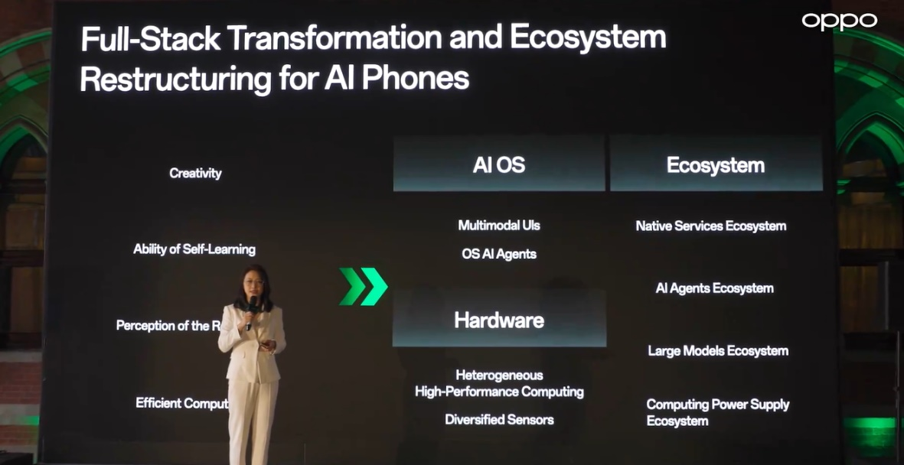
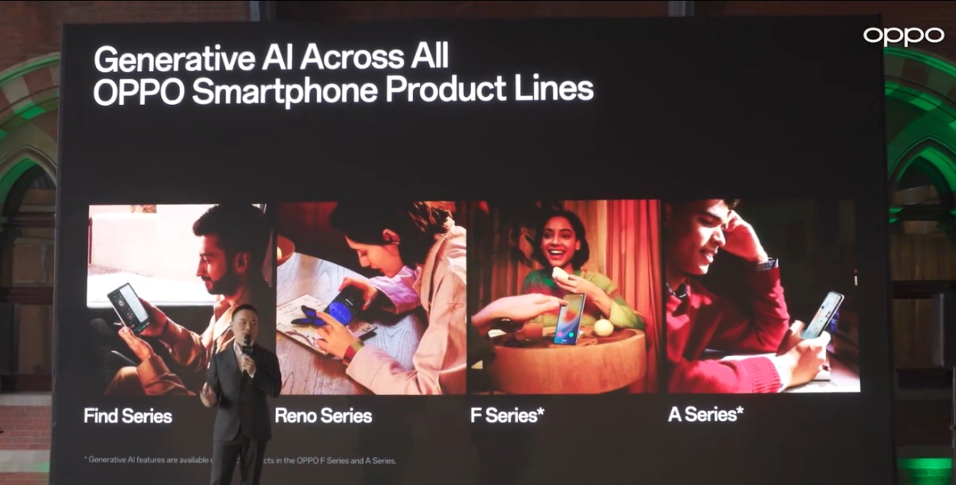
OPPO unveils AI strategy to add GenAI to mid-end A and F Series devices
During an event at the St. Pancras Renaissance Hotel in London, UK, OPPO announced its ambition to introduce GenAI features to 50 million users by bringing it to some mid-end A and F series OPPO devices.
Similar to Honor, a hybrid AI architecture is under development. Low-end devices may use a lighter, simpler LLM model and rely more on cloud computing. The Reno12 and future Find X series will use Google’s heavier and more sophisticated Gemini Nano model, with additional OPPO features such as AI Writer and AI Recording Summary.
An increased partnership with MediaTek is a crucial part of this strategy. MediaTek is reportedly collaborating on fine-tuning chipsets to improve future OPPO phones.
A key ambition for OPPO was the development of an “AI Agent,” which would support multimodal interaction such as voice. This was announced prior to Apple Intelligence and Siri improvements on June 10.
Nicole Zhang, general manager of AI Product at OPPO, stated at the event: “We believe that the intelligent OS will be embedded with AI Agents and support multimodal interaction. Meanwhile, the third-party services will be provided in a more flexible way. This will result in a full-stack transformation and ecosystem restructuring of AI phones.”
OPPO presentation on AI ecosystem
OPPO targets to bring AI to all smartphone lines
Source: OPPO
Source: OPPO

Slide 8
“OPPO’s aim to bring GenAI to its entire lineup, including low-cost phones, is a noble ambition and will play an important role in making AI truly accessible to all. By democratizing AI in this way, it could benefit more people, whether for educational purposes, translation tools, or business applications. A key next step would be to ensure that interaction with AI is multimodal, making it accessible to people with various disabilities.”
Zaker Li
Principal Smartphone Analyst, Consumer Devices

Slide 9
Appendix

Slide 10
Appendix
Authors
  Jusy Hong, Senior Research Manager, Components & Devices – Wireless Devices
  Zaker Li, Principal Analyst, Components & Devices – Mobile Handsets
  Aaron West, Senior Analyst, Components & Devices – Mobile Handsets
  askananalyst@omdia.com
  Omdia Consulting
  We hope that this analysis will help you make informed and imaginative business decisions. If you have further requirements, Omdia's consulting team may be able to help you. For more information about Omdia's consulting capabilities, please contact us directly at consulting@omdia.com.
  Citation Policy
  Request external citation and usage of Omdia research and data via citations@omdia.com.

