Slide 1
Smartphone Need-To-Know – July 2024
  Jusy Hong, Senior Research Manager, Components & Devices – Mobile Handsets
  Zaker Li, Principal Analyst, Components & Devices – Mobile Handsets
  Aaron West, Senior Analyst, Components & Devices – Mobile Handsets
  askananalyst@omdia.com

Slide 2
Contents
Samsung Unpacked event showcases newest foldables and wearables 3
Honor beats own thinnest foldable record with the new Magic V3 5
Lenovo introduces smartphone AI with newly released Motorola Razr 7
Apple and the European Commission’s dispute continues as Apple announces its AI features will not be coming to the EU 9

Slide 3
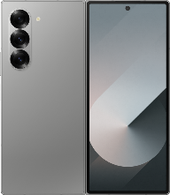
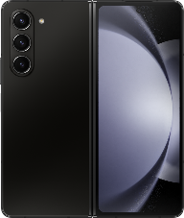
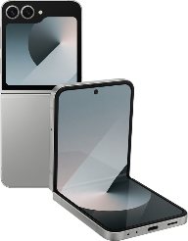
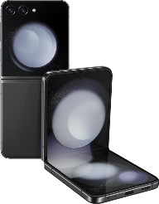
Samsung Unpacked event showcases newest foldables and wearables
On July 10, Samsung unveiled its latest, thinnest-ever foldable phones: the Z Fold6 and Z Flip6.
These new foldables have only slight hardware upgrades from their predecessors: the Z Fold6 is thinner and has a higher peak brightness main display, while the Z Flip6 has a larger battery and an upgraded 12GB of RAM.
Each also upgraded its displays to LTPO OLED, and its chipsets to the Qualcomm Snapdragon 8 Gen 3.
Outside minimal hardware improvements, Samsung emphasized new software applications, including Galaxy AI. One of these included using dual displays to translate conversations more seamlessly.
It also showcased the new Galaxy Watch Ultra, which follows suit from the Apple Watch Ultra, with similar design and features but for Android phone users.
The Galaxy Ring was the most interesting announcement, as the first smart ring from a smartphone brand, with key competitors currently being Oura, Ultrahuman, and Amazfit.
Model | Z Fold6 | Z Fold5 | Z Flip6 | Z Flip5
Thinness and weight | Unfolded: 5.6mm Folded: 12.1 mm 239g | Unfolded: 6.1mm Folded: 13.4 mm 253g | Unfolded: 6.9mm Folded: 14.9 mm 187g | Unfolded: 6.9mm Folded: 15.1 mm 187g
Main display | 7.6”, 2160x1856, 120Hz LTPO OLED, 2600 nits peak brightness | 7.6”, 2176x1812, 120Hz OLED, 1750 nits peak brightness | 6.7”, 1080x2460, 120Hz LTPO OLED, 2600 nits peak brightness | 6.7”, 1080x2460, 120Hz OLED, 2600 nits peak brightness
Sub display | 6.3”, 2376x989, 120Hz LTPO OLED, 1600 nits peak brightness | 6.2”, 2176x904, 120Hz OLED, 1200 nits peak brightness | 3.4”, 720x748, Super AMOLED, 2600 nits peak brightness | 3.4”, 720x748, Super AMOLED, 2600 nits peak brightness
Chipset | Snapdragon® 8 Gen 3 | Snapdragon® 8 Gen 2 | Snapdragon® 8 Gen 3 | Snapdragon® 8 Gen 3
Memory | 256GB–1TB ROM, 12GB RAM | 256GB–1TB ROM, 12GB RAM | 256–512GB ROM, 12GB RAM | 256–512GB ROM, 8GB RAM
Main cameras | 50MP wide with OIS 10MP telephoto, 3x zoom 12MP ultrawide, 123˚ range | 50MP wide with OIS 10MP telephoto, 3x zoom 12MP ultrawide, 123˚ range | 50MP wide OIS 12MP ultrawide, 123˚ range | 12MP wide OIS 12MP ultrawide, 123˚ range
Front camera | 4MP wide (inner display) 10MP wide (outer display) | 4MP wide (inner display) 10MP wide (outer display) | 10MP wide | 10MP wide
Battery | 4400mAh with 25W wired and Fast Wireless Charging 2.0 | 4400mAh with 25W wired and 15W wireless charging | 4000mAh with 25W wired and 15W wireless charging | 3700mAh with 25W wired and 15W wireless charging
Launch price | $1,899 | $1,799 | $1,099 | $999
Source: Omdia
Image Sources: Samsung

Slide 4
“The most important markets for Samsung’s foldable smartphones are Korea and the US. Sales of the Flip in Korea have been sluggish recently, as hardware improvements have slowed following the release of Z Flip4. As Samsung’s target group for the Flip is younger people, it must also contend with Apple’s iPhones—currently the go-to and “cooler” option. While the Z Flip6 has improved on weak points compared to its predecessor, it’s still expected to struggle to increase sales due to the bump up in price.”
Jusy Hong
Senior Research Manager,
Consumer Devices

Slide 5
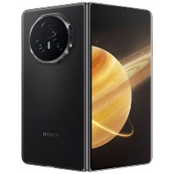
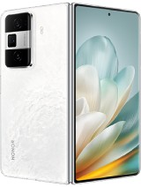
Honor beats own thinnest foldable record with the new Magic V3
Honor has been at the forefront of foldable phone innovation for a few years now, particularly around silicon battery use, making the phones thinner and lighter. The stated aim of this is to make book-style foldables indistinguishable in form and weight from regular smartphones when folded, while having the larger inner screen for entertainment and productivity uses.
This continues with the newly announced Magic V3, which is 0.8mm thinner than the previous V2, which was 10.1mm thick when folded. It also shaves 5g off the V2, down from 231g to 226g—making it lighter than the Samsung Galaxy S24 Ultra.
There are other hardware improvements, including a new Snapdragon 8 Gen 3 chip, improved 50MP 3.5x zoom telephoto, an inner display camera, more battery capacity, and an IPX8 water resistance rating.
It is worth noting, however, that the entry-level Magic V2 had 16GB of RAM, while the entry-level Magic V3 has 12GB.
The Magic V3 and Vs3 will be exclusive to China at launch, and there is currently no indication which international markets Honor will expand it to.
Model | Honor Magic V3 | Honor Magic Vs3 | Samsung Galaxy Z Fold6
Thinness and weight | Unfolded: 4.4mm Folded: 9.3 mm 226g | Unfolded: 4.65mm Folded: 9.8 mm 229g | Unfolded: 5.6mm Folded: 12.1 mm 239g
Main Display | 7.92”, 2344x2156, 120Hz LTPO OLED, 1800 nits peak brightness | 7.92”, 2344x2156, 120Hz LTPO OLED, 1800 nits peak brightness | 7.6”, 2160x1856, 120Hz LTPO OLED, 2600 nits peak brightness
Sub Display | 6.43”, 2376x1080, 120Hz LTPO OLED, 2500 nits peak brightness | 6.43”, 2376x1080, 120Hz LTPO OLED, 2500 nits peak brightness | 6.3”, 2376x989, 120Hz LTPO OLED, 1600 nits peak brightness
Chipset | Snapdragon® 8 Gen 3 | Snapdragon® 8 Gen 2 | Snapdragon® 8 Gen 3
Memory | 256GB–1TB ROM, 12-16GB RAM | 256GB–1TB ROM, 12-16GB RAM | 256GB–1TB ROM, 12GB RAM
Main cameras | 50MP wide with OIS 50MP telephoto, 3.5x zoom 40MP ultrawide, 112˚ range | 50MP wide with OIS 8MP telephoto, 5x zoom 40MP ultrawide, 112˚ range | 50MP wide with OIS 10MP telephoto, 3x zoom 12MP ultrawide, 123˚ range
Front camera | 20MP wide (inner display) 20MP wide (outer display) | 16MP wide (inner display) 16MP wide (outer display) | 4MP wide (inner display) 10MP wide (outer display)
Battery | 5160mAh with 66W wired and 50W wireless charging | 5000mAh with 66W wired and 50W wireless charging | 4400mAh with 25W wired and Fast Wireless Charging 2.0
Launch price | CNY8,999 ($1239) | CNY6,999 ($964) | $1,899
Source: Omdia
Image Sources: Honor and Samsung

Slide 6
“Honor continues to make its foldables thinner, with lighter materials, optimized hinges, and ultrathin batteries—with higher silicon materials to enable a 10% higher capacity without increasing the body size. In addition, the Honor Magic V3 has a higher resolution camera module, with a more powerful zoom. Add on IPX8 water resistance and 50W wireless charging, and it is even more surprising (and noteworthy) that it has not increased in price compared to the previous generation Magic V2—unlike Samsung’s counterparts.”
Zaker Li
Principal Smartphone Analyst, Consumer Devices

Slide 7
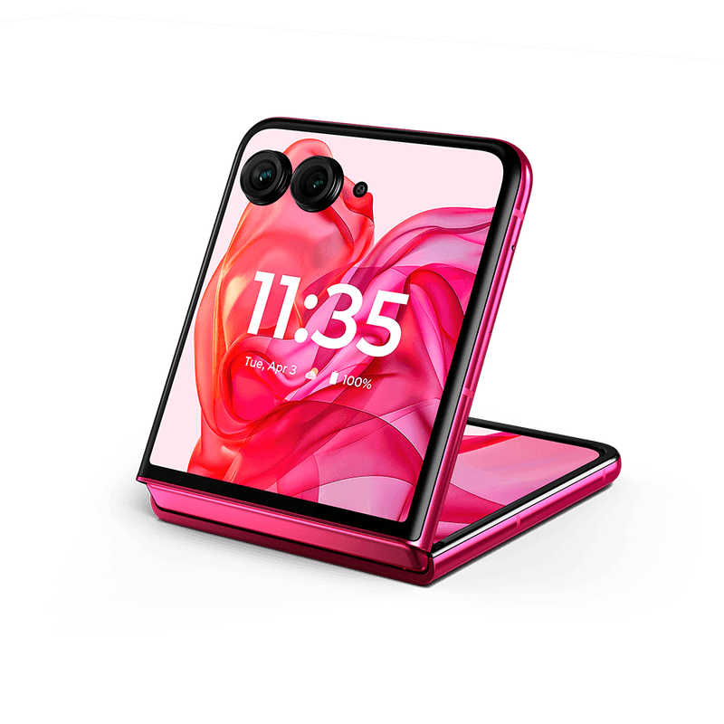
Lenovo introduces smartphone AI with newly released Motorola Razr
Lenovo launched the latest Motorola Razr series on June 25, with a big emphasis on the much-anticipated AI features. The series includes the standard Razr 2024 and the high-end Razr+ 2024. Outside the US, these are named the Razr 50 and Razr 50 Ultra.
Both were highlighted for having the “most intelligent” cover display of any flip-type foldable, with AI-powered applications accessible from this external screen, such as the Google Gemini app and Google Photos.
The higher-end Razr+ beats the Samsung Galaxy Z Flip6 on hardware in many ways. On displays, it has a large 4-inch external display and a 6.9-inch LTPO OLED main display, with a staggering 165Hz refresh rate and 3000 nits peak brightness. It also has 50MP telephoto camera with 2x optical zoom.
The one area where the Razr+ 2024 doesn’t match the Z Flip6 is the chipset; it uses the Snapdragon 8s Gen 3, a slightly slower version of the Snapdragon 8 Gen 3.
Lenovo also claims to have improved the hinge design, so it is usable with one hand, making it “ideal for dramatic hang-ups.”
Motorola is following Nokia’s trend of calling back to classic feature phones, with the Razr+ 2024 coming in a bright pink color inspired by the 2004 Razr V3 Pink.
The Ultra model is priced at $999/£999, and the standard version at $700/£799.
Motorola Razr+ 2024 in hot pink color inspired by the 2004 Razr V3 Pink
Source: Motorola

Slide 8
“Chinese OEMs offer little competition to Samsung in the foldable market, due to frequently being exclusive to the China market—so the Z Fold6 is still the go-to book-style foldable. However, for flip-style foldables, Motorola has slowly been increasing its competition with the Z Flip. The latest Razr+ 2024 is not only cheaper than the new Z Flip6 but has more impressive hardware in every way, other than the chipset, meaning the competition against Samsung is going to be even stronger.”
Aaron West
Senior Smartphone Analyst, Consumer Devices

Slide 9
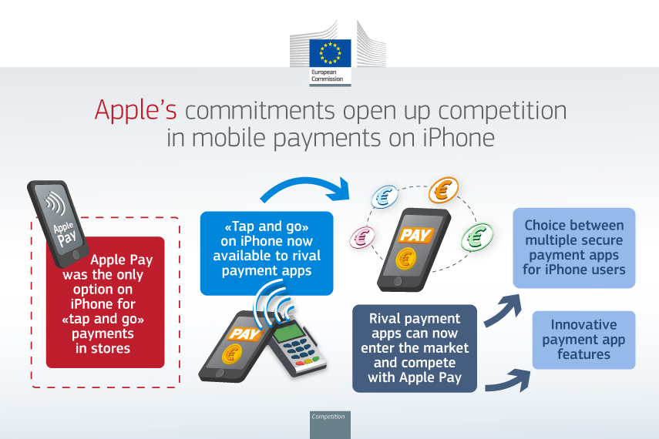
Apple and the European Commission’s dispute continues as Apple announces its AI features will not be coming to the EU
Despite the big announcement in June that Apple would be launching its version of AI called “Apple Intelligence” later this year, the company has now revealed that this won’t be coming to iPhones and iPads in the EU. This is due to reported “uncertainties” surrounding the EU’s Digital Markets Act, which has already forced Apple to make several concessions.
Margrethe Vestager, European Commission VP in charge of competition policy, said: “So Apple have said that they will not launch their new enabled features in the IRS environment, and they say that they will not do that because of the obligations that they have in Europe. And the obligations that they have in Europe, it is to be open for competition, that is sort of the short version of the DMA. And I find that very interesting, that they say we will now deploy AI where we’re not obliged to enable competition. I think that is the most sort of stunning, open declaration that they know 100% that this is another way of disabling competition, where they have a stronghold already.”
One of these recent concessions includes extending NFC and tap-to-pay functions to third-party applications, not just Apple Pay. Apple formally settled on and agreed to this, although only for devices in the 27 EU member countries, and only for 10 years. It is not yet clear if this 10-year concession window fits with the Digital Markets Act, although this has been approved by the European Commission for now.
This comes after much back-and-forth between Apple and the EU regarding the App Store being deemed uncompetitive for the digital music industry, with Spotify advocating for Apple to see stricter regulation.
Official graphic from the European Commission outlining its agreement with Apple
Source: European Commission

Slide 10
“The EU is a key market for Apple, yet its relationship with regulators in the region is becoming increasingly fraught. Whether it’s over anti-competitive practices or measures that limit right-to-repair, the EU is coming for Apple on multiple fronts. Apple’s announcement that it will not be bringing its AI features to the EU feels significant; it’s an escalation of this conflict and a slight admission from Apple that it knows it would be deemed as not meeting competition laws.”
Aaron West
Senior Smartphone Analyst, Consumer Devices

Slide 11
Appendix

Slide 12
Appendix
Further Reading
“Samsung announces 6th generation foldable smartphone focusing on conservative hardware improvements” Jusy Hong (July 2024)
MWC Shanghai 2024 Summary Zaker Li (July 2024)
MediaTek outgrowing Qualcomm Snapdragon in the 5G smartphone market Aaron West (July 2024)
Smartphone Market Performance Summary of JD.com’s 618 Shopping Festival Zaker Li (June 2024)
Authors
  Jusy Hong, Senior Research Manager, Components & Devices – Wireless Devices
  Zaker Li, Principal Analyst, Components & Devices – Mobile Handsets
  Aaron West, Senior Analyst, Components & Devices – Mobile Handsets
  askananalyst@omdia.com
  Omdia Consulting
  We hope that this analysis will help you make informed and imaginative business decisions. If you have further requirements, Omdia’s consulting team may be able to help you. For more information about Omdia's consulting capabilities, please contact us directly at consulting@omdia.com.
  Citation Policy
  Request external citation and usage of Omdia research and data via citations@omdia.com.

