Slide 1
Smartphone Need-To-Know – August 2024
  Jusy Hong, Senior Research Manager, Consumer Devices
  Zaker Li, Principal Analyst, Consumer Devices
  Aaron West, Senior Smartphone Analyst, Consumer Devices
  askananalyst@omdia.com

Slide 2
Contents
Global smartphone shipments continue to rise year-on-year for third consecutive quarter in 2Q24 3
Google brings Gemini AI to its phones’ personal assistant 5
New Google Pixel 9 series phones announced, including new foldable 7
Samsung Olympic sponsorship sees every athlete gifted a unique Z Flip6 Olympic Edition 9
Appendix 11

Slide 3
Global smartphone shipments continue to rise year-on-year for the third consecutive quarter in 2Q24
Global smartphone shipments totaled 290.3 million units in 2Q24. Compared to the previous year, this shows a 9.3% rise, following the 11.5% increase in 1Q24 and 8.6% increase in 4Q23. Compared to the previous quarter, this represents a 3.2% fall.
The slow growth indicates the industry is settling into sustainable levels of global shipments following strong growth between 4Q20 and 3Q21 and a decline in 2022. Many OEMs recorded large double-digit year-on-year growth, including Xiaomi, Vivo, Motorola, Realme, and Huawei, with Apple and Transsion seeing more moderate growth. Transsion, which previously saw triple-digit growth, recorded 4.1% growth.
Recently, the smartphone market has been experiencing accelerated polarization, with the mid-range market shrinking, and the low- and high-end markets increasing proportionally. Accordingly, while brands with a high proportion of low-end and high-end smartphones are increasing their shipments, brands with a high proportion of mid-end smartphones are struggling. Samsung, in particular, is facing challenges in the $250–600 mid-end price segment, where it generates most of its shipments.
While we had already anticipated that shipments in H124 would increase compared to the previous year, the higher shipments in both the first and second quarters compared to previous forecasts are adding to our belief that demand in the second half of the year will not be as bad as expected.
Quarterly results, 2Q24 (millions of units)
Rank | OEM | 2Q24 |  | 1Q24 |  | 2Q23 |  | QoQ | YoY
 |  | Shipment | M/S | Shipment | M/S | Shipment | M/S
1 | Samsung | 53.7 | 18% | 60.4 | 20% | 53.3 | 20% | -11.2% | 0.7%
2 | Apple | 45.6 | 16% | 50.7 | 17% | 43.2 | 16% | -10.1% | 5.6%
3 | Xiaomi | 42.3 | 15% | 40.8 | 14% | 33.2 | 13% | 3.7% | 27.4%
4 | vivo | 26.0 | 9% | 23.0 | 8% | 22.3 | 8% | 13.0% | 16.6%
5 | Transsion | 25.5 | 9% | 27.5 | 9% | 24.5 | 9% | -7.3% | 4.1%
6 | Oppo Group | 25.2 | 9% | 25.0 | 8% | 25.0 | 9% | 0.8% | 1.0%
7 | Honor | 15.5 | 5% | 16.5 | 6% | 14.1 | 5% | -6.1% | 9.9%
8 | Motorola | 13.5 | 5% | 13.0 | 4% | 10.4 | 4% | 3.8% | 29.2%
9 | Realme | 12.3 | 4% | 10.1 | 3% | 10.1 | 4% | 21.8% | 21.8%
10 | Huawei | 11.7 | 4% | 13.1 | 4% | 7.4 | 3% | -10.7% | 58.1%
 | Others | 19.0 | 7% | 19.8 | 7% | 22.1 | 8% | -4.1% | -13.9%
 | Total | 290.3 | 100% | 300.0 | 100% | 265.6 | 100% | -3.2% | 9.3%
Notes: M/S stands for market share. OPPO Group includes OPPO and OnePlus. Transsion includes Tecno, itel, and Infinix. Source: Omdia |  |  |  |  |  |  |  | © 2024 Omdia

Slide 4
“Chinese OEMs continue to see increased shipments as demand recovers in the Asia & Oceania region. While some Chinese OEMs remain somewhat conservative about 2H24 demand, based on performance in 1H24, it is certain that global smartphone shipments this year will increase compared to last year, with the growth rate likely to be higher than initially expected.”
Jusy Hong
Senior Research Manager,
Consumer Devices

Slide 5
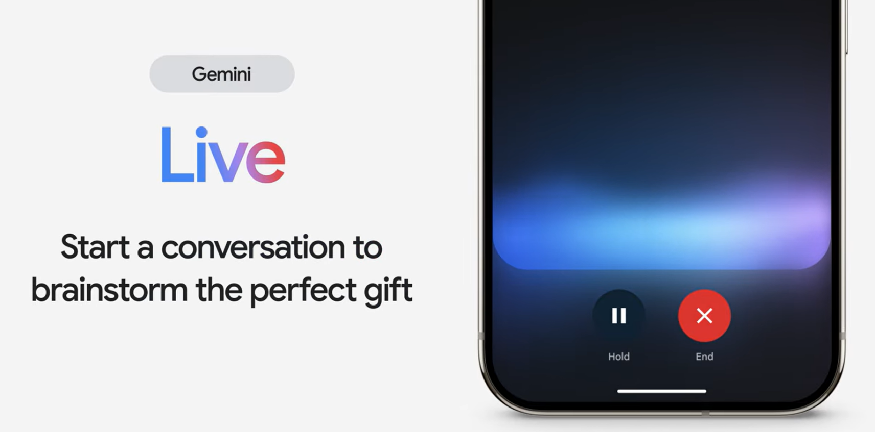
Google brings Gemini AI to its phones’ personal assistant
Google used its annual Made By Google keynote in October 2023 to launch Gemini AI on its Pixel 8 series. On August 13, Google brought forward this event to announce the Pixel 9 series earlier in the year and to show off Google’s latest AI innovations and plans, including how Google will manage personal data within hybrid AI.
The biggest announcement was that Gemini AI is taking over from Google’s personal assistant to allow users to ask questions and control their calendar, tasks, emails, notes, and more with their voice. In a live demonstration—which took multiple attempts to work—Gemini was used to scan a concert tour poster and combine that information with a personal calendar to suggest a day the user was free to attend.
By embedding truly context-aware AI, Google has brought us one step further to welcoming fully personable and knowledgeable AI into our lives.
Gemini Live AI conversation demonstration video from Google
Image source: Google
Part of this development is the new Gemini Live, a free-flowing conversation with AI that allows users to develop rapport—although this is only available to Gemini Advanced subscribers. This part of AI development is slowly looking more and more like the Scarlett Johansson-voiced AI assistant from the 2013 movie Her, which seems to be the end goal for Google and other smartphone brands.
Another AI feature coming exclusively to the Pixel 9 is Call Summary, which provides a summary note following a call, saving meeting details and telephone numbers during the call.
Also, Pixel Screenshots stores and organizes all your screenshots, allowing you to search, recall, and ask questions later, even storing the source page to allow you to revisit it.

Slide 6
“Monetizing and ensuring that the vast amount of investment being put into AI will pay dividends is a coming challenge for the industry. ChatGPT was made as a free product, costing $5bn to develop. Convincing people to pay for what used to be free is the biggest challenge of the AI industry—meaning convincing people to invite AI into their everyday lives. Google is laying the groundwork, though, with one year of Gemini Advanced included when buying a new Pixel 9 Pro phone.”
Aaron West
Senior Smartphone Analyst, Consumer Devices

Slide 7
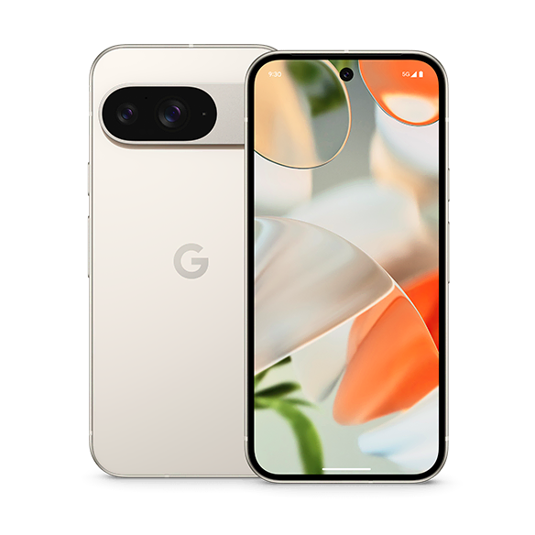
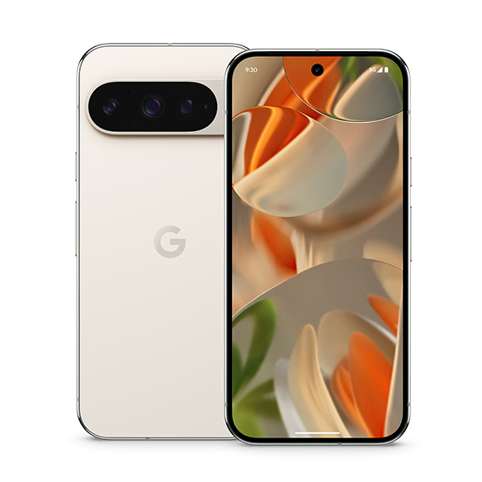
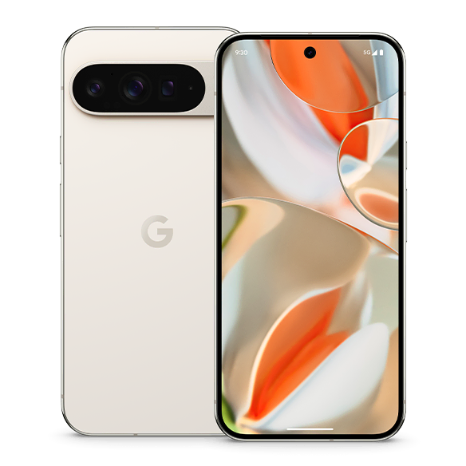
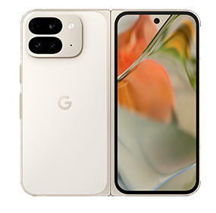
New Google Pixel 9 series phones announced, including new foldable
The latest generation of Google Pixel phones was announced at the Made By Google event, bringing forward its release month from October annually to August.
The line-up of phones expanded from two to four, with the Pro phones now coming in two sizes: one in the original larger size called the 9 Pro XL, and a new smaller version, matching the size of the standard Pixel 9.
The Google Pixel Fold is also being included in the 9 series, called the 9 Pro Fold, despite only being in its 2nd generation.
All use the latest Google Tensor G4 chip, developed with Samsung and similar to its Exynos series. This, along with the upgraded RAM, is the largest hardware improvement in the Pixel phones, which focus on AI processing.
They will also all support seven major Android upgrades, lasting until 2031.
At the event, Google also announced the new Google Buds Pro and Google Watch.
Model | Pixel 9 | Pixel 9 Pro | Pixel 9 Pro XL | Pixel 9 Pro Fold
Thinness and weight | 8.5mm 198g | 8.5mm 199g | 8.5mm 221g | Unfolded: 5.1mm Folded: 10.5mm 257g
Main display | 6.3” Inches, 1080x2424, 120Hz OLED, 2700 nits peak brightness | 6.3” Inches, 1280x2856, 120Hz LTPO OLED, 3000 nits peak brightness | 6.8” Inches, 1344x2992, 120Hz LTPO OLED, 3000 nits peak brightness | 6.3” Inches, 1080x2424, 120Hz OLED, 2700 nits peak brightness
Sub display |  |  |  | 8.0” Inches, 2076x2152, 120Hz LTPO OLED, 2700 nits peak brightness
Memory | 128–256GB ROM, 12GB RAM | 128GB–1TB ROM, 16GB RAM | 128GB–1TB ROM, 16GB RAM | 256–512GB ROM, 16GB RAM
Main cameras | 50MP wide with OIS 48MP ultrawide, 123˚ range | 50MP wide with OIS 48MP telephoto, 5x zoom 48MP ultrawide, 123˚ range | 50MP wide with OIS 48MP telephoto, 5x zoom 48MP ultrawide, 123˚ range | 48MP wide with OIS 10.8MP telephoto, 5x zoom 10.8MP ultrawide, 127˚ range
Front camera | 10.5MP ultrawide | 42MP ultrawide | 42MP ultrawide | 10MP wide (inner), 10MP wide (outer)
Battery | 4700mAh with 27W wired and 15W wireless charging | 4700mAh with 27W wired and 21W wireless charging | 5060mAh with 37W wired and 23W wireless charging | 4650mAh with 21W wired and 7.5W wireless charging
Launch price | $799 | $999 | $1,099 | $1,799
Source: Omdia
Image Sources: Google

Slide 8
“The latest AI features will run exclusively on Pixel 9 phones—likely cascading down to other flagship Android devices over the next year, as low-end devices continue to rely on cloud computing. Developing first for Pixel and then leveraging the entire Android ecosystem has been key to Google’s AI strategy so far, with Pixel phones accounting for just 1% of Android phone shipments in 2023. Even in its top markets, Pixel phones typically have less than a 10% share. However, with the Pixel 9 series, Google is looking to expand into nine new countries, most of which are in Central and Eastern Europe.”
Aaron West
Senior Smartphone Analyst, Consumer Devices

Slide 9
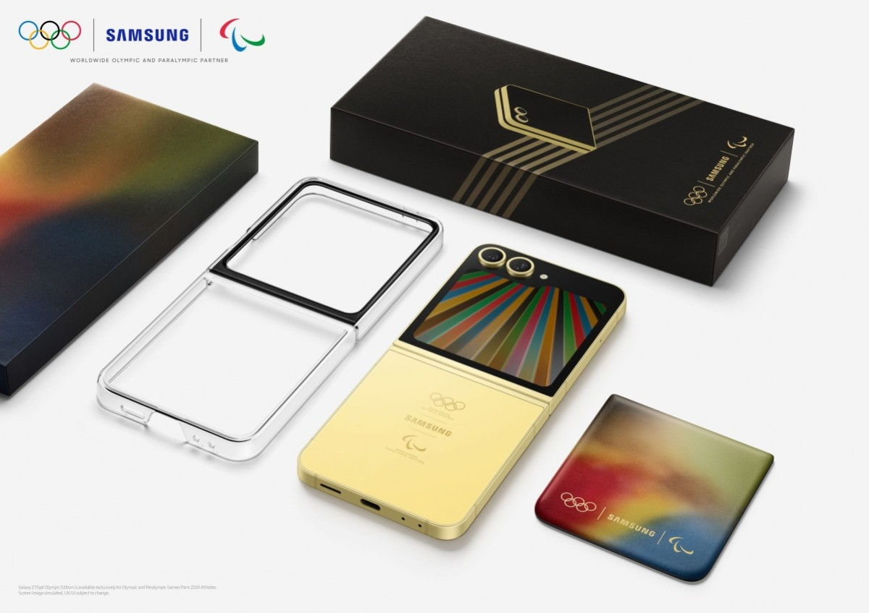
Samsung Olympic sponsorship sees every athlete gifted a unique Z Flip6 Olympic Edition
Samsung introduced the Galaxy Z Flip6 Olympic Edition prior to the games, later gifting one to the nearly 17,000 participating athletes of the Paris 2024 Olympics and Paralympics.
The medal ceremonies at the Olympics were also used as a promotion opportunity, with the medal-winning athletes taking victory selfies with Z Flip6—a key advertised feature of the phone.
Galaxy S24 Ultras were also used to film the sailing contests at the games, with the phones strapped to the side of the boats, livestreaming the progress of each—a great way of testing the phones’ optical image stabilisation.
This comes following Samsung’s long partnership with the International Olympic Committee (IOC), first starting in 1998 for the Nagano Winter Olympics. Samsung has used the Olympics as an opportunity to launch customized Galaxy phones since Sochi 2014, with a special edition of the Galaxy Note 3.
The Flip6 is the second foldable to receive Olympic treatment after the special Winter Dream White variant of the Galaxy Z Flip3 5G, launched for Beijing 2022.
Samsung Z Flip6 Olympic Edition given to all athletes at the Paris 2024 Olympics
Image source: Samsung

Slide 10
“Z Flip6 improved several weak points compared to its predecessor, but it is still expected to struggle to increase sales due to its increased price. In addition, the high preference for Apple among the younger generation—the main target consumer group—is also a difficulty that must be overcome to increase sales of the Galaxy Flip.”
Jusy Hong
Senior Research Manager,
Consumer Devices

Slide 11
Appendix

Slide 12
Appendix
Further Reading
“Google brings Gemini AI to its phones’ personal assistant, but whether AI will be profitable remains to be seen” (August 2024)
Global Smartphone Shipment Preliminary Result – 2Q24 (August 2024)
“Samsung announces 6th generation foldable smartphone focusing on conservative hardware improvements” (July 2024)
Authors
  Jusy Hong, Senior Research Manager, Consumer Devices
  Zaker Li, Principal Analyst, Consumer Devices
  Aaron West, Senior Smartphone Analyst, Consumer Devices
  askananalyst@omdia.com
  Omdia Consulting
  We hope that this analysis will help you make informed and imaginative business decisions. If you have further requirements, Omdia's consulting team may be able to help you. For more information about Omdia's consulting capabilities, please contact us directly at consulting@omdia.com.
  Citation Policy
  Request external citation and usage of Omdia research and data via citations@omdia.com.

