Slide 1
Smartphone Need-to-Know – September 2024
  Jusy Hong
  Senior Research Manager, Components & Devices – Mobile Handsets
  Zaker Li
  Principal Analyst, Components & Devices – Mobile Handsets
  Aaron West
  Senior Analyst, Components & Devices – Mobile Handsets
  askananalyst@omdia.com

Slide 2
Contents
Apple announces iPhone 16 series, ready for launch of Apple Intelligence later this year 3
Honor announces new Magic V3 smartphone at IFA 2024, the thinnest-ever book-style foldable 5
Huawei launches world’s first “tri-fold” phone, the Huawei Mate XT 7
HMD launches Barbie flip feature phone and Fusion modular smartphone 9

Slide 3
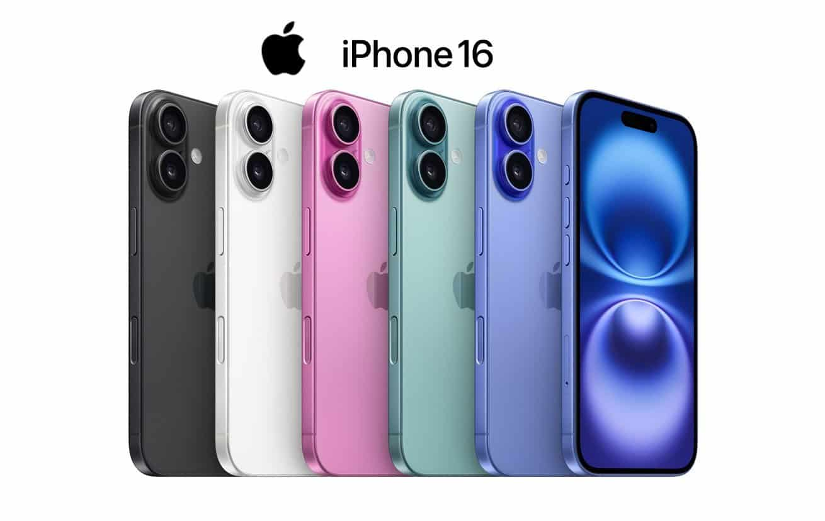
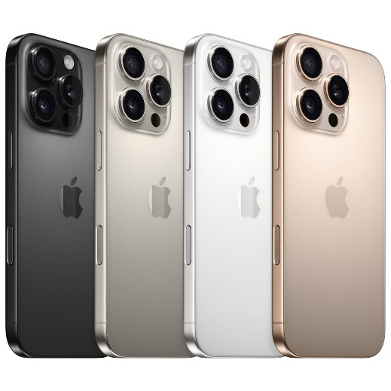
Apple announces new iPhone 16 series, ready for launch of Apple Intelligence later this year
At the Glowtime event on September 9, Apple announced its new iPhone 16 range, the Apple Watch 10, and the new AirPods 4.
The most significant and newsworthy upgrade to all iPhones is the new Camera Control, a touch-sensitive capacitive button on the side of the phone that allows for instant access to the camera, acts as a two-stage shutter button, and allows the user to zoom in and out and other controls with a light touch.
The new iPhone 16 and 16 Plus have been upgraded with an increased 8GB of RAM and a new A18 chipset. This is a significant improvement from the A16 chipset on the iPhone 15 and 15 Plus and skips entirely the A17 chipset that was on the iPhone 15 Pro and Pro Max. They are also available in three new colors: pink, teal, and ultramarine.
The new iPhone 16 Pro and Pro Max have fewer upgrades but are equipped with the new A18 Pro chipset, a slightly higher-powered version of the standard A18. It also comes in a new color called Desert Titanium.
The reason for many of these upgrades is ensure the new iPhones have the hardware ready for the launch of Apple Intelligence later this year. New AI features were showcased at the event, including generative AI (GenAI) image editing, text editing, Siri improvements, and image search. Many are similar to the Google Gemini and Galaxy AI features introduced earlier this year, although Apple’s Private Cloud Compute and its partnership with ChatGPT for larger queries is a key difference in how AI is being implemented in the Android ecosystem and iOS.
It was expected that Apple Intelligence would be ready to launch with iOS 18 this month. It was first announced at Apple WWDC in June 2024. However, the launch of Apple Intelligence has been delayed until iOS 18.1, iPadOS 18.1, and macOS Sequoia 15.1 with a target of October 2024 and with more features launching in the following months.
iPhone 16 in a range of new colors including pink, teal, and ultramarine
iPhone 16 Pro in all colors including the new Desert Titanium (right)
Source: Apple

Slide 4
“The new Camera Control button is arguably the biggest camera hardware upgrade to the iPhones since the addition of a second lens with the iPhone X, but it has wider implications than just iPhone photography. With Apple already priming the idea of AI image understanding, the Camera Control button could have big implications for how Apple Intelligence is implemented into the user experience.”
Aaron West
Senior Smartphone Analyst, Consumer Devices

Slide 5
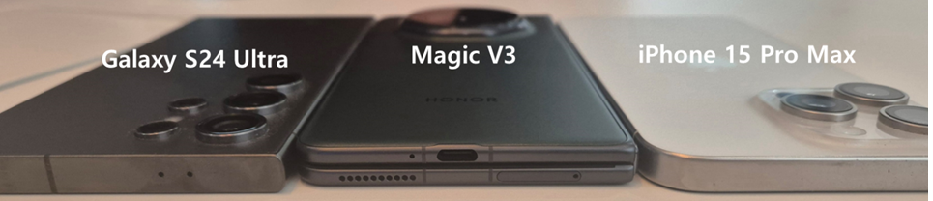
Honor announces new Magic V3 smartphone at IFA 2024, the thinnest-ever book-style foldable
IFA 2024 was very light on smartphone exhibitors and announcements, except for Honor. The Chinese brand used the largest European consumer electronics trade show to announce its latest foldable phone, the Magic V3.
The V3 is the successor to the V2, which was 9.9mm thick when folded and 4.7mm thick unfolded, making it the thinnest foldable phone until now. The V3 breaks this record: it is 9.2mm folded and 4.35mm unfolded, just a few mm thicker than the USB-C type port, which may be the limit of how thin it can become.
This is achieved alongside other hardware improvements including a periscope back camera, improved front-facing cameras, increased 5,160mAh battery capacity, and IPX8 water resistance.
It is powered by the Snapdragon® 8 Gen 3 chipset, meaning it has the latest Honor Magic AI features including the Magic Portal drag-and-drop user interface feature.
Over the past three generations of foldables, Honor has resolved many of the inconvenience issues that plagued foldable phones, including thickness, weight, and battery life. However, the price remains a key problem. The Honor foldables are priced much higher outside China at around $1,799, more than the CNY8,999 ($1,270) they cost in China. This will limit overseas sales considerably.
Source: Omdia analyst
Model | Honor V3 | Honor V2
Thinness and weight | Unfolded: 4.35mm Folded: 9.2mm 226g | Unfolded: 4.7mm Folded: 9.6mm 231g
Main display | 6.43 inches, 1,060×2,376, 120Hz OLED, 5,000 nits peak brightness | 6.43 inches, 1,060×2,376, 120Hz OLED, 2,500 nits peak brightness
Sub display | 7.92 inches, 2156×2,344, 120Hz LTPO OLED, 1,800 nits peak brightness | 7.92 inches, 2156×2344, 120Hz LTPO OLED, 1,600 nits peak brightness
Memory | 128–256GB ROM, 12–16GB RAM | 256–512GB ROM, 16GB RAM
Main cameras | 50MP wide with OIS 50MP periscope, 3.5× zoom and OIS 40MP ultrawide | 50MP wide with OIS 20MP telephoto, 2.5× zoom and OIS 50MP ultrawide
Front camera | 20MP (inner), 20MP (outer) | 16MP (inner), 16MP (outer)
Battery | 5,160mAh with 66W wired and 50W wireless charging | 5000mAh with 66W wired and no wireless charging
Launch price | CNY8,999 | CNY8,999
Source: Omdia, Honor |  | © 2024 Omdia

Slide 6
“The price of foldable smartphones has been rapidly falling in recent years. As of the second quarter of 2024, the average selling price of foldable smartphones worldwide was $1,180, and the average price of book-type foldables was $1,444, a drop of nearly $300 from the same period two years ago. Chinese OEMs are aggressively targeting foldable phones at more affordable prices, mostly in the domestic China market. Sales in overseas markets are still very low and mostly dominated by Samsung.”
Jusy Hong
Senior Research Manager,
Consumer Devices

Slide 7
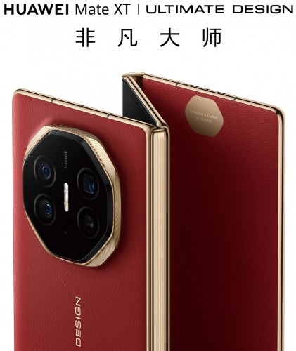
Huawei launches world’s first “tri-fold” phone, the Huawei Mate XT
Huawei announced the new Mate XT just hours after the iPhone 16 announcement and a year after the Chinese company had announced its new P60 following the iPhone 15 announcement in September 2023.
The XT is a significant innovation in foldable hardware, featuring two hinges to allow users unfold the display twice, extending the 6.4-inch display first into a 7.9-inch inner display and then to its 10.2-inch full size.
When entirely folded up, the XT is 12.8mm thick, making it noticeably larger than other premium devices and similar in thickness to the 12.1mm Samsung Z Fold6. At 298g, it is also roughly 20–30% heavier than other premium smartphones. However, when it is unfolded, its display is just 3.6mm thick, beating even the Honor V3.
Its full display is a 10.2-inch tri-foldable LTPO OLED with a 120Hz refresh rate and a 2,232×3,184 resolution, meaning it has a 16:11 widescreen, ready for “cinema-level immersive viewing,“ according to Huawei. With widescreen content not fitting the square-like inner screen of book-style foldables, this is a significant improvement to the use case of foldable phones.
It runs on Huawei’s own HarmonyOS and a Kirin 9000 series chipset with 16GB of RAM on all variants.
But with a battery capacity of just 4,400mAh (the same as the Samsung Z Fold6), there are concerns that this will not be enough considering the increased power use of the larger display.
The XT comes in red and black, starting at 256GB and going up to 1TB of storage options, and costs CNY19,999–21,999 ($2,824–3,106).
Huawei tri-fold Mate XT phone
Source: Huawei

Slide 8
“The Huawei Mate XT is a significant innovation in smartphone hardware in many ways. It is ultrathin, just 3.6mm thick when unfolded, and expands out to a 10.2-inch panel. When closed it is 12.8mm thick, noticeably thicker than other phones. It weighs 298g, making it heavier too. With a starting retail price of CNY19,999 ($2,824), it is twice the price of other premium devices. Despite this, demand for the limited amount being sold has been high: the phone has already sold out, and some resellers are reportedly asking for more than $6,000.”
Zaker Li
Principle Analyst,
Consumer Devices

Slide 9
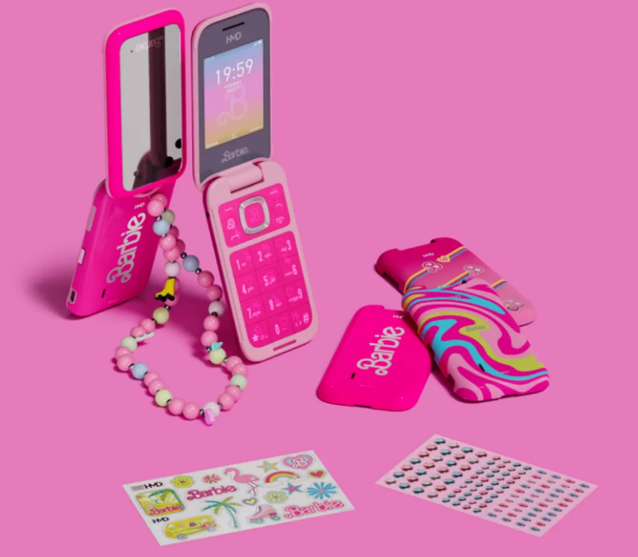
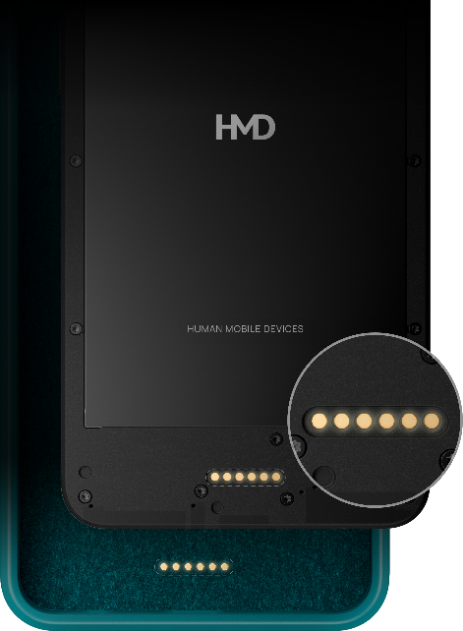
HMD launches Barbie flip feature phone and Fusion modular smartphone
After teasing it at MWC Barcelona 2024 in February, HMD has finally launched its Barbie flip phone, made in partnership with Mattel.
As a feature phone, it only takes calls and messages and has a small 2.3-inch TFT-LCD inner display with 240×320 resolution in a 4:3 ratio and a tiny 1.77-inch cover screen. The camera has just 0.3MP in Europe, although the US version, which is coming soon, will be equipped with a 5MP camera.
It is available for £99 on HMD in the UK and the EU, in selected retail stores in the UK, and will be coming to the US soon. There are also accessories, including a phone strap, replaceable covers, and decorative stickers and rhinestones.
HMD also released its new Fusion smartphone, which is much in line with the brand’s previous low-end devices but with a crucial difference. The HMD Fusion is equipped on the back with what HMD is calling “Smart Pin,” which will allow users to add “Smart Outfits” cases to the phone. These pins give power and two-way communication to the case to allow for uses such as handheld gaming controls, ring lights, camera grips, solar arrays, and more.
HMD says the Smart Outfits are all open source, and it will not gatekeep control. It hopes to incentivize third-party developers to create their own Smart Outfits for the phone.
It is not clear what HMD Fusion’s target audience is, but a key use case could be small business owners using the phone for work, whether that be as a payment terminal, barcode reader, or something else.
Users can also replace the screen and the battery, just as with previous HMD-made Nokia phones and the recently released HMD Skyline series. Parts are available via iFixit for seven years.
HMD Barbie phone with wrist strap, back cover, and sticker accessories (left) HMD Fusion phone with Smart Outfit capability highlighted (right)
Source: HMD/Mattel

Slide 10
“The Barbie phone is not only a fantastic marketing opportunity for both HMD and Mattel, it would also be a great starter phone for kids. Parents increasingly want to restrict how much access their kids have to full internet access and social media. Making a ‘dumb phone’ that still appeals to children is a fantastic way of introducing technology to the new generation.”
Aaron West
Senior Smartphone Analyst, Consumer Devices

Slide 11
Appendix

Slide 12
Appendix
Further reading
“Honor releases Magic V3, a foldable smartphone 9.2mm thin” (September 2024)
Authors
  Jusy Hong, Senior Research Manager, Components & Devices – Wireless Devices
  Zaker Li, Principal Analyst, Components & Devices – Mobile Handsets
  Aaron West, Senior Analyst, Components & Devices – Mobile Handsets
  askananalyst@omdia.com
Omdia Consulting
  We hope that this analysis will help you make informed and imaginative business decisions. If you have further requirements, Omdia's consulting team may be able to help you. For more information about Omdia's consulting capabilities, please contact us directly at consulting@omdia.com.
Citation Policy
  Request external citation and usage of Omdia research and data via citations@omdia.com.

