Slide 1
Event Recap:
MSP Summit by Channel Partners Conference & Expo – 2024
Event date: September 16–19, 2024
Devan Adams
Principal Analyst, Channel Research & Consulting
askananalyst@omdia.com

Slide 2


MSP Summit – 2024: Omdia team at the event
Omdia’s Channel Research and Consulting Practice team
Debbie Kane
Principal Consultant​
Omdia Channel Research ​
& Consulting Practice
Devan Adams
Principal Analyst
Omdia Channel Research ​
& Consulting Practice

Slide 3
Contents
Show overview 05
Top stories 08
Key takeaways 11
  Channel market TAM 12
  Thriving MSPs 13
  Be decisive 14
  Strategic artificial intelligence (AI) 16
  Pervasive cybersecurity threats 18
  DEI under attack 19
Final recommendations 21
Appendix 24

Slide 4
Key topics and channel trends
01
Channel market TAM Massive opportunities await
02
Thriving MSPs Capitalizing on growth
03
Be decisive Know your ‘Why’ to make better decisions
04
Strategic artificial intelligence (AI) The best path to monetization
05
Pervasive cybersecurity threats Every business is vulnerable
06
DEI under attack Bottom-line impact is crucial for survival

Slide 5
Show overview

Slide 6

Show overview:
The New Era Of Managed Service – Theme
Background: This year’s MSP Summit was presented as being the ultimate gathering of the top managed services professionals, coming together to discuss what will define the new era of managed services.
Theme: This year’s theme was ‘The New Era Of Managed Services’.
Attendees and exhibitors: Organizations from the entire channel ecosystem attended the event.
  Channel partners: managed service providers (MSPs)/managed security service providers (MSSPs), cloud services providers, value-added resellers (VARs), consultants, systems integrators, and independent software vendors (ISVs).
  Vendors/ suppliers: vendors that sell to, through, or with channel partners.
Approximately 100+ sponsors and exhibitors, and 1,000 attendees were at the event in Atlanta, GA.
Source: MSP Summit 2024, photo taken by Omdia analysts, September 2024
© 2024 Omdia

Slide 7
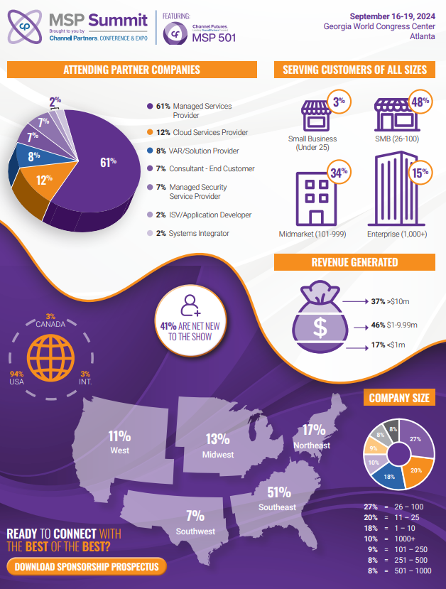
Show overview: Audience breakdown
MSP Summit Audience breakdown based on pre-show prospectus
MSP Summit hosted by Channel Partners Conference & Expo
  Channel partner attendees at the 2024 MSP Summit included a wide variety partners from different business types, geographies, company sizes, customer sizes served, and revenue bands.
  Attendees interacted and participated in various key activities to make connections and gather insights to help grow their businesses.
    Networking sessions
    Expo and exhibitor hall
    Workshops
    MSP 501 Awards Gala
Source: MSP Summit 2024, photo taken by Omdia analysts, September 2024
© 2024 Omdia

Slide 8
Top stories

Slide 9



Omdia view (1/2)
  Massive channel market opportunities
  Canalys estimates $4.9T IT total addressable market spend (TAM) in 2024 (~70% thru channel), which exemplifies the key role partners play in the customer buying journey.
  This further validates how instrumental partners are in businesses’ digital transformations, global expansion, and the growing small-medium business (SMB) space.
  MSPs are thriving
  In 2023, $475B managed services revenue was generated globally, by nearly 337K channel partners, per Canalys.
  MSPs are capitalizing on IT market trends like subscription-based service needs and evolving vendor go-to-market strategies by expanding their portfolios and partnerships accordingly.
  MVDs (Most valuable decision-makers)
  ‘The worst decision, is no decision’, says Paul Epstein. People make 35,000 decisions daily and each should focus on head, heart and hands.
  The most successful partners know their ‘Why’ and use it to drive better business decisions. Whether the decisions pertain to vendor onboarding, customer acquisitions, technology sells, or hiring.
Source: Omdia
© 2024 Omdia

Slide 10



Omdia view (2/2)
AI strategy before AI services
AI offers a huge opportunity, with nearly 80% of enterprises exploring or using it. This is driven by specific vertical applications, vast content generation, automation efficiencies, etc.
Yet, monetizing it remains a challenge and creating AI services requires a full playbook and framework based on best practices.
Cyber attackers don’t discriminate
In this new age of IT, every business environment is a cyber attack vulnerability.
The critical need for cybersecurity is boosted by increased threat landscapes, more prevalent and complex attacks, regulatory pressures related to data privacy laws, and cloud migration risks from protecting hybrid environments.
DEI is currently on trial
DEI is in a fragile state and needs to prove its worth to survive.
DEI initiatives are being de-prioritized as businesses face economic pressures to reduce expenses and raise profitability, emphasize near-term KPIs over long-term cultural investments, and remove previous advocates from leadership.
Source: Omdia
© 2024 Omdia

Slide 11
Key takeaways

Slide 12
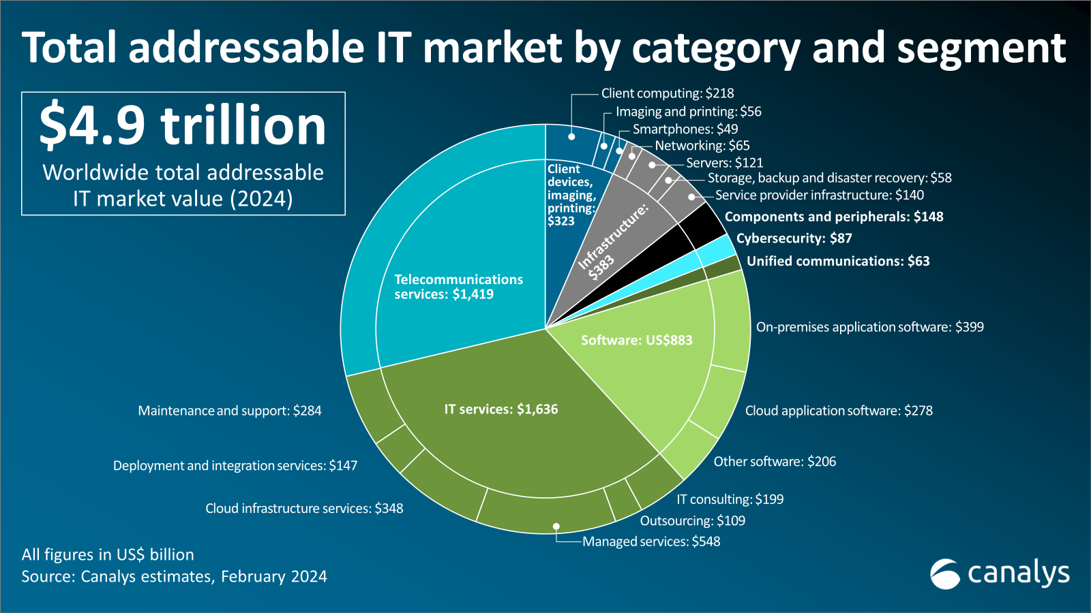
US$4.9T total addressable IT market in 2024
Keynote: “Hot Data”, led by Canalys (an Informa Tech company) Chief Analyst Jay McBain.
Key takeaways:
  $105T worldwide economy
    The world economy is growing at 2.9%, the tech industry (which makes up about 5% of world GDP) is growing at 6.2%, and MSPs are growing at 12% in a tough economic climate.
  $4.9T IT spend in 2024, with services outpacing hardware and software spend.
    Approximately 70% of IT spend will flowing to, through, or with channel partners.
    Managed services will represent $548B (12% Y/Y growth in 2024) and roughly 15 cents out of every IT dollar spent.
  89% of sales teams work with partners (per Salesforce) and 58% of those that don’t, plan to do so in the next year.
  The average customer has 7 partners they trust for buying decisions.
    Within the customer IT buying journey, partners play a major role in advising, designing, procuring, building, adopting and managing their solutions and magnifying 6-7x customer value.
Source: Canalys (an Informa Tech company)
© 2024 Omdia

Slide 13
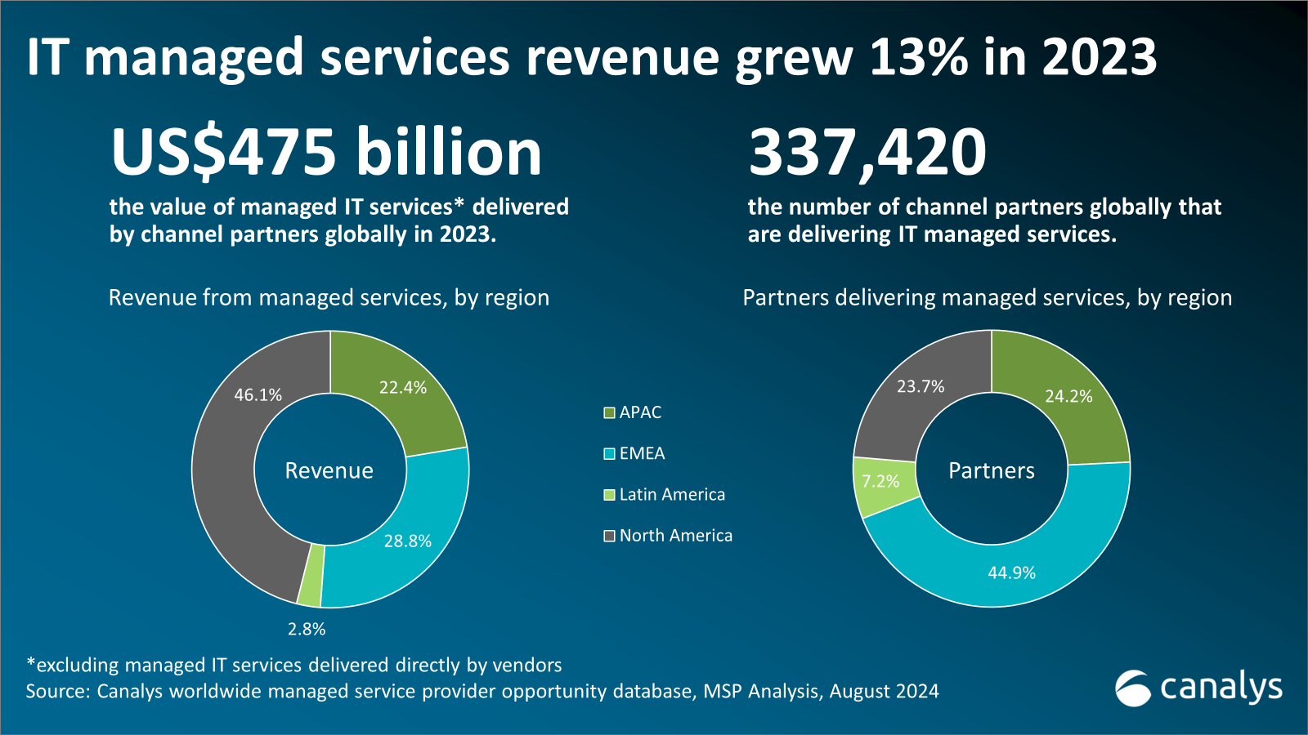
US$475B IT managed services revenue in 2023
Keynote: “Hot Data”, led by Canalys (an Informa Tech company) Principal Analyst Robin Ody.
Key takeaways:
  $475B managed services revenue generated globally in 2023, by roughly 337K channel partners.
  The United States accounted for $208B of managed services revenue in 2023, via approximately 73K channel partners.
    Of those partners delivering managed services: 21% were defined as MSPs (50% or more of total revenue from managed services).
  Within the managed services market
      Revenue obtained from small-medium business (SMBs) customers made up 57% of the total revenue, up 13% Y/Y.
      Revenue obtained from Enterprise customers made up 43%, of the total revenue, up +14% Y/Y.
    MSPs stated their biggest market challenges are
      New customer acquisition
      Customer budget constraints
      Bringing in new skilled staff
Source: Canalys (an Informa Tech company)
© 2024 Omdia
“The MSPs at the highest level treat their MSPs like an actual business. They’re businesspeople first; they’re technology people second.”
– Fred Voccola, CEO at Kaseya (Keynote: Channel Futures Interview)

Slide 14


Better decisions faster: The worst decision made is no decision, be decisive (1/2)
Keynote: “Better Decisions Faster” by Paul Epstein.
  Paul spent 15 years in leadership roles in the NFL and NBA, is a two-time bestselling author, and founder of the “Win Monday” Community.
  He gave a very powerful presentation which focused on helping us develop better decision-making skills and transitioning from an MVP (most valuable player) to an MVD (most valuable decision-maker) mentality.
Key takeaways:
  85% of people say the inability to make decisions is having a negative impact on their quality of life.
  On average, people make 35,000 decisions everyday.
  To make the best decisions, focus three key areas.
    Head-mindset (Do you think it is good idea).
    Heart-authenticity (Do you feel it is a good idea).
    Hands-actions (Do it).
  Decisiveness is a unique trait of successful people, regardless of results or outcomes (success/ failure) they’re able to capitalize on every opportunity.
Source: MSP Summit 2024, photo taken by Omdia analysts, September 2024
© 2024 Omdia

Slide 15
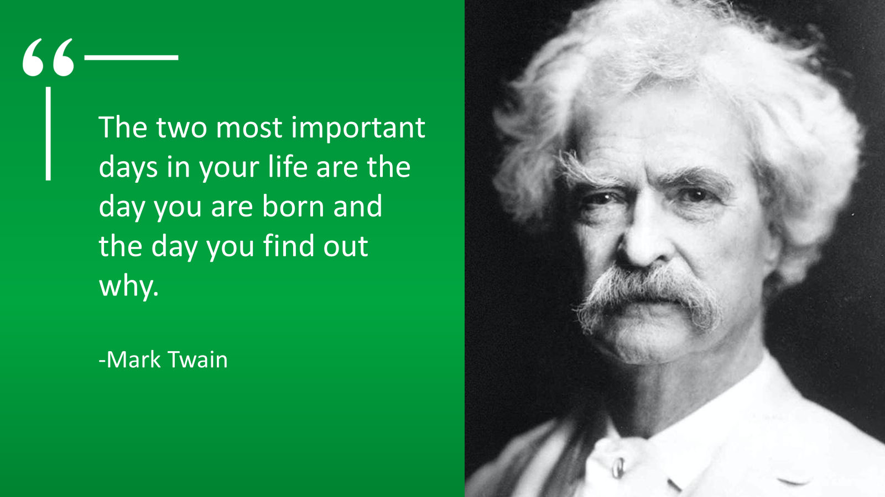
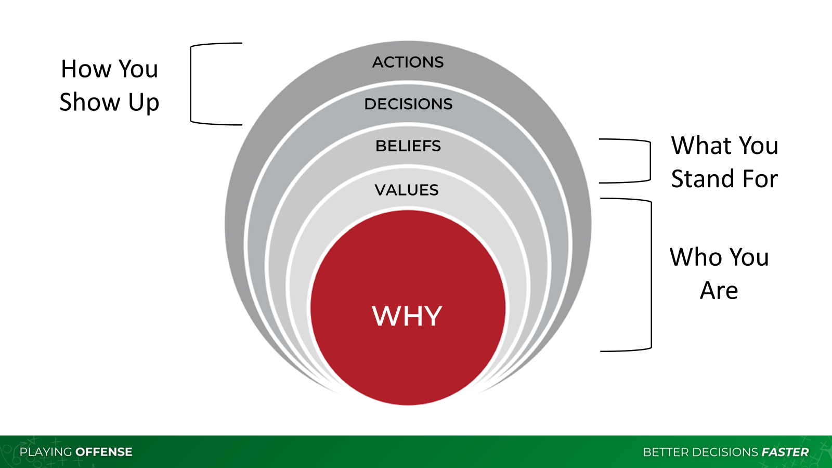
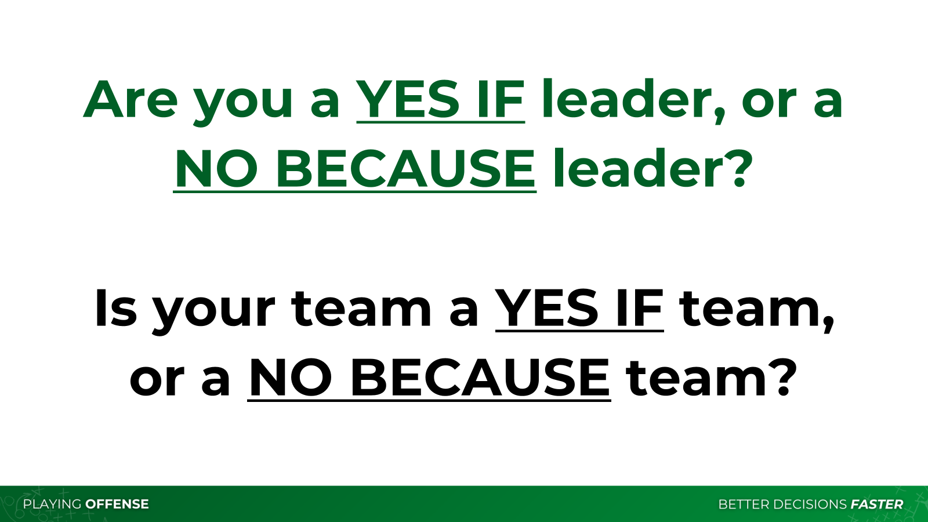
Better decisions faster: The worst decision made is no decision, be decisive (2/2)
Key takeaways (Continued):
  Finding your Why is critical to finding purpose
    The two most important days in your life are the day you are born and the day you find out why.
  The most successful people in life have alignment between the
    Outer layers (How you show up- Your decisions and actions).
    Inner layers (Who you are- Your ‘why’, values, and the beliefs you stand for).
  Adversity does not Build character, it Reveals it.
    The goal of every week should be to ‘Win Monday’ because Monday is birthplace of momentum.
      Every Monday, we should identify one occasion to transform a “No because” response to a “Yes if” opportunity. “Yes if”, is an optimistic approach vs. “No, because” is a dream killer, pessimistic approach.
Source: MSP Summit 2024, photo taken by Omdia analysts, September 2024
© 2024 Omdia

Slide 16
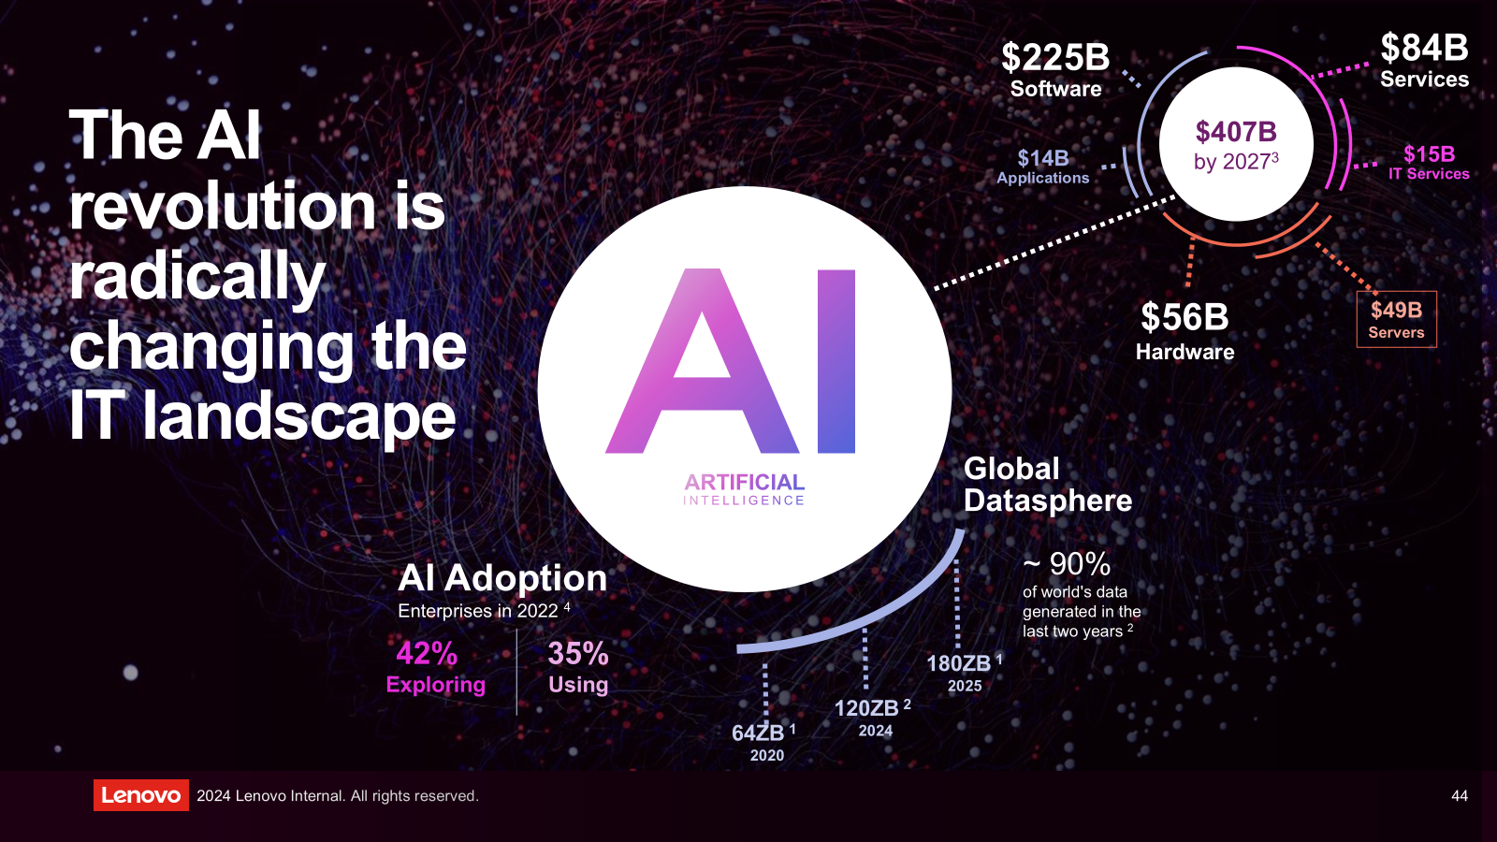
Vertical-specific AI applications represent massive opportunities
Keynote: “Smarter AI for All”, led by Cassie Jeppson, Director Channel Programs and Operational Strategy at Lenovo.
Key takeaways:
  The total addressable market for AI is expected to reach over $400 billion by 2027.
  AI transforms the way businesses operate, such as stimulating creativity and improving productivity; optimizing processes via improved data analysis and decision-making; and providing real-time insights that improve outcomes.
  5 steps to build a fully managed, secure, scalable AI services portfolio
    AI discovery- identify ways to create value
    Advisory- define outcomes, plan and roadmap
    Fast Start- design and build critical AI elements to display outcomes
    Deploy and scale- implement a secure and scalable AI system
    Management- continuously manage and optimize AI systems
  There are numerous verticals where MSPs can apply AI to support specific client needs:
    Manufacturing- predictive maintenance can reduce downtime by up to 40%.
    Healthcare- by 2025, 90% of hospitals will adopt AI for remote patient monitoring and early diagnostics.
    Finance- U.S. automobile lending firms will be able to cut losses by 23% annually using AI.
    Retail- AI will boost productivity by as much as +59% by 2035.
Source: MSP Summit 2024, photo taken by Omdia analysts, September 2024
© 2024 Omdia

Slide 17
Vertical-specific AI applications represent massive opportunities (2/2)
Keynote: “Smarter AI for All”, led by Cassie Jeppson, Director Channel Programs and Operational Strategy at Lenovo.
Key takeaways Continued:
  There are numerous verticals where MSPs can apply AI to support specific client needs:
    Manufacturing- predictive maintenance can reduce downtime by up to 40%.
    Healthcare- by 2025, 90% of hospitals will adopt AI for remote patient monitoring and early diagnostics.
    Finance- U.S. automobile lending firms will be able to cut losses by 23% annually using AI.
    Retail- AI will boost productivity by as much as +59% by 2035.
“You may lose your job to a robot, but you’re more likely to lose your job to someone who knows more about AI than you do"
– Doug Gray, Director of Data Science at Walmart Global Tech (Keynote: “AI Is Real: How Large Organizations Like Walmart Are Putting AI to Work”)
© 2024 Omdia

Slide 18
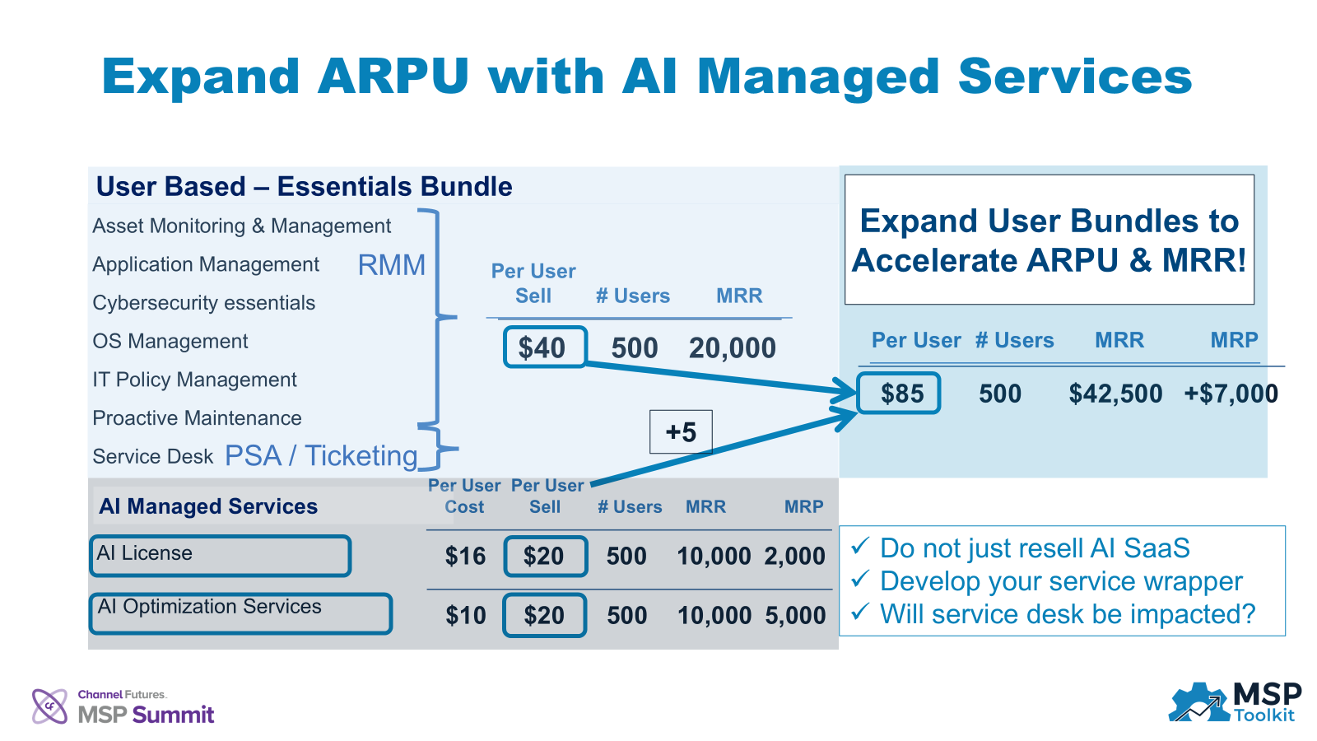
Best practices to design monetizable AI managed services
Keynote: Building Your AI Practice: A 60-Minute Crash Course, moderated by Len DiCostanzo, CEO of MSP Toolkit.
  Len moderated a panel which included Chuck Canton, Founder of Sourcepass; Chance Weaver, Vice President of New Charter Technologies; and Phil Christianson, Chief Product Officer of Xurrent. Len and the panel shared a playbook for MSPs to design their own AI practice.
Key takeaways:
  Understand client requirements- perform an assessment to understand their business objectives, pain points etc.
  Establish solution design basics- begin using off-the shelf AI solutions; then understand clients’ security structure, and location of critical data and intellectual property (IP).
  Data consideration- centralize data, then use AI to ensure data integrity to weave out good vs bad data, improving data quality and overall business solutions.
  AI solution deployment strategies- ensure integrated business systems​, focus on staff training like prompt engineering​, and use cloud-based AI solutions to avoid higher cost and supplier lock-in.
  AI managed services- create AI service bundles which are SaaS-based and offer monthly recurring revenue i.e., advanced analytics, training & adoption programs, optimization services, Co-pilot based services etc..
  Pricing consideration- consider AI services value-add and risks to tailor pricing models based on services delivered and costs e.g., hourly/per user developer services, flat fee AI assessments​, product plus services markup.
  Rapid prototyping- first test AI solutions in-house before selling to clients to understand use cases and best practices to understand key metrics and KPIs e.g., the average user saves 14 min/day with Co-pilot (per Microsoft).
  Client engagement- create a framework for AI privacy and security, and drive AI services awareness via webinars, workshops, and customer-initiated conversations.
Source: MSP Summit 2024, photo taken by Omdia analysts, September 2024
© 2024 Omdia

Slide 19
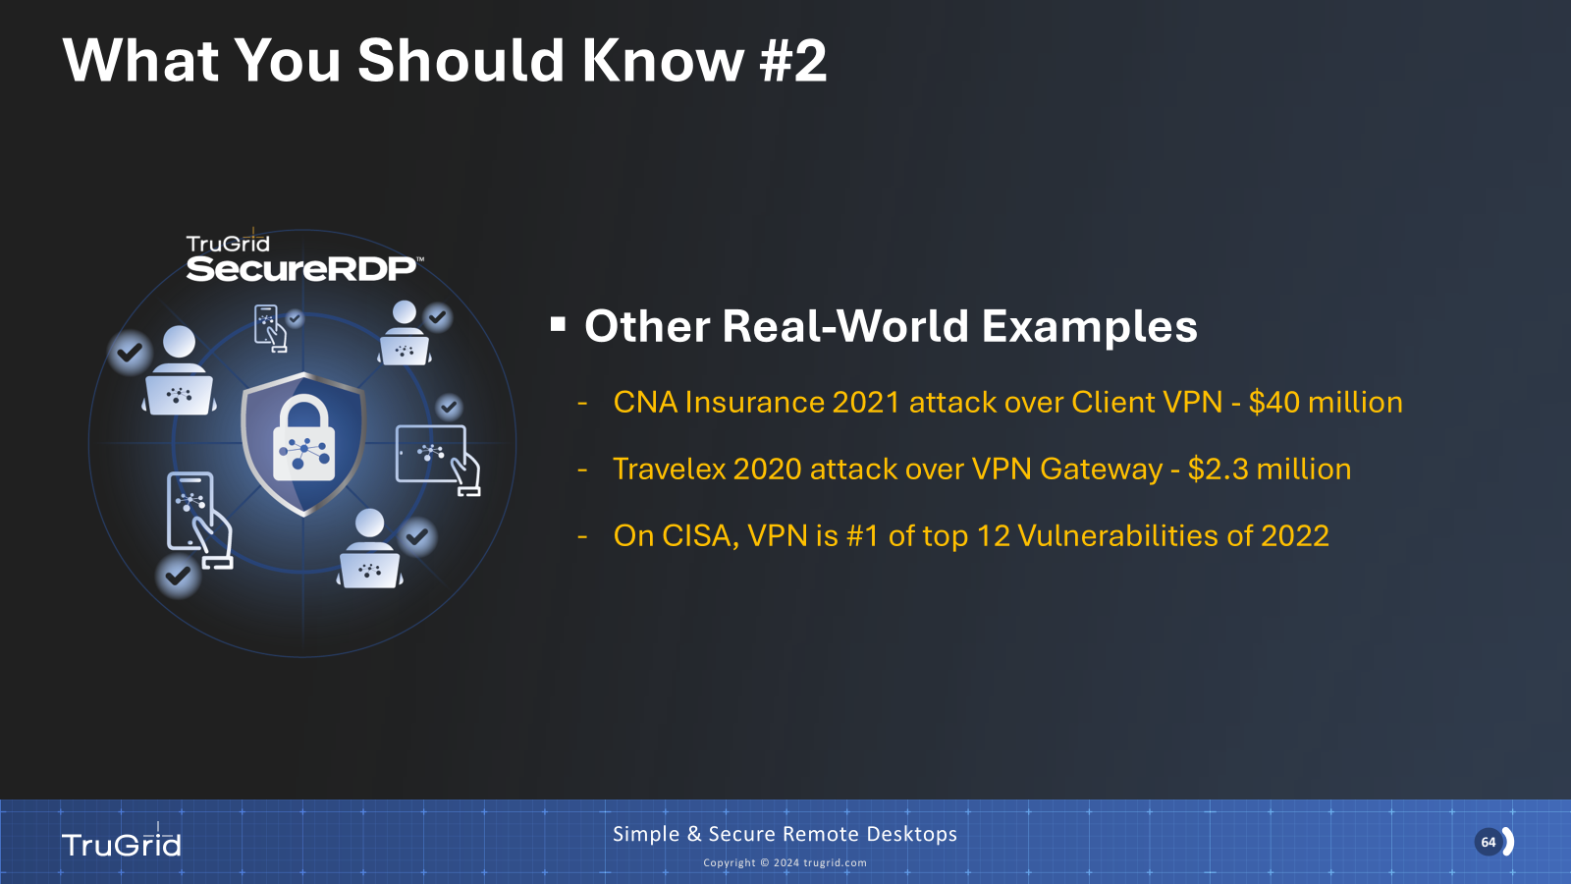
Every IT surface environment is a cybersecurity vulnerability
Keynote: “Cyber Strategies: Reduce Your Attack Surfaces”, led by Peter Ayedun, CEO & Co-founder of TruGrid.
Key takeaways:
  Common problems and cybersecurity vulnerabilities include:
    Open inbound ports are exposed over the internet and are invitations to bad actors.
    VPNs are exposed over remote endpoints and an extension of your private network.
    Cloud Services are globally exposed and can be compromised offshore.
  Key learning from past cybersecurity attacks is that breaches may originate from anywhere i.e., endpoints, VPNs (via clients or gateway appliances), internet (http or https), and through different methods like brute force, password stuffing etc..
  Recommendations to reduce cyber attack vulnerabilities:
    Kill VPN and open inbound ports.
    Use proxied or private access solutions.
    Deploy cloud providers with built-in cybersecurity features (i.e., Microsoft 365, Dropbox and Box cloud storage, Salesforce CRM, Vendor-hosted RMM, PSA).
    Enable geo-blocking to block countries outside of your primary business operations and only allow logins from desired regions and/or locales.
Source: MSP Summit 2024, photo taken by Omdia analysts, September 2024
© 2024 Omdia

Slide 20


DEI is being attacked, strategic changes are needed for its survival
Keynote: “Understanding Strategies to Build Company Culture Today and on the Path Forward” by Kelli McMillan, Director of Global Partners at Five9, Inc.; Brandon Knight, Global Head of Channel CX at Zoom; and Ronnell Richards, President at Ronnell Richards LLC.
Key takeaways: The panel of diversity, equity, and inclusion (DEI) protagonists shared their perspective on the current fragile state of the initiative.
Roadblocks
Resolutions
The benefits and support of DEI initiatives have been reduced or eliminated.
Associating DEI as just another race topic.
Lack of metrics/measurements to display the value-add and impact on bottom-line.
Most people create and join DEI initiatives for personal and/or emotional reasons.
The lack of DEI initiatives at a company are often the result of it not being presented as an opportunity or priority.
DEI requires universal, company-wide support, not just minority employees or special interest groups.
Align DEI with business objectives and demonstrate it supports business goals like innovation, customer satisfaction, employee engagement, and productivity.
Collect and analyze data to assess the impact of DEI initiatives on metrics like hiring, promotions, and retention rates.
Benchmark the company’s DEI efforts with industry standards to identify areas for improvement.
Engage senior leaders to make DEI part of leadership’s responsibility and appoint DEI champions in leadership that act as advocates.
Offer DEI training and equip managers with the skills to lead diverse teams effectively.
© 2024 Omdia

Slide 21
Final recommendations

Slide 22
Final recommendations
Eliminate program waste
Cut underperforming partner programs and invest in top programs and partners that target key markets. Create turnkey, pre-configured solutions that can be easily managed which offer rapid time-to-market. Expand co-selling/marketing to increase partner success.
Facilitate partner success
Empower partners to develop custom AI solutions by supplying them with tools to innovate, like open APIs and AI toolkits. Launch cybersecurity training and certification programs that afford partners with robust security and incentives for compliance.
Find your niche
Capitalize on vast channel market opportunities by becoming vertical specialists. Use white-label solutions from vendors to increase your own managed services brand. Evaluate your client base to determine which ones are least vs. most profitable then target new clients that fit the profile of the latter.
Exploit top tech trends
Launch industry-specific AI managed services and package consulting with AI integrations to build high-margin offerings. Bundle cybersecurity into every offering by making it a non-negotiable part of every contract and illuminate to clients the ramifications of not being protected.
Vendors/ suppliers
Channel partners
© 2024 Omdia

Slide 23
“Trying to be everything to everyone guarantees you’ll become nothing to anyone. Find your niche and dominate it.”
Devan Adams
Principal Analyst,
Channel Research and Consulting Practice

Slide 24


Slide 25
Appendix
Further reading
The channel future is now: Channel Partners Expo and MSP Summit 2023—key takeaways (June 2023)
On the Radar: AKATI Sekurity’s award-winning managed security services (February 2024)
Event Recap: Channel Partners Expo and MSP Summit – 2024 (April 2024)
Quarterly Market Outlook Survey Insights – 1Q24 (June 2024)
Managed Service Provider (MSP) 501 Survey Insights – 2024 (July 2024)
Next-Generation Managed Service Providers (MSPs) Survey Insights – 2024 (August 2024)
Dave Raffo, “Women MSP Leaders Outline Strategies for Growth” Channel Futures, accessed October 2024
Dave Raffo, “Kaseya CEO Voccola: MSPs Deserve Better Margins” Channel Futures, accessed October 2024
Robert DeMarzo, “The Channel's Search for AI Monetization,” Channel Futures, accessed October 2024
Craig Galbraith, “Walmart AI Examples Motivate MSPs to Learn About AI” Channel Futures, accessed October 2024
Craig Galbraith, “MSP Partner Program Success Is a 2-Way Street” Channel Futures, accessed October 2024
Dave Raffo, “MSP Leaders Offer Advice for Managing Young Staff” Channel Futures, accessed October 2024
Sources
OpenAI’s large language model (ChatGPT) was used to co-create minor portions of this report (October 2024)
Author
  Devan Adams, Senior Principal Analyst – Informa Tech, Omdia Channel Research and Consulting Practice
  askananalyst@omdia.com

