Slide 1
Smartphone Need-To-Know – October 2024
  Jusy Hong, Senior Research Manager, Components & Devices – Mobile Handsets
  Zaker Li, Principal Analyst, Components & Devices – Mobile Handsets
  Aaron West, Senior Analyst, Components & Devices – Mobile Handsets
  askananalyst@omdia.com

Slide 2
Contents
Apple Intelligence finally drops with iOS18.1 following delays 3
MediaTek introduced its fourth-generation Dimensity 9400 flagship chipset 5
Huawei announces the new version of its Android rival: HarmonyOS Next 9

Slide 3
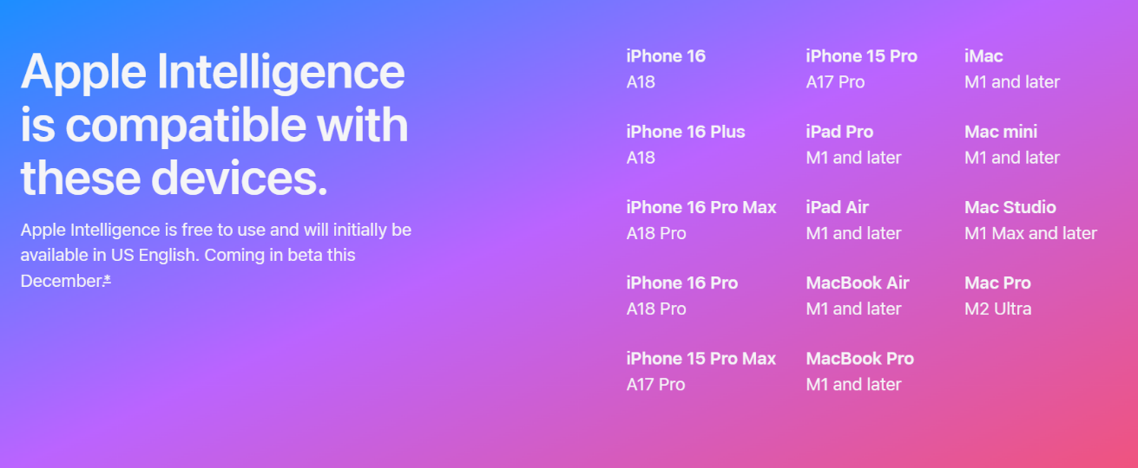
Apple Intelligence finally drops with iOS 18.1 following delays
Following first being announced in June 2024, and expected to be released with the iPhone 16 and iOS 18 in September, Apple has finally launched its first Apple Intelligence features with iOS 18.1.
Apple Intelligence is also coming to iPadOS 18.1 and macOS Sequoia 15.1 at a later date.
For some features, you will have to wait until 2025, with this first launch only including: Siri enhancements, priority notifications, summary, Writing Tools, Image Editing, and Genmoji.
It was also unclear for a long time whether older devices would get Apple Intelligence features, in the same way older S23 phones got Galaxy AI. Now it has been announced that the iPhone 15 Pro and 15 Pro Max will get some features, as well as devices which have the M1 or M2 chips (both older iPads and MacBook devices).
Fine print on the Apple website specifies that Apple Intelligence will be available in beta for US English in October, with other English (Australia, Canada, New Zealand, South Africa, UK) language support available this December. Some features and support for additional languages, like Chinese, English (India, Singapore), French, German, Italian, Japanese, Korean, Portuguese, Spanish, Vietnamese, and others, will be coming over the course of the next year.
Apple’s introduction of AI is also notable as the first to work openly with ChatGPT from OpenAI, integrating it directly into Siri improvements and AI Writing Tools. Apple has clarified that users will be in control whenever ChatGPT is used and will be asked before any information is shared, with no ChatGPT account needed. ChatGPT subscribers can connect accounts to access paid features within these experiences.
List of Apple Intelligence devices on the company’s website
Image sources: Apple

Slide 4
“Many have noted that the roll-out of Apple Intelligence has been particularly messy—not at all like Apple’s usually tightly planned launch events. Typically, the company waits years before jumping on new features and innovations, from Dynamic Island to wireless charging. But with how much hype surrounds AI and how quickly Google and Samsung are moving, it feels as though Apple’s hand has been forced to launch AI earlier than it was ready to, perhaps to appease investors more than its consumers.”
Aaron West
Senior Smartphone Analyst, Consumer Devices

Slide 5
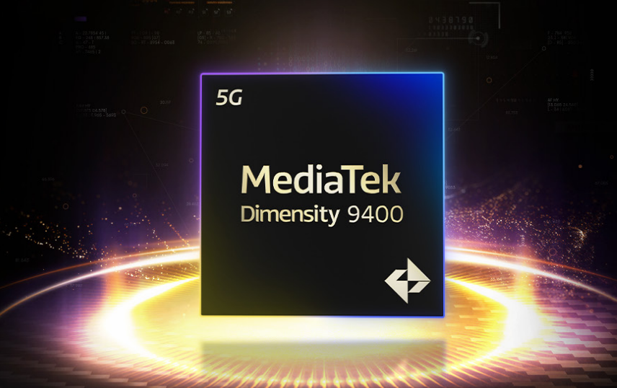
MediaTek introduced its fourth-generation Dimensity 9400 flagship chipset
On October 9, MediaTek announced its latest flagship chipset, the Dimensity 9400. This is the successor to the 9300 chipset used on smartphones such as the Vivo X100 series and Xiaomi 14T Pro.
The SoC is built by TSMC on the 3nm process (N3E), with the chipset maker claiming it has been optimized for edge-AI applications, immersive gaming, and high-end photography.
MediaTek claims it is 35% faster in single-core performance and 28% faster in multi-core performance, with an overall 40% power efficiency improvement over the 9300 chipset.
For GenAI, MediaTek noted that the Dimensity 9400 chipset supports up to 80% faster large language model prompt performance, integrating MediaTek’s own AI engine, designed to support smartphone makers adding AI features and developers to build AI agents.
MediaTek president Joe Chen stated in the official release of the Dimensity 9400 chipset that it builds on MediaTek’s “momentum of steady growth in market share, and MediaTek’s legacy of delivering flagship performance in the most efficient design for the best user experiences.”
As well as AI, gaming is a key focus of development with MediaTek claiming the Dimensity 9400 will be able to bring PC-level gaming features to smartphones. It stated the HyperEngine technology it co-developed with Arm would offer high quality imagery.
MediaTek Dimensity 9400 flagship chipset
Image source: MediaTek

Slide 6
“With increasing consumer interest in on-device AI and camera and gaming performance while OEMs expand their sales of high-value products, the shipment of smartphones equipped with premium SoCs is expected to see significant growth this year.”
Jusy Hong
Senior Research Manager,
Consumer Devices

Slide 7
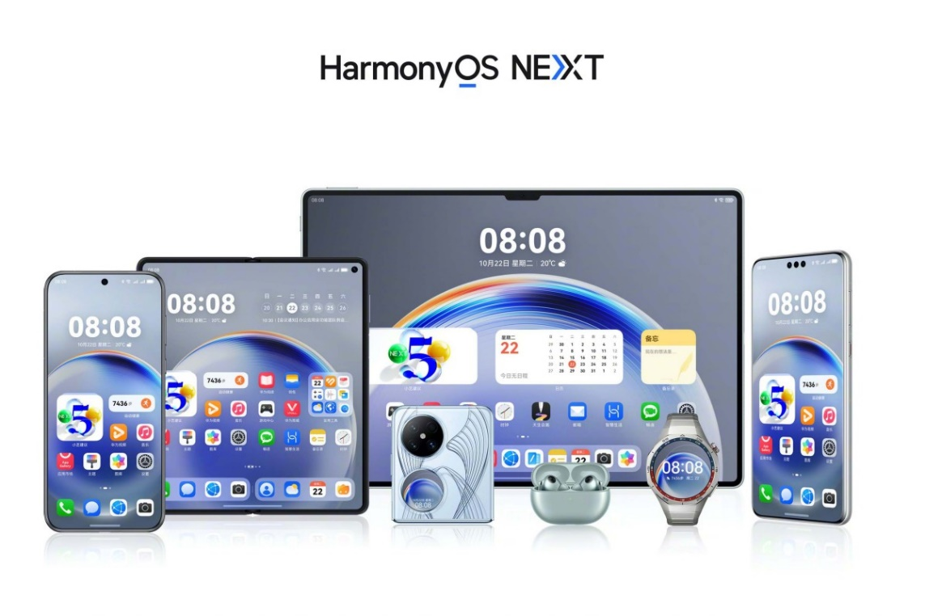
Huawei announces the new version of its Android rival: HarmonyOS Next
On October 22, Huawei unveiled its first operating system built independently from Android, named HarmonyOS Next. This is part of its long-term plans as it aims to transition its devices to an entirely in-house OS. This OS will be on a range of Huawei devices, from smartphones to wearables, smart home devices, and even car displays. To begin with it will power current and future Huawei devices in China, but a global release has been confirmed, although unspecified when.
It uses a self-developed Huawei microkernel from the OpenHarmony open-source core. It supports apps from Huawei Mobile Services (HMS) and promises a seamless unified architecture between HarmonyOS Next devices, the cloud as well as interconnectivity across various device form factors. It was announced by Consumer Business Group Chairman Richard Yu that 15,000 apps and services are part of the HarmonyOS Next ecosystem, with more coming.
It refreshes the visual identity of previous versions of HarmonyOS with more lock screen and home screen customization, a redesigned control center, faster animations, and AI features on the deck powered by system-level AI based on the Pangu large language model.
For security—a key point of contention for Huawei globally—HarmonyOS Next will bring a new self-developed Star Shield architecture with system-level protection.
Huawei has begun its public beta of HarmonyOS Next to users in China on supported devices, including the Pura 70 series, Huawei Pocket 2, and the MatePad Pro 11 (2024).
HarmonyOS Next on a range of Huawei devices
Image source: Huawei

Slide 8
“The launch of HarmonyOS Next marks a significant step for Huawei, who have not had access to Google Play Services since 2019. By developing its own kernel and architecture, the company can develop a more robust app ecosystem and system-level AI model. While it is unconfirmed when HarmonyOS Next will launch outside of China, it will rock the consumer smartphone landscape, which, for the first time in many years, will have another operating system to choose from other than Apple and Android.”
Zaker Li
Principle Analyst,
Consumer Devices

Slide 9
Appendix

Slide 10
Appendix
Authors
  Jusy Hong, Senior Research Manager, Components & Devices – Wireless Devices
  Zaker Li, Principal Analyst, Components & Devices – Mobile Handsets
  Aaron West, Senior Analyst, Components & Devices – Mobile Handsets
  askananalyst@omdia.com
  Omdia Consulting
  We hope that this analysis will help you make informed and imaginative business decisions. If you have further requirements, Omdia's consulting team may be able to help you. For more information about Omdia's consulting capabilities, please contact us directly at consulting@omdia.com.
  Citation Policy
  Request external citation and usage of Omdia research and data via citations@omdia.com.

