Slide 1
Smartphone Need-To-Know – November 2024
  Jusy Hong, Senior Research Manager, Components & Devices – Mobile Handsets
  Zaker Li, Principal Analyst, Components & Devices – Mobile Handsets
  Aaron West, Senior Analyst, Components & Devices – Mobile Handsets
  askananalyst@omdia.com

Slide 2
Contents
Global smartphone market continues to grow in 3Q24, with a 6.6% increase from the previous quarter 3
Qualcomm unveiled the new mobile SoC, Snapdragon 8 Elite 5
Apple investment into GlobalStar satellite services and local Indonesia supplier 7
Oppo claims on-device AI breakthrough with ‘Mixture of Experts’ AI architecture 9

Slide 3
Global smartphone market continues to grow in 3Q24, with a 6.6% increase from the previous quarter
Quarterly results, 3Q24 (millions of units)
Rank | OEM | 3Q'24 |  | 2Q'24 |  | 3Q'23 |  | QoQ | YoY
 |  | Shipment | M/S | Shipment | M/S | Shipment | M/S
1 | Samsung | 57.5 | 19% | 53.7 | 18% | 58.5 | 19% | 7.0% | -1.7%
2 | Apple | 54.5 | 18% | 45.6 | 16% | 53.4 | 18% | 19.4% | 2.0%
3 | Xiaomi | 42.8 | 14% | 42.3 | 15% | 41.8 | 14% | 1.3% | 2.5%
4 | Oppo Group | 28.6 | 9% | 25.2 | 9% | 26.6 | 9% | 13.5% | 7.5%
5 | vivo | 27.2 | 9% | 26.0 | 9% | 22.6 | 7% | 4.7% | 20.4%
6 | Transsion | 25.5 | 8% | 25.5 | 9% | 27.1 | 9% | 0.0% | -5.9%
7 | Motorola | 15.4 | 5% | 13.5 | 5% | 11.2 | 4% | 13.9% | 37.3%
8 | Honor | 14.9 | 5% | 15.5 | 5% | 15.8 | 5% | -3.7% | -5.6%
9 | Realme | 13.7 | 4% | 12.3 | 4% | 11.4 | 4% | 11.3% | 20.6%
10 | Huawei | 11.5 | 4% | 11.7 | 4% | 10.7 | 4% | -1.7% | 7.5%
 | Others | 18.3 | 6% | 19.4 | 7% | 22.9 | 8% | -5.8% | -20.2%
 | Total | 309.9 | 100% | 290.8 | 100% | 302.0 | 100% | 6.6% | 2.6%
Notes: M/S stands for market share. OPPO Group includes OPPO and OnePlus. Transsion includes Tecno, itel, and Infinix. Source: Omdia |  |  |  |  |  |  |  | © 2024 Omdia
Global smartphone shipments totaled 309.9 million units in 3Q24. This is a 6.6% increase from the previous quarter, with Apple shipment growing most with its new release of the iPhone 16 series in September.
Compared to the previous year it is a 2.6% increase, marking four-quarters or 1-year of continuous growth, with vivo, Motorola and Realme all recording double-digit increases. All other major OEMS also recorded growth, including Apple, Xiaomi and Oppo, with only Samsung, Transsion and Honor seeing falling shipments year-on-year compared to 3Q23.
However, in contrast, shipments from Honor and Transsion fell short of expectations as competition intensified among OEMs.
Samsung still had the most shipments in 3Q24, with a 7.0% increase from the dip seen in 2Q24. This is not enough to reach shipment levels seen in 2022, though, with a 1.7% fall compared to 3Q23. Samsung’s declining market share in the past year can be attributed to the decline in the mid-end segment. More than two-thirds of Samsung’s shipments come from its mid-end A-series devices or below $400 smartphones. But demand for these devices has stagnated as a result of high inflation globally and the growing refurbished smartphone market. The high-end segment has also increased, but it wasn’t strong enough to offset the decreasing shipment of mid-end.

Slide 4
“The smartphone shipments in the third quarter exceeded our initial expectations. This was due to the continued strong demand for budget smartphones, leading to higher-than-expected shipments from Oppo, Realme, and Motorola. Additionally, Vivo's shipments surpassed forecasts, supported by the recovery in the Chinese smartphone market. As such, smartphone shipments this year are expected to exceed our initial forecasts. The annual growth rate is now projected to be around 5%.”
Jusy Hong
Senior Research Manager,
Consumer Devices

Slide 5
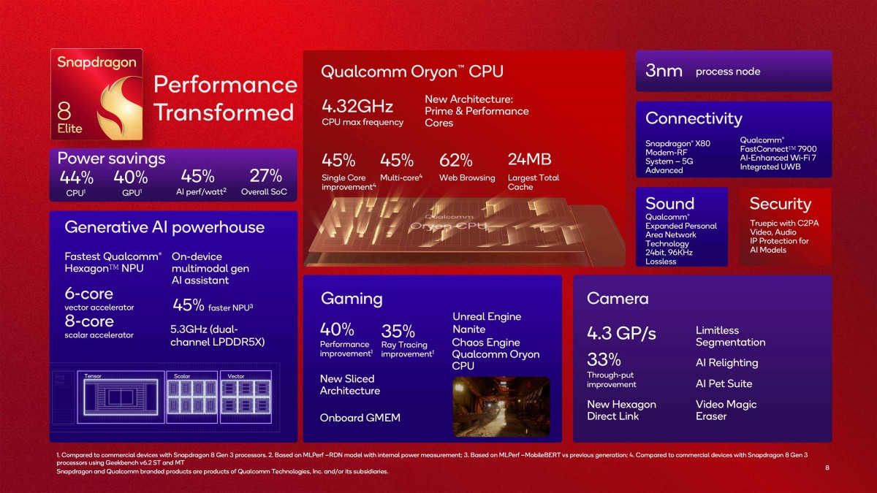
Qualcomm unveiled the new mobile SoC, Snapdragon 8 Elite
Qualcomm announced its second on-device AI SoC, the Snapdragon 8 Elite. Unlike its predecessor, the Snapdragon 8 Gen 3, it has not been named Gen 4; instead, it adopts the Elite branding, unifying Qualcomm's flagship SoCs across smartphones, PCs, and automotive applications.
It focuses on reducing power consumption through AI, enhancing gaming experiences, and improving image and video performance.
The Snapdragon 8 Elite features Qualcomm’s second-generation Oryon CPU, boasting peak speeds of 4.32GHz, a 45% increase in CPU performance, and a 44% improvement in power efficiency. Qualcomm emphasizes enhanced gaming experiences based on this power efficiency. The combination of the Oryon CPU and Adreno GPU delivers a 40% performance improvement and 40% greater power efficiency for the GPU. Additionally, low-latency, lag-free spatial audio enriches the gaming experience even further.
The Snapdragon 8 Elite will support eight years of software and Android version updates – one year more than Google implemented last year with its Tensor chipsets, and Samsung followed this year with their flagship models. This is a win for sustainability and cybersecurity, extending the lifespan of smartphones, delivery security updates to consumers for longer, and allowing for longer reselling as used or refurbished devices.
Qualcomm announced that smartphone OEMs and brands such as ASUS, Honor, iQOO, OnePlus, OPPO, RealMe, Samsung, Vivo and Xiaomi plan to release smartphones featuring the newly unveiled Snapdragon 8 Elite. Xiaomi’s Mi 15, Honor Magic7 and Asus ROG 9 are the first models that are coming in a couple of months, powered by Snapdragon 8 Elite.
Qualcomm Snapdragon 8 Elite specifications and performance improvements
Image source: Qualcomm

Slide 6
“Last year's Snapdragon 8 Gen 3 opened the era of on-device AI smartphones, and Elite chip only improves on this. Starting with Google's Pixel 8 Pro last year, a new trend emphasizing AI in smartphones has emerged, with Samsung's Galaxy S24 this year making on-device AI a key marketing point for premium devices. With increasing consumer interest in on-device AI, and as OEMs expand their sales of high-value products, the shipment of smartphones equipped with premium SoCs such as the Snapdragon 8 Elite is expected to see significant growth.
Jusy Hong
Senior Research Manager,
Consumer Devices

Slide 7
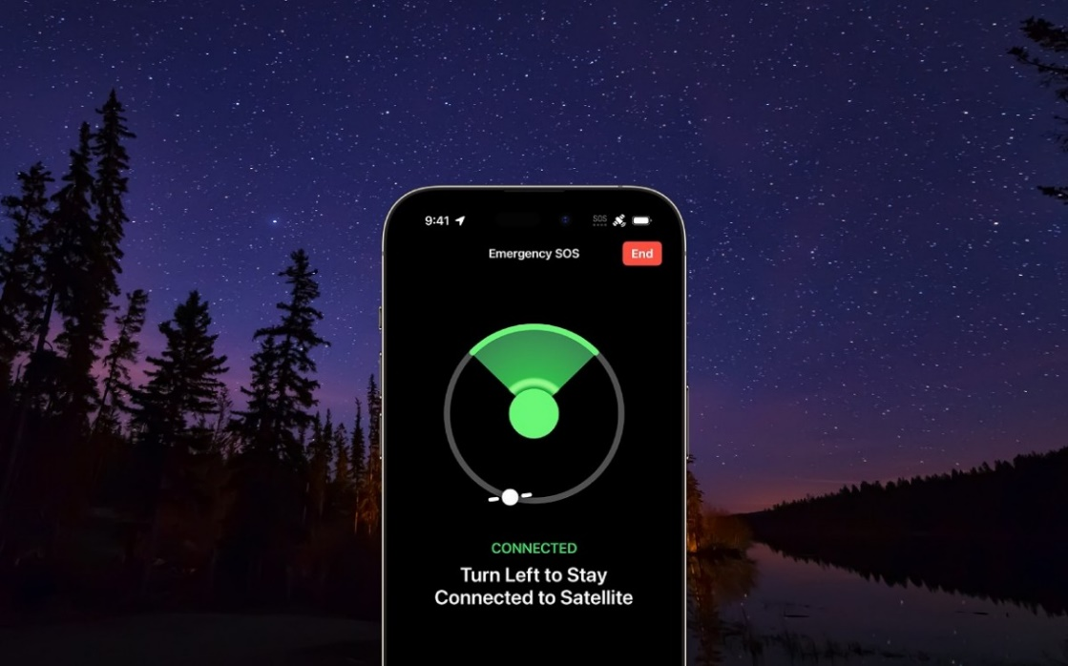

Apple pours $1.1b investment into GlobalStar satellite services
Apple iPhone Emergency SOS feature
Apple first introduced satellite communication with its iPhone 14 series in 2022 with the addition of its Emergency SOS feature. This allows for emergency services texts when you have no mobile or Wi-Fi coverage. This relies on the infrastructure of US-based satellite services provider GlobalStar.
With this new commitment of $1.1 billion of investment from Apple, GlobalStar will expand its satellite infrastructure capacity, significantly boosting capacity to handle satellite messaging requests from iPhone users.
In an SEC filing, Globalstar explained that this large investment from Apple will cover expand its satellite constellation, with more ground infrastructure and a greater capacity for global licensing deals.
This investment secures Apple 85% of this new fleet capacity, with the remainder being free for GlobalStar to license to other customers. This is in addition to Apple now owning 20% of Globalstar via an equity deal worth $400 million.
Apple’s Emergency SOS was initially promised for two years as a free service to consumers. This meant that day-one iPhone 14 buyers in 2022 would have lost support by now, but Apple has extended this free service for another year, meaning it will now last until November 2025.
It is not yet clear if and how Apple will commercialise this service, and whether they will begin charging customers for the Emergency SOS or other new satellite communication features.
Image source: Apple
GlobalStar logo
Image source: GlobalStar

Slide 8
“Apple’s huge investment into satellite communication may initially seem confusing because of how limited current use-cases are. Yet it seems that Apple is trying to future-proof its capabilities in this area. With 6G coming from 2030, satellite infrastructure could become more crucial. Elon Musk’s StarLink satellite services company is also rapidly expanding internet availability in under-served areas of the planet. In response, Apple may be considering what it can offer in this increasingly competitive area which seems primed for US government subsidies and investment.”
Aaron West
Senior Analyst,
Consumer Devices

Slide 9
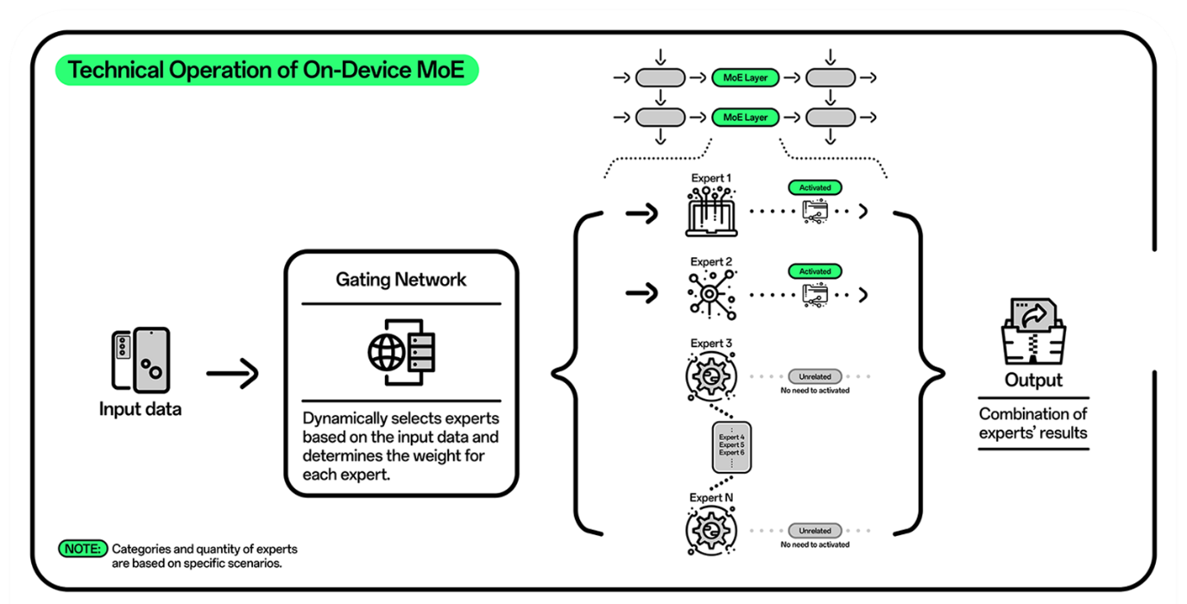
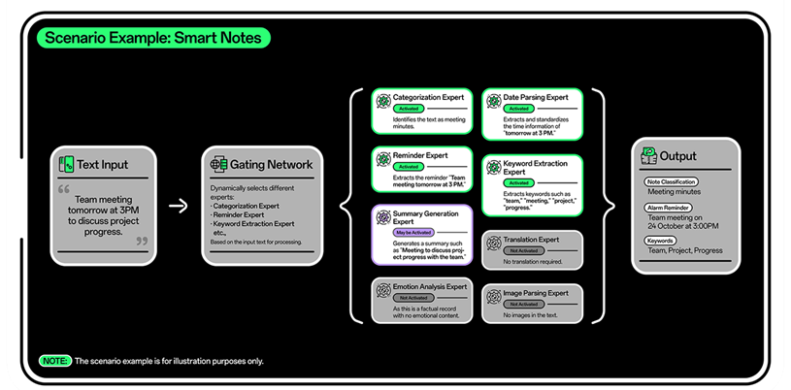
Oppo claims on-device AI breakthrough with ‘Mixture of Experts’ AI architecture
The Chinese smartphone OEM announced in a press release on October 23rd that it has “achieved a significant breakthrough by becoming the first company to implement the Mixture of Experts (MoE) architecture on-device. This milestone enhances AI processing efficiency, opens new possibilities for more advanced and flexible on-device AI, laying the groundwork for future innovations in AI's integration with mobile hardware.”
The architecture works by activating sub-models to handle specific tasks, rather than the whole model as is usually the case. Oppo cited laboratory tests which reveals this accelerates how quickly tasks can be completed by approximately 40 per cent. This would reduce resource demands and improve energy efficiency of the processor, leading to overall better battery life of the smartphone.
By allowing more to be done on-device, it would allow for enhanced privacy protections, too, as user data does not have to be shared with cloud model servers.
Oppo ‘Mixture of Experts’ AI architecture
Image source: Oppo

Slide 10
“Oppo announced earlier this year that it is aiming to bring generative AI to 50 million of its smartphone users globally by the end of 2024, spanning the full-range of its devices. And now with 5,860 patent applications in the AI field, it’s clear that OPPO is investing heavily in AI R&D. It’s up against some of the biggest tech players, though, with Apple partnering with OpenAI and Google leading AI research in the smartphone field. Introducing AI onto low-end devices could be a key differentiator for Oppo, though.”
Zaker Li
Principle Analyst,
Consumer Devices

Slide 11
Appendix

Slide 12
Appendix
Further reading
  Global Smartphone Shipment Preliminary Result – 3Q24, November 2024
  Qualcomm unveiled the new mobile SoC, Snapdragon 8 Elite, October 2024
  Authors
  Jusy Hong, Senior Research Manager, Components & Devices – Wireless Devices
  Zaker Li, Principal Analyst, Components & Devices – Mobile Handsets
  Aaron West, Senior Analyst, Components & Devices – Mobile Handsets
  askananalyst@omdia.com
  Omdia Consulting
  We hope that this analysis will help you make informed and imaginative business decisions. If you have further requirements, Omdia's consulting team may be able to help you. For more information about Omdia's consulting capabilities, please contact us directly at consulting@omdia.com.
  Citation Policy
  Request external citation and usage of Omdia research and data via citations@omdia.com.

