Slide 1
Smartphone Need-To-Know – July 2025
Jusy Hong, Senior Research Manager, Components & Devices – Mobile Handsets
Zaker Li, Principal Analyst, Components & Devices – Mobile Handsets
Aaron West, Senior Analyst, Components & Devices – Mobile Handsets
askananalyst@omdia.com

Slide 2
Contents
Worldwide smartphone shipments marginally down in 2Q25 as uncertainties mount 3
Samsung launches new foldables, introducing a new cheaper FE version of the Z Flip7 5
The new Nothing Phone (3) targets the premium segment and flagships for the first time 7
HMD announces plan to “scale back” its US business, as many vendors evaluate the cost of continuing business in the US 9

Slide 3
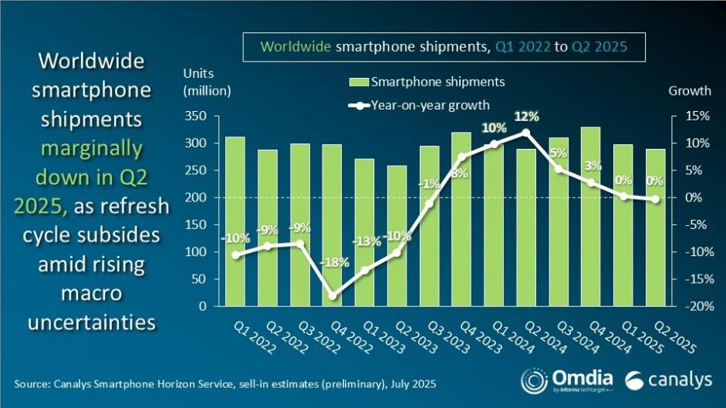
Worldwide smartphone shipments marginally down in 2Q25 as uncertainties mount
The latest research reveals that the global smartphone market marginally declined in 2Q25, marking the industry’s first decline in six quarters.
The marginal shipment drop reflects stable vendor performances against a backdrop of cautious consumer sentiment and increasing uncertainties and volatility in the global macroeconomic environment.
Samsung successfully defended its leading position in 2Q, claiming a 19% market share, predominantly thanks to its Galaxy A series. This is an increase of 3% on the previous year.
Apple finished second with a 16% market share, down 2%, while Xiaomi had a stable quarter with a 15% market share and a flat shipment volume change year-on-year.
vivo and TRANSSION completed the top five, with vivo growing a slight 1% from the previous year and Transsion brands Infinix, Tecno, and iTel collectively decreasing 2%. Each has an overall market share of 9%.
Worldwide preliminary survey results
Source: Omdia
© 2025 Omdia

Slide 4
“Many consumers who delayed purchases in the first half of 2025 are anticipated to buy during the major shopping festivals and events toward the end of the year. Effective pricing and clever promotions are as important as ever for vendor success, as shown by Huawei’s and Apple’s reception during China’s 618 shopping festival in May.”
Amber Liu
Practice Leader for Smartphone Research at Canalys (now part of Omdia)

Slide 5



Samsung launches new foldables, introducing a new cheaper FE version of the Z Flip7
At Samsung’s Unpacked event on July 9, 2025, it unveiled its latest foldables: the Z Fold7, the Z Flip7, and for the first time a cheaper Z Flip7 FE model.
The Fold7 and Flip7 have both had major hardware improvements focusing on reducing thickness and weight. The Z Fold7 been reduced from 5.6mm to 4.2mm when unfolded (barely thicker than the USB-C charging port) and from 12.1mm to 8.9mm when folded—less than 1mm thicker and actually slightly lighter than the Samsung Galaxy S25 Ultra.
The Z Flip7 also sees a key improvement to the outer secondary display, which now stretches from corner to corner, with cutouts for the two main cameras and flash. This increases the display size to 4.1 inches, with Samsung aiming to allow more simple tasks to be possible without opening the device fully—crucial for those aiming to reduce their screentime.
The Fold7 and Flip7 are retaining the same price as previous iterations, starting from $1,999 for the Fold and £1,099 for the Flip. The addition of the new, cheaper Z Flip7 FE (Fan Edition) does offer a lower entry point into the world of foldables for those who are not interested in the latest and best hardware, starting from $899.
Model | Z Fold7 | Z Flip7 | Z Flip7 FE
Main display size (inches) | 8 | 6.9 | 6.7
Secondary display size (inches) | 6.5 | 4.1 | 3.4
Chipset | Snapdragon 8 Elite | Snapdragon 8 Elite | Exynos 2400
Battery (mAh) | 4400 | 4300 | 4000
Main camera | 200x10x12, 3x zoom | 50x12 | 50x12
Thickness in mm (unfolded) | 4.2 | 6.5 | 6.9
Thickness in mm (folded) | 8.9 | 13.7 | 14.9
Weight (g) | 215 | 188 | 187
Source: Omdia |  |  | © 2025 Omdia
Image source: Samsung

Slide 6
“Samsung is expected to solidify its leadership in the global foldable smartphone market—excluding China—through the launch of the Galaxy Z Fold7 and Flip7, which significantly address key drawbacks of previous models such as thickness, weight, and battery life. At 8.9mm, the Z Fold7 is now matching many of its competitors, including the Honor V5, vivo X Fold5, and Oppo Find N5.”
Jusy Hong
Senior Research Manager
Consumer Devices

Slide 7
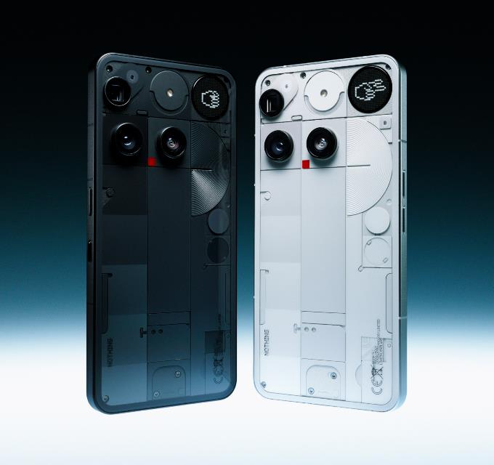
The new Nothing Phone (3) targets the premium segment and flagships for the first time
The latest phone from Nothing was unveiled on July 4, 2025, following many weeks of speculation and a teaser campaign. A focus of the new Nothing Phone (3) is the upgraded hardware specs and price, with the brand billing it as its “first ever flagship.”
Starting from £799, the Nothing Phone (3) will not be competing with the Ultra flagships of the world but is similar in price to entry-level models in many vendors’ flagship series, including the Google Pixel 8 and Samsung Galaxy S25—both of which will be key competitors in the Western Europe market for Nothing.
For the flagship price, there are some flagship-level specs:12GB of RAM as standard, with an option for 16GB; a triple 50x50x50MP main camera with OIS and 3x optical zoom; a 5150mAh Si/C battery (5500mAh for the India exclusive model); and a 6.67” OLED with 120Hz refresh rate and 4500 nits peak brightness.
It was noted by many reviewers that a key spec didn’t match the flagship claim, though, with the Snapdragon 8s Gen 4 chipset not being as powerful as the 8 Gen 4 or 8 Elite seen on many flagships. Nothing’s CEO Carl Pei later explained in a marketing video that this was due to the higher individual BOM costs facing the company as a result of being a small vendor.
Nothing Phone (3) in Black and in White
Source: Nothing

Slide 8
“The Nothing Phone brand has gone from strength to strength over the past two-and-a-half years. It began by establishing its name in the industry as a design-led market disruptor from its base in London in the Western European market. Now it is seeing further success in its tactical targeting of the Indian phone market—now a key source of shipments and sales for the brand.”
Aaron West
Senior Analyst
Consumer Devices

Slide 9


HMD announces plan to “scale back” its US business, as many vendors evaluate the cost of continuing business in the US
In a public statement on July 11, 2025, HMD announced that it is “navigating a challenging geopolitical and economic environment” and that the company has “made the decision to scale back our US operations.”
Following this, the HMD webstore in the US market is no longer online, with no buying information, although some models are still available from third-party retailers.
The implication of HMD’s exit from the US market is that the business could not sustain the increased costs as a result of tariffs introduced under Donald Trump’s administration. This follows HMD’s strong entry into the US market in 2021 following a licencing agreement with Nokia.
HMD’s deal with Nokia to license the Nokia brand name expires in March 2026. Prior to HMD, the Nokia brand was used by Microsoft for the Windows Phone. It is possible that the Nokia brand will be licenced again by another OEM in the future.
HMD will continue to operate in its key markets of Europe, Latin America, and India.
HMD Skyline phone in Neon Pink and Blue Topaz
Source: HMD

Slide 10
“The US smartphone market is currently incredibly difficult for small- to medium-sized vendors to operate within. More than 90% of shipments comes from just three brands: Apple, Samsung, and Motorola. This lack of consumer demand combines with strict requirements from carriers and a regulatory environment that is hostile to investment, with many fearing sanctions and limited patent access, for a perfect storm against new smartphone business.”
Aaron West
Senior Analyst
Consumer Devices

Slide 11
Appendix
Author
Jusy Hong, Senior Research Manager, Components & Devices – Wireless Devices
Zaker Li, Principal Analyst, Components & Devices – Mobile Handsets
Aaron West, Senior Analyst, Components & Devices – Mobile Handsets
askananalyst@omdia.com

Slide 12
Appendix
Omdia Consulting
We hope that this analysis will help you make informed and imaginative business decisions. If you have further requirements, Omdia’s consulting team may be able to help you. For more information about Omdia’s consulting capabilities, please contact us directly at consulting@omdia.com.
Citation Policy
Request external citation and usage of Omdia research and data via citations@omdia.com.

