Slide 1
Smartphone Need-To-Know – August 2025
Jusy Hong, Senior Research Manager, Components & Devices – Mobile Handsets
Zaker Li, Principal Analyst, Components & Devices – Mobile Handsets
Aaron West, Senior Analyst, Components & Devices – Mobile Handsets
askananalyst@omdia.com

Slide 2
Contents
India emerges as the largest manufacturing base for US smartphones, as vendors react to uncertainty over ever-changing tariffs 3
Google launch Pixel 10 series, including the Pixel 10 Pro Fold with IP68 water and dust resistance 5
Apple and Samsung announce increased investments into US manufacturing, R&D and end-to-end silicon supply chain 7
Deutsche Telekom launches low-cost “AI phone” in partnership with Perplexity 9

Slide 3
India emerges as the largest manufacturing base for US smartphones, as vendors react to uncertainty over ever-changing tariffs
The uncertain outcome of negotiations with China has accelerated supply chain reorientation. The share of US smartphone shipments assembled in China shrank from 61% in Q2 2024 to 25% in Q2 2025. Most of this decline has been picked up by India; the total volume of “Made-in-India” smartphones grew 240% year on year and now accounts for 44% of smartphones imported into the US, up from only 13% of smartphone shipments in Q2 2024.
Apple is the largest smartphone vendor in the US, and has been investing in its production capacity in India over the last several years as a part of its ‘China Plus One’ strategy. This has allowed it to rapidly shift production of the smartphones intended for the US market to India.
Samsung and Motorola have also increased their share of US-targeted supply from India, although their shifts are significantly slower and smaller in scale than Apple’s. Motorola, similar to Apple, has its core manufacturing hub in China, whereas Samsung relies mainly upon producing its smartphones in Vietnam.
All this has occurred while smartphones are currently exempt from the retaliatory tariffs imposed by Donald Trump. Even if smartphones remain exempt, so many other categories are impacted that consumers’ spending patterns and smartphone demand will both be hit.
Manufacturing country of US smartphone shipments

Slide 4
“Apple has scaled up its production capacity in India over the last several years as a part of its ‘China Plus One’ strategy and has opted to dedicate most of its export capacity in India to supply the US market so far in 2025. While Apple is still dependent on China for Pro model production for the US, it will be considering how it could shift entirely to India for the upcoming iPhone 17 series.”
Sanyam Chaurasia
Principal Analyst for Smartphone Research at Canalys (now part of Omdia)

Slide 5




Google launch Pixel 10 series, including the Pixel 10 Pro Fold with IP68 water and dust resistance
At the star-studded Made By Google event hosted by Jimmy Fallon on August 20, 2025, the newest Pixel 10 series smartphones where announced, including the Pixel 10, Pixel 10 Pro, Pixel 10 Pro XL and Pixel 10 Pro Fold.
A major part of the announcement was the latest Tensor G5 chipset on all 4 devices. While the Snapdragon 8 Elite has more power on-paper, Google’s aim with this custom-designed processor is optimisation and AI. It will enable the latest Gemini Nano model to run fully on-device on all the new phones.
The Pixel 10 series is also the first major Android phones to use Qi2 wireless charging – by incorporating magnets the phone aligns and snaps into place. As such, Google are also launching new magnetic accessories, including MagSafe accessories for the new phones.
The Pro Fold has an unfolded thickness of 5.2mm, making it 1mm thicker than the recently launched Samsung Galaxy Z Fold7. Although, the Pixel has IP68 compared to Samsung’s IP48.
Also announced at the event was the new Pixel Watch 4 and Pixel Buds 2a. The Pixel Buds Pro 2 which were launched last year are also being updated in the new Moonstone color to match the latest Pixel phones.
Model | Pixel 10 | Pixel 10 Pro | Pixel 10 Pro XL | Pixel 10 Pro Fold
Main display | 6.3” Actua display 1080x2424 3000 peak nits | 6.3” Super Actua 1280x2856 3300 peak nits | 6.8” Super Actua 1344x2992 3300 peak nits | 6.4” Actua display 1080x2364 3000 peak nits
Secondary display |  |  |  | 8.0” Super Actua 2076x2152 3000 peak nits
RAM and storage | 12 GB RAM 128 / 256 GB ROM | 16 GB RAM 128GB-1TB ROM | 16 GB RAM 256GB-1TB ROM | 16 GB RAM 256GB-1TB ROM
Main camera | 48x13x10.8MP 5x zoom | 50x48x48MP 5x zoom | 50x48x48MP 5x zoom | 48x10.5x10.8MP 5x zoom
Secondary camera | 10.5MP | 42MP | 42MP | 10MP
Battery (mAh) | 4970 | 4870 | 5200 | 5015
Weight | 204g | 207g | 232g | 258g
Launch starting price
Source: Omdia |  |  |  | © 2025 Omdia
Image source: Google

Slide 6
“One big announcement that Google slipped under-the-radar of their star-studded Pixel 10 phone announcement was that they will be eSIM only in the US. This mirrors the same decision Apple made for the iPhones in the US since the iPhone 14 series in 2022. This move from Google will likely add fuel to the growing shift towards eSIM globally.”
Aaron West
Senior Analyst
Consumer Devices

Slide 7
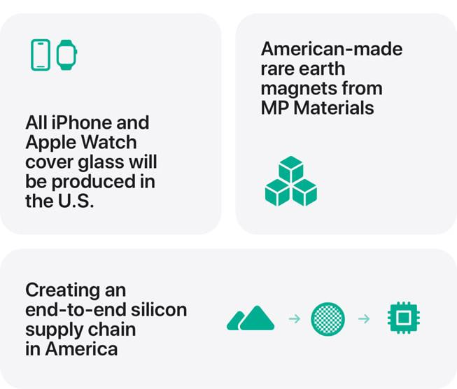
Apple and Samsung announce increased investments into US manufacturing, R&D and end-to-end silicon supply chain
Earlier this month, Apple announced its American Manufacturing Program, with Apple CEO Tim Cook presenting Donald Trump with the commitment in the Oval Office. This program will expand its $500 billion spending commitment from earlier this year by another $100 billion and will mean hiring 20,000 people in the US across its R&D, silicon engineering, software development, AI and machine learning departments.
The biggest claim from the program on smartphone manufacturing is end-to-end silicon supply chain in the US – including supply chain partners in every aspect of silicon production, from R&D to fabrication and packaging. This included the expectation of 19 billion chips in 2025, primarily from TSMC’s Arizona plant.
Following this, Samsung announced ahead of the South Korea-USA summit that it will increase its investment in US chip manufacturing from $37 billion to $44 billion. This is largely aimed at advanced chip packaging, with plans to produce 2nm and 4nm chips to meet demand from new clients such as Apple and Tesla.
This fresh investment from Apple and Samsung could be a way to appease Donald Trump’s demand for more manufacturing in the US, as a way of de-escalating and avoiding tariffs.
Apple American Manufacturing Program
Source: Apple

Slide 8
“With this new investment, it appears that Samsung plans to outperform the competition in the US by offering a complete manufacturing solution, including chip production, chip packaging, and memory chip manufacturing. This would out-manoeuvre TSMC, which only offer chip manufacturing and packaging, and SK Hynix, which only make memory chips in the US.”
Jusy Hong
Senior Research Manager
Consumer Devices

Slide 9
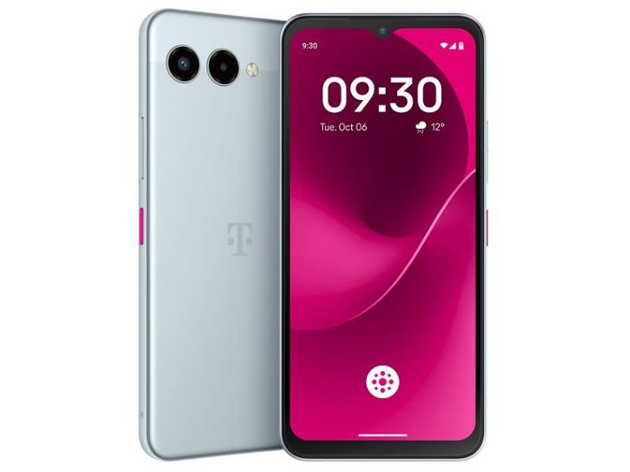
Deutsche Telekom launches low-cost “AI phone” in partnership with Perplexity
In an effort to increase smartphone AI accessibility and adoption, Deutsche Telekom have announced the T Phone 3 in partnership with Perplexity AI.
Through Perplexity Assistant, it’s claimed the T Phone 3 will support functions including real-time translation, trip planning, tutoring, email drafting, content summarisation and image editing – all features currently seen on premium flagship smartphones which utilise the latest chipsets to enable on-device AI.
In its key market of Germany, the AI-phone is available from €149 with bundle offers reducing this to just €1 each when purchased alongside a tariff. An 18-month subscription to Perplexity Pro is included in the purchase. Prices vary across the other nine launch markets, including Austria, Croatia, Czechia, Greece and Hungary.
A Pro version of the AI-phone is currently scheduled to launch later this year.
Deutsche Telekom also announced the T Tablet 2, with the same Perplexity AI features and starting at €199, with the same €1 bundle deal.
Deutsche Telekom’s AI phone, the T Phone 3
Source: Deutsche Telekom

Slide 10
“Deutsche Telekom’s claims over the AI capabilities of its new phone and tablet seem to very ambitious. While the devices are labelled as AI-capable, in reality this is likely to be entirely cloud-based AI, relying on Perplexity AI models running on AWS servers. The €1 bundle cost along with 18-months of Perplexity Pro (which costs $20 per month currently) also suggests that this may be a loss-making project for both DT and Perplexity.”
Aaron West
Senior Analyst
Consumer Devices

Slide 11
Appendix
Author
Jusy Hong, Senior Research Manager, Components & Devices – Wireless Devices
Zaker Li, Principal Analyst, Components & Devices – Mobile Handsets
Aaron West, Senior Analyst, Components & Devices – Mobile Handsets
askananalyst@omdia.com

Slide 12
Appendix
Omdia Consulting
We hope that this analysis will help you make informed and imaginative business decisions. If you have further requirements, Omdia’s consulting team may be able to help you. For more information about Omdia’s consulting capabilities, please contact us directly at consulting@omdia.com.
Citation Policy
Request external citation and usage of Omdia research and data via citations@omdia.com.

