Slide 1
Event Recap: CES Las Vegas 2026
TV team
Patrick Horner, Practice Leader, TV Set Research – Consumer
Matthew Rubin, Principal Analyst, TV Set Research – Consumer
Kelly Lee, Principal Analyst, TV Set Research – Consumer
Bing Zhang, Senior Principal Analyst, TV Set Research – Consumer
Ken Park, Research Director, TV/ProAV - Consumer
askananalyst@omdia.com

Slide 2
Contents
TV operating systems: Key takeaways
  Whale OS
  Roku
  Xperi
  Vidaa
  Google TV
  Tizen
  WebOS
  Dolby Vision 2
Appendix
Show overview
Top stories
Artificial intelligence
RGB mini LED
TV brands: Key takeaways
  Samsung
  LG Electronics
  Hisense
  TCL
  Changhong
  Toshiba
  Dreame

Slide 3
Show overview

Slide 4

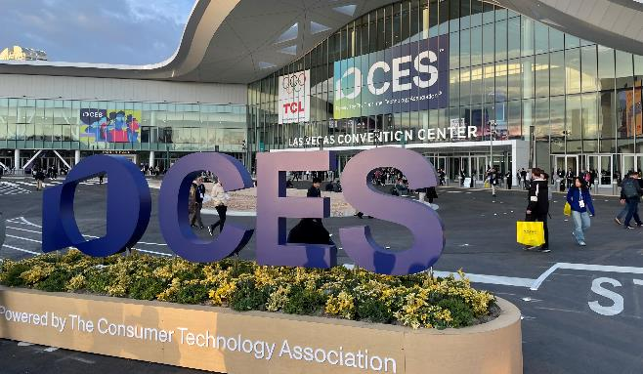


CES Las Vegas 2026
CES 2026 in Las Vegas drew in more than 4,100 exhibitors, more than 148,000 visitors, and more than 6,900 global media, content creators, and industry analysts.
TV brands continue to dedicate considerable resources to showcasing their latest technology and product launches. This year’s show key themes focused on
  RGB mini LED proliferation
  AI use-case improvements across lifestyle, picture, and audio quality
  QD technology upgrade
Omdia team at the event
Patrick Horner
Matthew Rubin
Practice Leader
Principal Analyst
Source: Omdia analyst / CES 2026
© 2026 Omdia

Slide 5
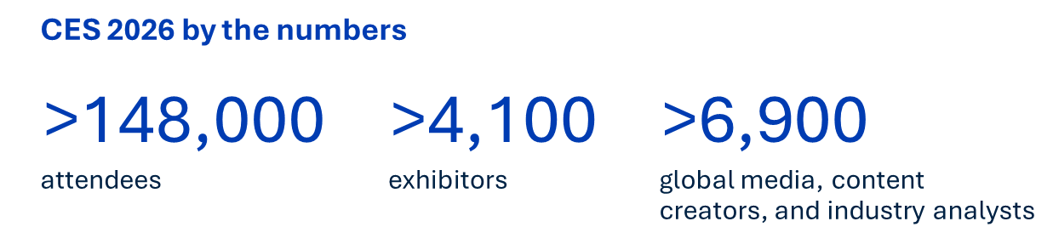
How did attendance at this year’s CES compare with prior years?
CES 2026 reached a postpandemic peak with more than 148,000 attendees, an increase of approximately 4% over the previous year. Though the event has shown steady recovery since 2022, total attendance remains below the record prepandemic highs of more than 170,0000.
Exhibitor scale: The 2026 show featured more than 4,100 exhibitors, including 1,200 startups, spread across 2.6 million net square feet of exhibition space.
International reach: Approximately 55,000 (>37% of the total) international attendees participated, confirming the show’s regained global status.
Executive presence: More than 55% of attendees were senior-level executives, reinforcing the event’s shift toward high-level business strategy rather than just product showcasing.
Media coverage: The event drew some 6,900 members of the media.
Attendance comparison (2020–26): The following data highlights the show’s recovery trajectory following the COVID-19 pandemic:
  CES 2026: ~148,000 attendees
  CES 2025: 142,465 attendees
  CES 2024: 138,789 attendees
  CES 2023: 117,841 attendees
  CES 2022: ~45,000 attendees (first in-person return)
  CES 2021: Virtual-only event
  CES 2020: 171,000-plus attendees (prepandemic benchmark)

Slide 6
Top stories

Slide 7
Television hardware highlights at CES 2026
Television hardware at CES 2026 was defined by the transition of “micro RGB” backlighting into consumer models, a surge in “true wireless” designs, and the arrival of high-brightness “tandem OLED" panels.
Major television debuts
  Samsung S95H QD-OLED: Winner of several “Best of CES” awards, this flagship is 35% brighter than its predecessor. It is the first OLED capable of displaying static art from the Samsung Art Store without burn-in risk and offers an optional Wireless One Connect box with eight HDMI 2.1 ports.
  LG OLED evo W6 “Wallpaper”: Measuring just 9mm thick, this ultra-slim set mounts flush to the wall and uses a wireless Zero Connect Box to receive 4K video and audio. It features a 165Hz refresh rate and the new α11 AI Processor Gen 3.
  Hisense 163MX RGBY microLED: An industry-first display that adds a yellow sub-pixel to the traditional red, green, and blue structure. This “RGBY” architecture covers 100% of the BT.2020 color gamut.
  TCL X11L SQD-Mini LED: This “Super Quantum Dot” model targets premium theater installs with a staggering 10,000 nits peak brightness and 20,000 local dimming zones. It is one of the first to support the new Dolby Vision 2 format.
Key display technology trends
  Micro RGB backlighting: A major shift for 2026, brands such as Samsung and Hisense have moved away from blue-only LEDs. These sets use individual red, green, and blue LEDs in the backlight for purer color production and higher saturation.
  Tandem OLED panels: Previously limited to tablets, tandem OLED (dual-layer) technology reached the midrange with the LG C6H (77" and 83" sizes), providing a massive jump in brightness comparable to previous flagship G-series models.
  AI Integration: Many 2026 models debuted Vision AI Companions (VAC), which use conversational AI to act as a smart home hub and offer content recommendations.

Slide 8
Top stories
The rise of RGB LED
AI use cases improve across lifestyle, picture, and audio quality
QD technology gets an upgrade
With the TV industry’s strong emphasis on RGB LED TVs at CES 2026, the market is expected to grow rapidly, starting in 2026 by positioning at the high-end segment of mini LED.
Most brands now have an RGB mini LED TV in their range, highlighting the surging interest in the technology.
The higher cost of production remains a key barrier to wider uptake of RGB mini LED TVs over the next few years.
Hisense claimed the world’s largest RGB mini LED TV at 116”, because it is currently available for purchase. Samsung displayed a 130” RGB TV but gave no detail on availability.
The key selling point for the technology is that it achieves 100% of the BT.2020. However, TCL opted to showcase its SQD TVs, which also achieve the same performance levels.
AI is being positioned as a useful addition, beyond content recommendation, to support consumers with better picture and audio quality.
Most brands promised the expected incremental developments to AI at CES, such as better and easier use of natural language along with more accurate content recommendation. AI-derived improvements to image quality are also claimed but are more difficult to clearly prove, especially with the latest display technology offerings, such as RGB and QD.
Google showcased a notable development: its Gemini AI platform enables the use of natural language to adjust things such as screen brightness and to isolate and improve vocal elements of audio. These seemingly simple capabilities are more aligned to the kinds of everyday improvements that consumers are more likely to notice.
Most brands have positioned OLED or RGB mini LED as the flagship technology, but TCL has taken a different route, opting for SQD-mini LED for its most premium tier.
SQD (Super Quantum Dot) technology uses blue-light LED chips but with an improved color filter and better QD film, creating a wider color gamut and achieving 100% BT2020.
This creates clear differentiation with other brands. Hisense is focused on RGB mini LED displays, LG Electronics on OLED, and Samsung on balancing both.
Source: Omdia
© 2026 Omdia

Slide 9
Artificial intelligence

Slide 10
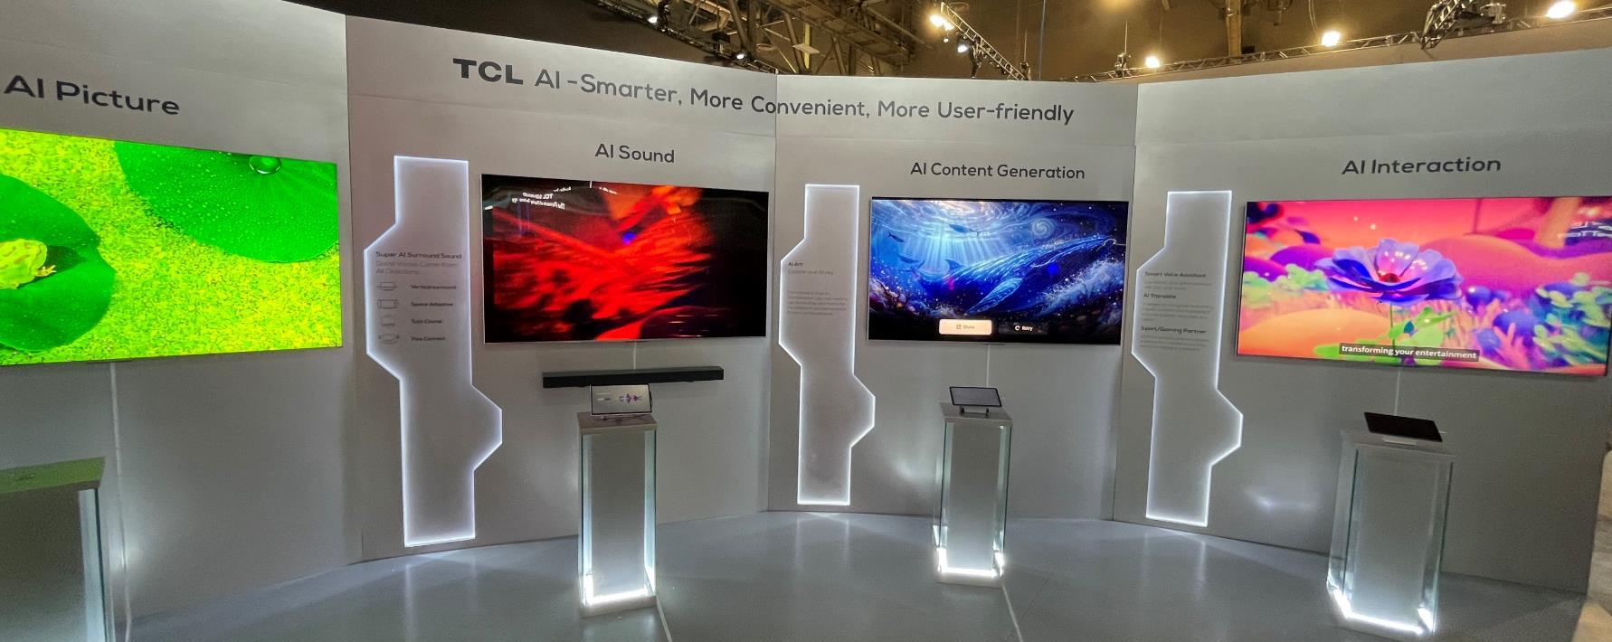
TCL’s AI display showcased the key areas of focus for AI at CES this year, across natural language interaction, AI content, and picture/sound quality
Source: Omdia analyst / CES 2026
© 2026 Omdia

Slide 11




CES 2026: AI-capable TVs with AI PQ processors
 | Samsung | LG Electronics | Hisense | TCL
TV series | 8K TV 4K OLED TV 2025 (S95F/S90F/S85F) OLED/QLED/The Frame (Neo QLED 8K QN990F, 2025) QLED 4K with 165Hz (2025) “MovingStyle” smart monitor (IFA 2025) Full line AI TV series (CES 2026) RGB micro LED TV, Max 130″ demo (S95H), (55~115″) (2026) | OLED evo series (2025), 165Hz OLED evo WallPaper TV W6 series (2026), 165Hz with Zero Connect Box Micro RGB evo TV (75″/86″/100″) (2026) | TriChroma mini LED TV (RGB mini LED TV) 116″ 116UX (2025) U8 with 165Hz/U7/U6 series TV (2025) RGB mini LED evo TV (116UXS, 2026) RGB mini LED TV (UR8 & UR9 series) (55~100″, 2026) | QM6K/QM7K TV Model (2025) QD mini LED TV (C9K/C8K X11K) (IFA 2025) SQD mini LED TV(75″/85″/98″) X11L and X955 Max (115″) (2026)
TV SoC | In-house (Samsung LSI) | In-house (LG in-house) | MediaTek | MediaTek (MTK9655+)
AIPQ processor | NQ8 AI 3rd Gen processor (NPU, 2× faster than the previous processor) (2025~) NQ4 AI Gen3 processor for OLED TV (2025~) Samsung Vision AI (CES 2025) Samsung Vision AI Companion (IFA 2025) Samsung Vision AI Companion & Entertainment Companion (CES 2026) | Alpha α11 AI processor (Gen 2, 2025) Alpha α11 AI processor (Gen 3, 2026) Compared with previous year of OLED evo models (α9 AI processor Gen 8, Up to 5.6× NPU faster AI) (dual AI engines in micro RGB) | AI image processor (Hi-View AI Engine X) (2025—performance +40%) AI Image processor (PQ) (2026, Hi-View AI Engine RGB H7 ) | AI PQ Ultra processor (AI picture quality) AI PQ Pro processor (2025) AI PQ Pro processor (2026)
AI key features | Common TV issues with sporting content, such as ball distortion (Deep learning to apply the proper ball detection model) Q-Symphony function expand to Audio brands (Harman/JBL 2026) Separates voices from noises Generative wallpaper Personal—Live Translate/Click to Search/Samsung Food (2025) Sync to smart home devices, “Samsung Food” recipe sent to oven or smart display in kitchen (2026) | Dynamic Tone Mapping Pro AI Picture Pro AI Sound Pro Microsoft Copilot to do personal voice search (2025) Affectionate Intelligence (2H24 & 2025) Personal—AI Concierge/AI Chat robot(2025) From “Affectionate Intelligence “ to “AI in Action” (2026) | AI picture quality: deep learning to enhance the viewing experience Local tone mapping optimization RGB Local Dimming PQ Chip (2025) Real-time optimizations for picture and sound quality (2025) RGB Local Dimming PQ Chip with new four colors (2026) | AI to control local dimming zones AI picture quality: AI functions and multiple proprietary algorithms AI contrast, AI clarity, AI color, AI motion, and AI HDR Google Gemini TV (2025 Sep to 2026)
Processor foundry | Samsung Foundry | TSMC | TSMC | n/a
Processor process node (nm) | 7–8nm (8K TV model) | 12nm | 22nm | 22nm
Source: Omdia
© 2026 Omdia

Slide 12
AI TV trends updated forecast at CES 2026
AI TV availability will grow from 2025 to 2027, and TOPS will increase from 1–3 TOPS to 10–20 TOPS because new applications require it and will start to add edge AI functions. Leading TV brands have already required TV SoC vendors to provide better TV performance (GPU, CPU) from 4Q24 and need them to increase NPU (TOPS) in the future. Samsung in-house LSI TV SoCs with AI function already have 5–8 TOPS in 2025, and we expect 2026–27 will bring edge applications (such as live translation). TV SoC with edge computing, currently planned by Realtek and MediaTek, will be released during 2026/27.
TV product with AI performance development by time and TOPS/applications
Deep learning
Machine learning
AI processor
Deep learning
Machine learning
Natural language processing (NLP)
Google Photo to GenAI pictures at TV
TOPS/
applications
AI processor
AI expands to other devices & actions
Deep Learning
Machine Learning
Vison: Click to search
Real-time sports updates
AI processor
Live translate
GenAI wallpaper
AI with edge function (2H26 to 2027)
Personal information
Content optimization
Audio quality
Audio quality
Audio quality
Picture quality
Picture quality
Picture quality
5–8 TOPS
20–25 TOPS
1–3 TOPS
3–5 TOPS
10–15 TOPS
Samsung and LG (Microsoft Copilot and Google), Hisense, TCL with Google (new Gemini AI 2025)
2023
2024
2025
2026
2027
2028
2029
2030
Time
Source: Omdia
© 2026 Omdia

Slide 13
RGB mini LED

Slide 14
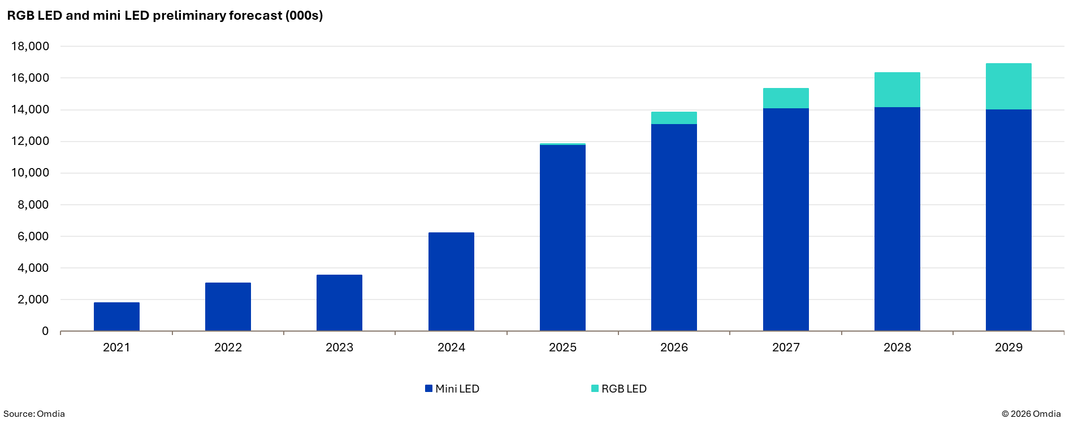
Strong emphasis on RGB LED TVs at CES 2026 shows the market is expected to grow rapidly, starting 2026 at the high end of mini LED

Slide 15
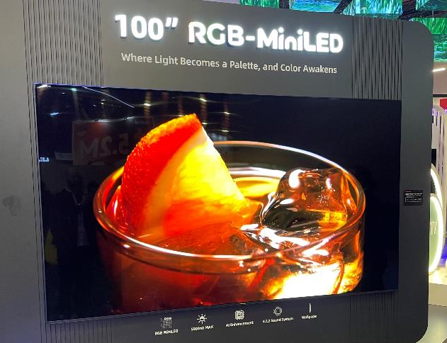
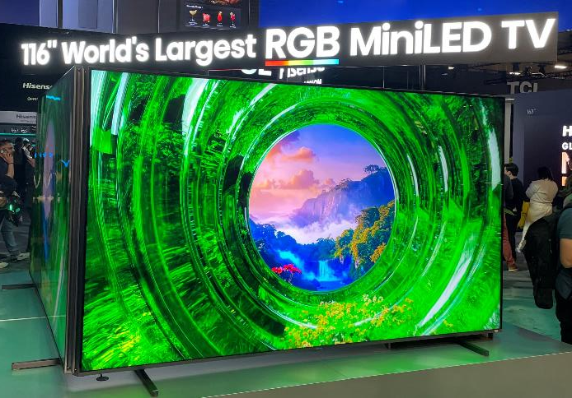
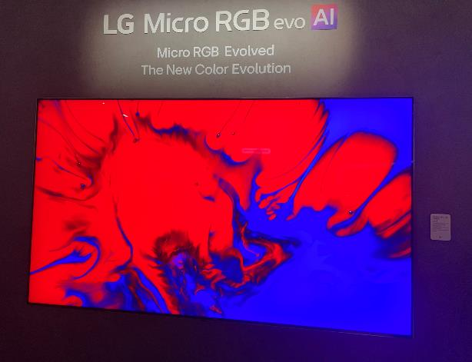
RGB mini LED
Changhong 100″ RGB-mini LED
Most brands now have an RGB mini LED TV in their range, highlighting the surging interest in the technology.
The higher cost of production remains a key barrier to wider uptake of RGB mini LED TVs over the next few years.
Hisense claimed the world’s largest RGB mini LED TV at 116”, because it is currently available for purchase. Samsung displayed a 130” RGB TV, but offered no detail on availability.
The key selling point for the technology is it achieves 100% of the BT.2020. However, TCL opted to showcase its SQD TVs, which also achieve the same performance levels.
Hisense 116″ RGB mini LED TV
LG Micro RGB TV
Source: Omdia analyst / CES 2026
© 2026 Omdia

Slide 16
QD mini LED versus RGB mini LED
 | Typical QD mini LED | RGB mini LED
Structure | LED array consisting of blue LED chips only. Most commercial mini LED products are applying QD sheets. R/G/B colors are achieved with the combination of blue color and QD sheet. | LED array consisting of separate R/G/B LED chips.
Color gamut | Good Color purity of QD usually varies by color. Green (and blue) QDs are known to be poorer than red QDs. | Best All pure R/G/B colors are available. Separate R/G/B dimming helps to maintain high color gamut over all gray level.
Emission efficiency | Good QD can provide sharp emission peaks. | Best Sharp emission of all R/G/B colors is available. Emission wavelength can be adjusted to match with LCD C/F absorption spectra.
Reliability | Good The combination of blue LED chips and QD sheet has been in mass production for more than a decade. | Moderate or bad Usually, R/G/B LED chips show different characteristics. It may lead to a color shift under varying conditions or during extended operation time. As QD or phosphor is not included, it is more stable under high humidity conditions.
Cost | High or moderate Large number of mini LED chips makes the cost high. Recently, mini LED products with a smaller number of chips have begun to be introduced. | Highest The number of chips is 3× the normal QD-Mini LED chips. R/G chips are more expensive than B chips since their production volume is much smaller.
Source: Omdia |  | © 2026 Omdia
QD sheet

Slide 17
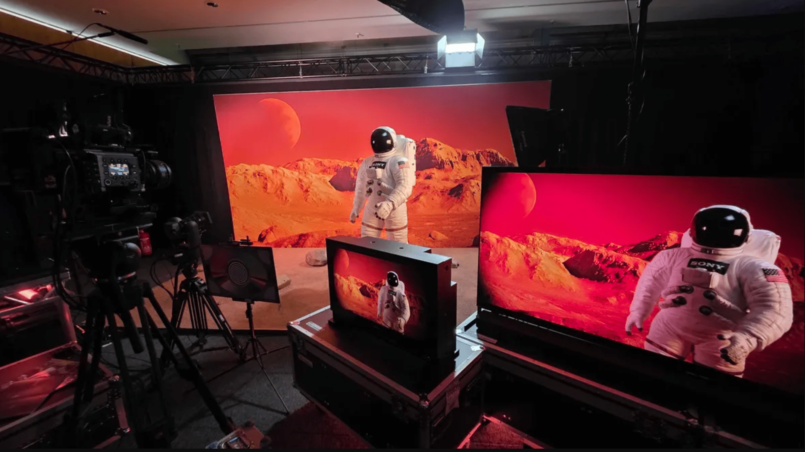
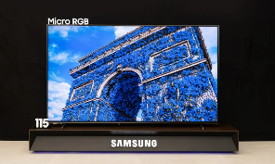
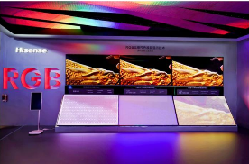
IC engine for 2026 RGB mini LED TVs
Local dimming IC engine for RGB mini LED TV in 2026
 | 1 | 2 | 3 | 4
 | MediaTek | Realtek | Hi-image (Hi-View) | Amlogic
IC chip name | MT9131 (another IC from SoC) LD engine | RTD2811 | H7 (RGB Local Dimming PQ Chip ) | NA
Cooperated TV SoC series | MTK Pentonic 800 and 1000 (4K 165Hz and 120Hz segment) | 4K 120Hz segment (RTD 2885N) | Mediatek or others | Amlogic 4K 120Hz segment (T966D5/T968D4)
Time | Sample 2H25, mass production for TV customers in 2026 | 1Q26 | 2025 & 2026 New Gen | Coming soon for 2026
TV customers | Sony Samsung Hisense (2026) TCL (2025) | TCL (2026) LGE | Hisense (2025/2026) | Chinese brands TCL
Solution | 2026 is all 1+1 (TV SoC + LD engine IC); 2027 will integrate into one chip (TV SoC)
Source: Omdia
© 2026 Omdia

Slide 18
TV brands: Key takeaways

Slide 19
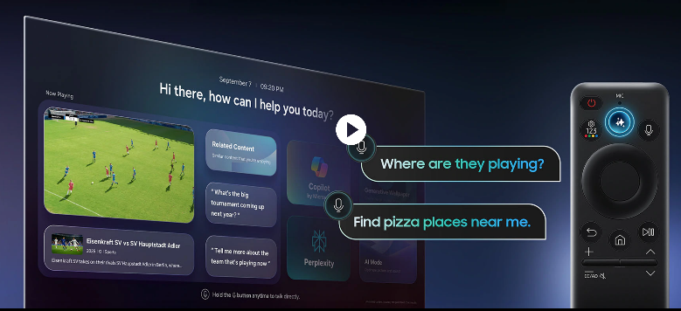
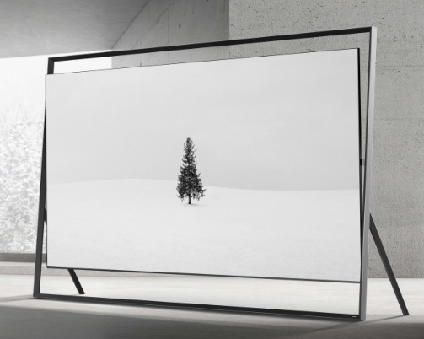

Samsung’s CES 2026 First Look: Samsung Vision AI & 130″ micro RGB
Samsung Vision AI promises to transform the smart TV screen into a hub for smart solutions. Dr. TM Roh came on stage to kick off the Samsung First Look press conference at CES 2026. He is CEO, president, head of device eXperience division, and head of mobile eXperience (MX) business at Samsung Electronics. He drives strategies to ensure synergy across Samsung’s business units. Roh described how Vision AI leverages the full scale of Samsung devices under one seamless unified AI. Samsung ships more than 500 million devices per year. Vision AI combines both on-device AI and cloud AI as a unified AI across devices. Key to this system’s trust and privacy is the Samsung Knox Security.
The next speaker was Seok Woo (SW) Yong, corporate president and head of visual display business. He described how TV intelligence is the companion to AI living. Samsung has been the number 2 TV brand worldwide for 20 years, shipping more than 30 million smart TVs annually. Its 2026 TV lineup will be fully AI capable to ensure fast AI adoption. Yong went on to introduce the other featured TV technologies. Samsung unveiled the world’s first 130″ micro RGB TV (R95H model) at CES 2026, marking the debut of its largest micro RGB display and a bold new design direction for ultra-premium displays.
Samsung unveils world’s first 130″ micro RGB
Source: Samsung
Source: Samsung

Slide 20
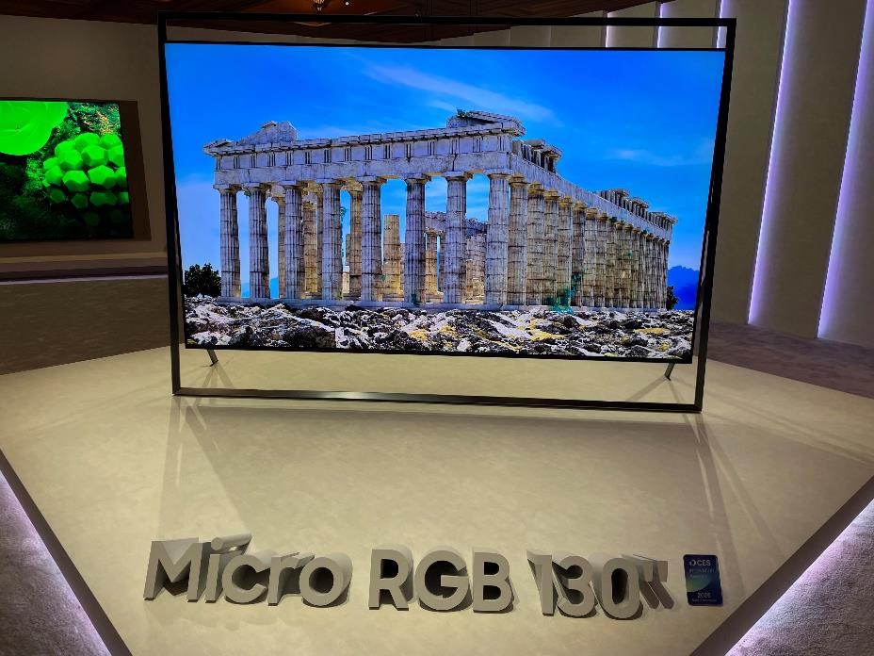
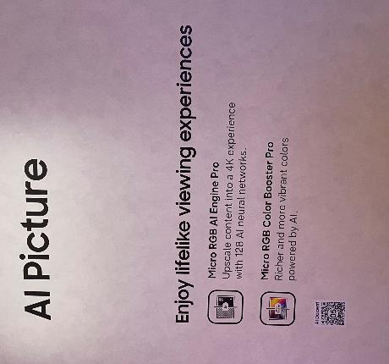
Samsung
Samsung Micro RGB – 130″
Samsung showcased the largest TV based on RGB mini LED technology at CES, at 130″.
Less focus was placed on OLED displays this year as RGB technology and AI become the key focal points.
AI is being positioned as a useful addition beyond content recommendation, to support consumers with better picture and audio quality.
Samsung AI Picture
Source: Omdia analyst / CES 2026
Source: Omdia analyst / CES 2026
© 2026 Omdia
Source: Omdia analyst / CES 2026
© 2026 Omdia

Slide 21
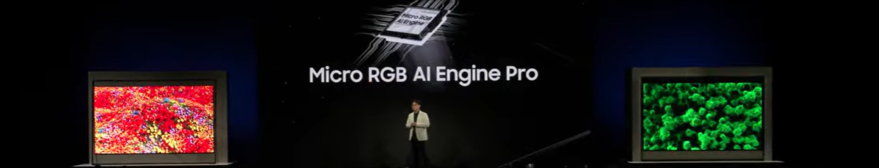
Samsung
Source: Omdia analyst / CES 2026
© 2026 Omdia
 | Samsung
Size | 55~115″, demo max size 130″ at CES 2026 (130″ MP time will from 2027)
Color | 100% BT.2020 (VDE BT.2020 Certification) Ultimate vibrancy: Capable of displaying extremely high-saturation deep reds and emerald greens.
Processor | Micro RGB AI Engine Pro
Color space standard | Area ratio | Usage/coverage
BT.2020 | 100% | Approx. 150% NTSC
NTSC | Approx. 64% | Historical analog TV standard
DCI-P3 | Approx. 72% | Digital cinema & high-end HDR content
Adobe RGB | Approx. 70% | Professional graphic design & printing
sRGB/Rec. 709 | Approx. 46% | Standard web, HD video, and SDR content

Slide 22
Samsung: Product range structure
Micro-LED : 110” (PCB)
RGB LED: 115”, 100”, 85”, 75”, 65”, 55”
R95H (65”, 75”, 85”, 115”)
R90H (55”, 65”, 75”, 85”, 100”)
Samsung unveiled the world’s first 130″ micro RGB TV at CES 2026, but commercialized models will be available in 55” to 100”. After launching 115” last year with MR95F, Samsung will add two more series such as R95H and R90H.
Samsung is placing a strong emphasis on RGB LED TVs at CES 2026 while simultaneously enhancing its OLED TV portfolio and fine-tuning its overall OLED TV strategy. A notable highlight is the introduction of a 48″ model to S95H series, which expands its premium OLED TV lineup.
Samsung’s most significant strategic move in 2026 is the expansion of its MINI LED TV lineup alongside RGB LED TVs. This approach is seen as a deliberate effort to solidify its leadership in the mini LED TV market by swiftly capturing demand from consumers transitioning away from entry QLED TVs.
Conversely, Samsung is expected to gradually lose market share in QD LCD TVs that rely solely on QD technology; the lineup is expected to phase out by 2026.
Micro-LED
/ micro RGB
OLED /
Neo QLED 8K/4K
Neo mini LED /
QLED / Lifestyle (Frame, Terrace, Serif, Sero, Moving)
Crystal UHD
FHD / HD
OLED : 83”/77”/65”/55”/48”/42”
S95H ; 48”, 55”, 65’, 77”, 83”
S90H : 42”, 48”, 55”, 65”, 77”, 83”
S85H : 55”, 65”, 77”, 83”
Neo QLED : 43”/50”/55”/65”/75”/85”/98”/100”/115
Neo mini LED :
- M7H : replacing Q7F
M8H : replacing Q8F
QLED : Q6F
U8000H
U6000
U5000
Source: Omdia
© 2026 Omdia

Slide 23
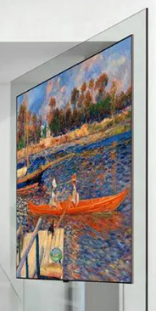
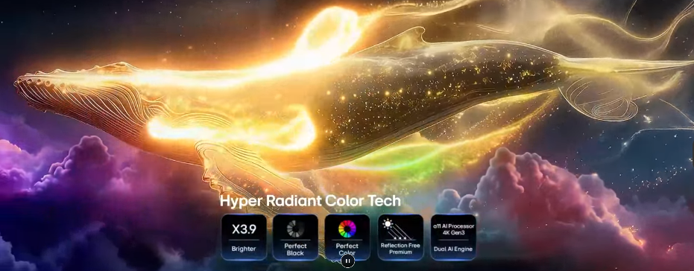
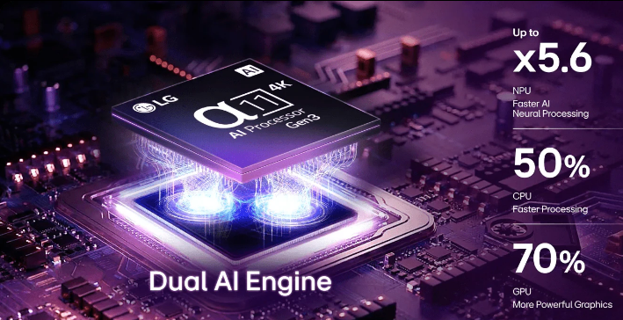
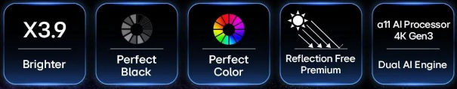
LG Electronics unveils “Innovation in tune with you” and Wallpaper TV
At CES 2026, the CEO of LG Electronics, Lyu Jae-cheol, presented the theme of “Innovation in tune with you.” He cited the advantages of “Affectionate Intelligence in Action”. An AI home will give you time back by making a zero-labor home. For example, LG’s Cloyd robot can fold the laundry, communicate with other appliances, and work together to solve household problems.
The big product announcement was the LG OLED evo W6 Wallpaper TV. It is only 9mm thick and delivers 4K resolution at a fast 165Hz refresh rate wirelessly. Hyper Radiant Color Tech is LG’s next-generation OLED technology that delivers 3.9× brightness, Perfect Black, and Perfect Color.
WebOS AI TVs integrate AI into the smart TV experience for personalized picture/sound, voice control via the Magic Remote, and streamlined content discovery with features including AI Brightness Control and personalized recommendations via Quick Cards, all powered by processors such as the Alpha 11 AI Processor, making them smarter and more adaptive to user habits and room conditions. LG’s webOS is integrating Google Gemini and Microsoft Copilot into its AI TVs for enhanced voice search and content discovery. This move shows LG’s multi-AI strategy, highlighting user demand for control over AI features on their smart TVs.
Source: LG Electronics
Source: LG Electronics

Slide 24
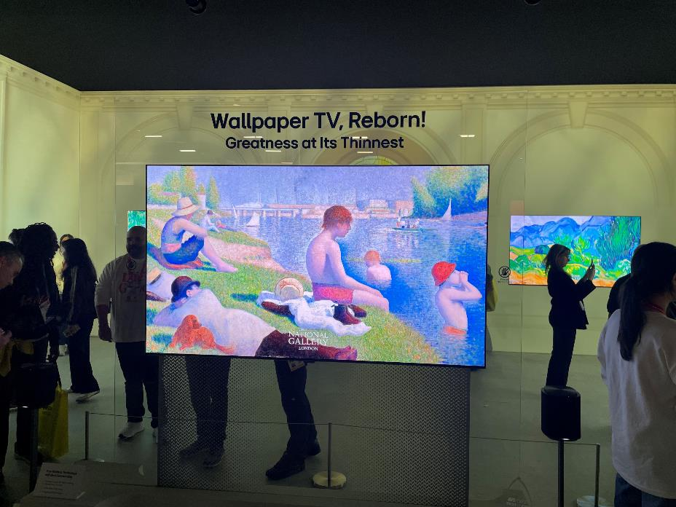
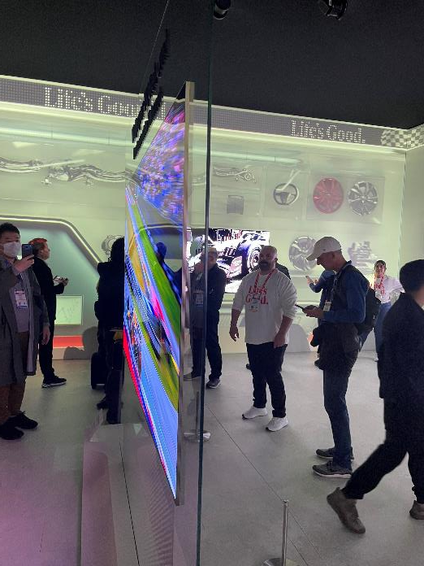
LG Electronics Wallpaper TV
LG Electronics dedicated significant space at its booth to its updated LG OLED evo W6, True Wireless Wallpaper TV. The W6 revives LG’s Wallpaper Design, first introduced in 2017, now combined with True Wireless connectivity and the Hyper Radiant Color Technology.
All inputs are located on the Zero Connect Box, which can be positioned up to 10 meters away.
LG Electronics claims The Wallpaper TV is the world’s thinnest True Wireless OLED TV, at 9mm thick.
LG Electronics Wallpaper TV
LG Electronics Wallpaper TV
Source: Omdia analyst / CES 2026
© 2026 Omdia
Source: Omdia analyst / CES 2026
© 2026 Omdia

Slide 25
LGE: Product range structure
OLED : 97”, 83”, 77”, 65”, 55”, 48”/42”
W6 (65”, 77)
M6 (97”, 83”, 77”, 65”, 55”)
G6 (97”, 83”,77”, 65”, 55”, 48”)
C6 (83”, 77”, 65”, 55”, 48”, 42”)
B6 (83”, 77”, 65”, 55”, 48”)
LG Electronics has consistently positioned OLED TVs as its flagship models. At CES 2026, the company unveiled its groundbreaking, completely wireless Wallpaper TV, eliminating the need for any cables for the first time since the launch of its ultra-slim Wallpaper TV in 2017. M6 series is Ture Wireless OLED TV being positioned one grade lower than W6 series with screen sizes from 55″ to 97″.
While maintaining OLED TVs as its flagship offerings, LG Electronics has strategically positioned its latest innovation, the Micro RGB evo—featuring advanced RGB LED backlight technology—at the pinnacle of its LCD TV lineup. These models in 75″, 86″, and 100″ sizes are set to launch .
The QNED MINI, incorporating MINI LED backlight technology alongside RGB LED TV features, is expected to be positioned above the current QNED lineup.
The long-standing NANO product line will continue to be available and is expected to serve as part of the value-up segment, particularly for emerging countries
OLED
Micro RGB evo /
QNED MINI
QNED / NANO
UHD / FHD
RGB LED : 100”/86”/75”
QNED MINI: 43”/50”/55”/65”/75”/86”/100”/115”
QNED : 100”, 86”, 75”, 65”, 55”, 50”, 43”
QNED85. QNED80, QNED70
NANO :85”, 75”, 65”, 55”, 50”, 43”
- NANO80
UHD/FHD : 85”, 75”, 65”, 55”, 50”, 43”
UB90
UB85
UB75
Source: Omdia
© 2026 Omdia

Slide 26
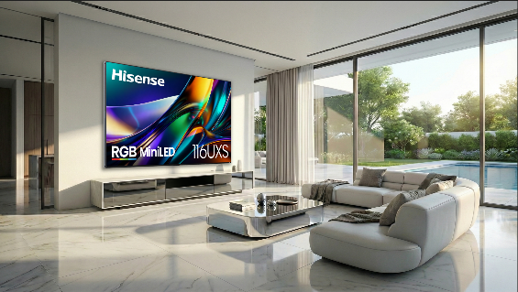
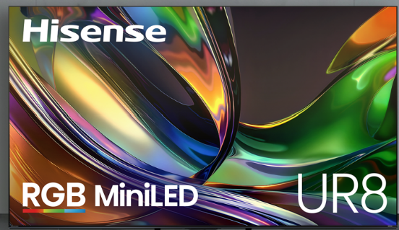
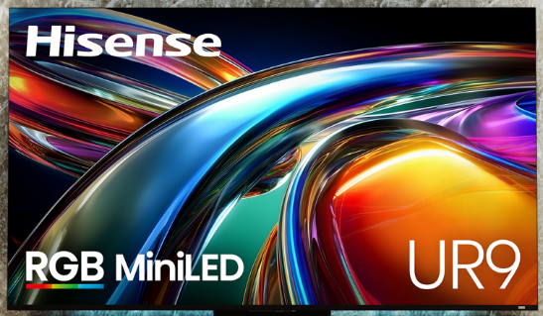
Hisense CES 2026 focused on FIFA World Cup and RGB mini LED
David Gold, president at Hisense USA, and Sarah Larsen, chief marketing officer, kicked off the CES 2026 press conference with a theme of “Innovating a brighter life.” Speed to market was cited as a core value at Hisense, and it explains why Hisense is asserting leadership in RGB mini LED technology. It is pioneering “RGB mini LED evo,” adding a fourth Sky Blue LED for superior color accuracy in premium models. It is also making the tech mainstream with affordable models (UR8/UR9). It is positioning itself as the “origin of RGB mini LED” driving category innovation beyond traditional RGB. The strategy involves flagship innovations such as the 116UXS and broad market adoption through accessible price points. Hisense is aiming to set new standards for large-screen TVs with better color fidelity, brightness, and viewing comfort.
The shift to a true RGB mini LED backlight, which uses separate red, green, and blue mini LEDs instead of a single white or blue light source with a quantum dot filter, offers significant advantages. By generating pure red, green, and blue light directly, the technology provides a wider color gamut and more accurate color reproduction. This architecture helps address common LCD pain points including blooming (haloing around bright objects on a dark background) and color purity issues. The technology maintains higher and more stable brightness than other display types such as OLED, making it well suited for bright viewing environments. The TVs are powered by the Hi-View AI Engine RGB, which intelligently manages thousands of dimming zones in real time to optimize picture quality.
Source: Hisense
Source: Hisense
Source: Hisense

Slide 27
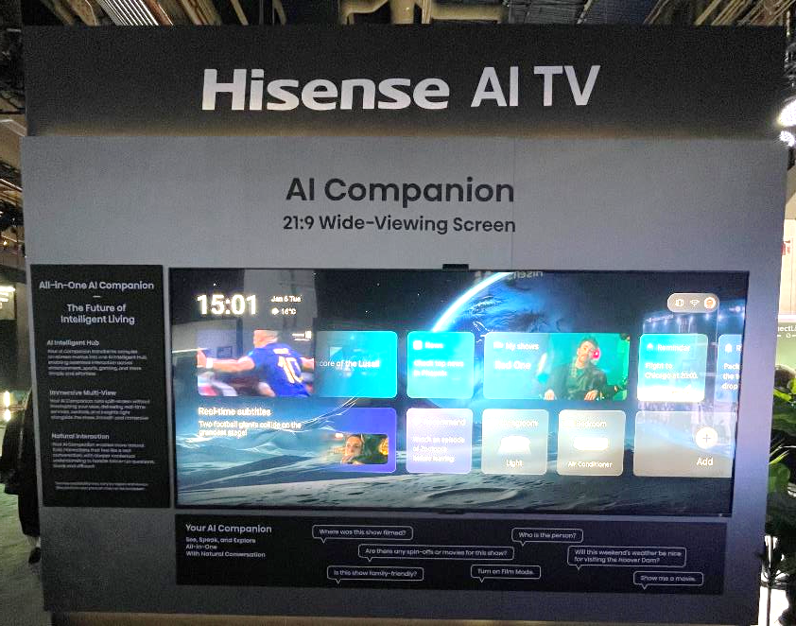
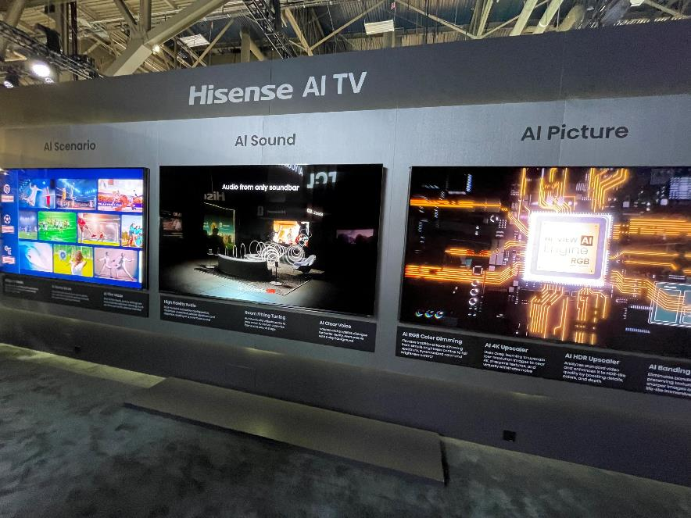
Hisense
Hisense followed a common theme at CES 2026, with TV brands showcasing the breadth of AI capabilities, including being a lifestyle assistant and improving picture and audio quality. Hisense’s “AI companion” shows a notably improvement from previous years by integrating more capabilities and blending better into the user experience.
Hisense AI TV
Hisense AI TV
Source: Omdia analyst / CES 2026
© 2026 Omdia
Source: Omdia analyst / CES 2026
© 2026 Omdia

Slide 28
Hisense: Product range structure
Sizes: LCD: 116″/110″/100″/85″
Laser: 300″/150″/100″/88″/80″
RGB mini-LED Evo (4-core chips)
Hi-View H7 PQ Engine
8k nits, 5,500–10,752 zones
BT. 2020 110%
Devialet/Harman Kardon Audio
At CES 2026 Hisense has adopted a more aggressive approach to cutting-edge TV technologies, including mini LED backlighting, color gamut improvement, and its unique laser display technology.
Hisense introduces its new RGB mini LED backlight system, RGB mini LED vvo, building on the traditional red, green, and blue backlight structure, RGB mini LED evo is the industry’s first to introduce a Sky Blue-Cyan fourth LED chip into the mini LED backlight system, completing one of the most commonly missing portions of the natural light spectrum.
With the advanced 134-bit color control and a color coverage exceeding 110% of BT.2020, RGB mini LED evo delivers professional-grade color accuracy with ΔE<1.0 through enhanced system-level color calibration.
Hisense’s TriChroma laser technology means the new Laser TV model XR10 offers an immersive home theater solution for projections up to 300″.
Flagship
UX
Laser TV
High-end
UR9S/8S
U Series 7 Pro/8Q
Mainstream
E Series 8/7/5
U Series 7E/6Q
Entry level
A series Vidaa
Sizes: 100″/85″/75″/65″/55″
RGB mini LED
Hivew H7 PQ Engine
3,500-8,000 nits, 2,600–7,000 zones
BT. 2020 100%
Devialet Audio
Sizes: 100″/98″/85″/75″/65″/55″
QLED
Hi-View H6 PQ Engine
1,500–3,000 nits
HFR
Sizes: 75″/65″/58″/55″/50″/43″/32″
LED
~1,000 nits
HFR
Source: Omdia
© 2026 Omdia

Slide 29
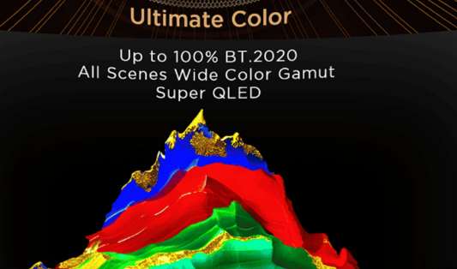
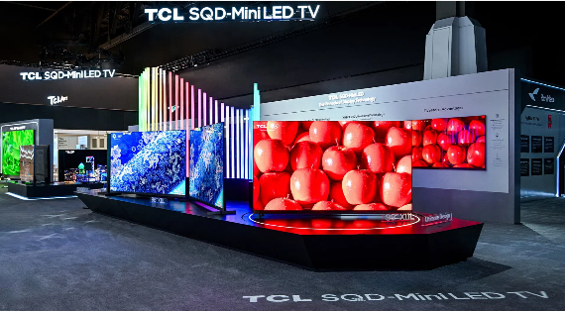
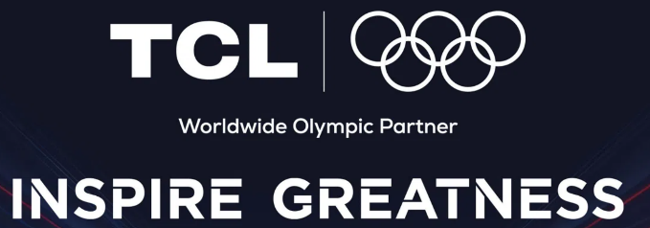
TCL: Worldwide Olympic Partner, and the latest SQD-Mini LED
TCL operated the largest booth at the Las Vegas Convention Center, using the event to highlight its role as the world’s No. 1 mini LED TV brand. It unveiled several major television announcements.
TCL’s headlining product was the X11L Flagship TV, featuring next-generation SQD-Mini LED technology. This tech uses a single-chip pure white light source for higher brightness, more dimming zones, and superior color accuracy. Unveiled as a major upgrade over conventional mini LED, it combines Super QLED and an Ultra Color Filter Panel to offer peak performance in both highlights and shadows. TCL’s SQD-Mini LED (Super Quantum Dot mini LED) technology is a proprietary display innovation that fundamentally changes how backlighting works in an LCD TV, resulting in superior brightness, color accuracy, and a thinner design. Unlike conventional RGB mini LEDs that mix colored light to simulate white, SQD-Mini LED uses a single-chip pure white light source with an advanced quantum dot conversion layer. This simplified structure reduces optical interference and eliminates a decade-long industry challenge called “color crosstalk” or color bleeding, ensuring colors stay clean and accurate, even at high brightness levels.
TCL showcased its sports partnerships with major sports events, including Super Bowl LX and the Milan/Cortina Winter Olympic Games, positioning itself as a key provider for high-stakes viewing.
Source: TCL
Source: TCL
Source: TCL

Slide 30
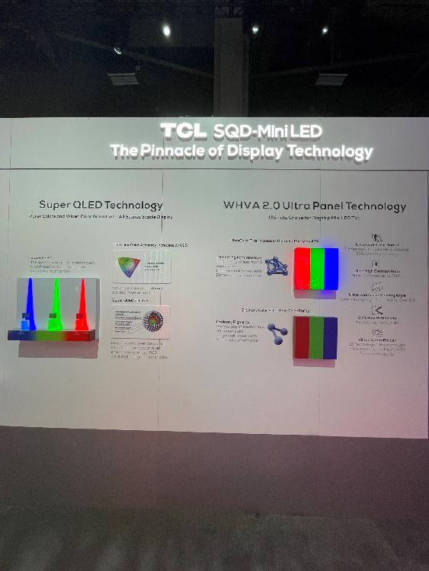
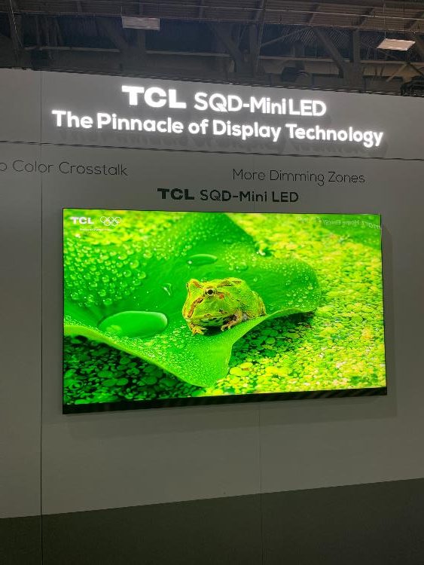
TCL
TCL SQD-Mini LED explanation
TCL SQD-Mini LED TV
Most brands have positioned OLED or RGB mini LED as the flagship technology, but TCL has taken a different route, opting for SQD-Mini LED for its most premium tier.
SQD (Super Quantum Dot) technology uses blue light LED chips but with an improved color filter and improved QD film.
This creates clear differentiation from other brands, with Hisense focused on RGB mini LED displays, LG Electronics on OLED, and Samsung balancing both.
Source: Omdia analyst / CES 2026
© 2026 Omdia
Source: Omdia analyst / CES 2026
© 2026 Omdia

Slide 31
TCL: Product range structure
For LCD TV, TCL adopts its new Quantum Dot solution, which it has called ’SQD-mini LED’ for its 2026 flagship technology. This has been chosen instead of RGB mini LED, which they have positioned a tier down in the high-end segment with Q10 and Q9 series mainly in the China domestic market.
The SQD-Mini LED backlight still uses blue LEDs with red and green conversion via the improved “super” quantum dot materials.
SQD-Mini LED improved quantum dots delivers better picture quality, with 100% BT.2020, 10,000 nits, and more than 20,000 dimming zones.
At CES 2026, TCL launched its new X11L as the 2026 flagship model in the US and European market.
Sizes: 163″/115″/98″/85″/75″/65″
Micro LED
SQD-Mini LED
10,000 nits, 20,736 zones
BT. 2020 100%
B&O Audio
Flagship
X11
High-end
Q10/9
QM8/7
Mainstream
T/S/C Series
Entry level
V series FFalcon
Sizes: 98″/85″/75″/65″
SQD-Mini LED/RGB mini LED
4,000–8,300 nits, 3,000–10,000 zones
BT. 2020 100%
Onkyo Audio
Sizes: 85″/75″/65″/55″/50″
QD-Mini LED
QLED
700–2,000 nits
HFR
Sizes: 75″/65″/58″/55″/50″/43″/32″
LED
700–2,000 nits
HFR
Source: Omdia
© 2026 Omdia

Slide 32
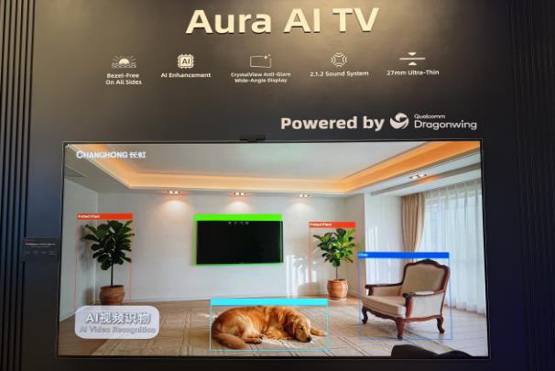
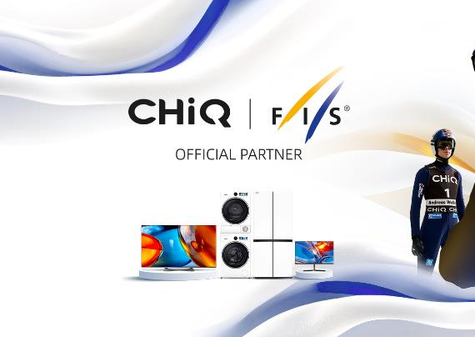
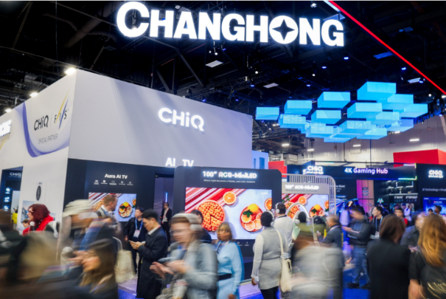
Changhong: Launched AI TV Q10Light powered by Qualcomm
Changhong has opted for a differentiated technological path, partnering with the leading mobile chip giant Qualcomm to launch the AI TV Q10Light. The standout feature of this product lies not in its display technology but in its “computational empowerment.” Equipped with Qualcomm’s Snapdragon computing platform, it incorporates an on-device AI subtitle translation model, enabling real-time multilingual translation and subtitle synchronization for audiovisual content. Changhong is accelerating the construction of its three major bases in Europe, Australia, and Indonesia.
ChiQ, the subbrand of Changhong, strengthens global sports engagement with an FIS Ski Jumping World Cup partnership.
Source: Changhong
Source: Changhong
Source: Changhong

Slide 33
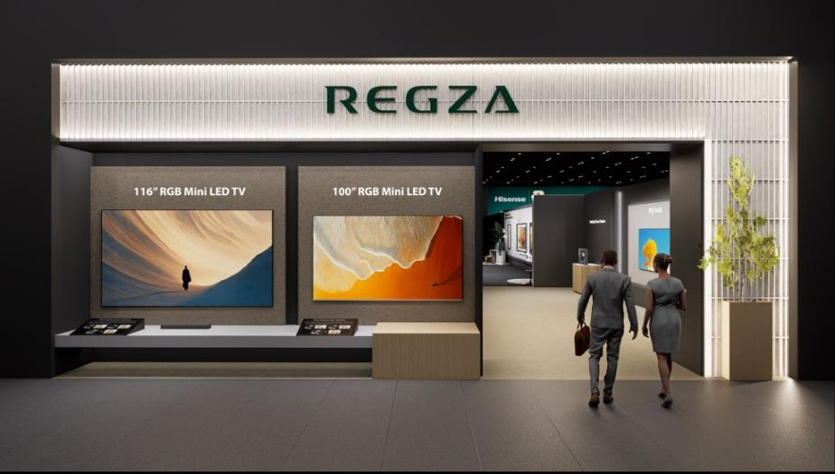
Toshiba REGZA: Continuously investing in display and sound effects
Toshiba REGZA made its debut at CES 2026 and showcased two large-sized RGB mini LED TVs, including 100" and 116". REGZA introduced the newly developed ZR RGB mini LED backlight system, which independently controls red, green, and blue LEDs to achieve dramatically improved color purity and brightness. This technology is a significant improvement over conventional systems, offering a 110% wider color gamut. It delivers vivid yet natural images with rich reds, clear blues, and deep greens that retain their depth even in bright scenes.
REGZA also announced the release of REGZA Immersive Audio 7.1.2, a cutting-edge sound architecture that seamlessly integrates the TV’s built-in 5.1.2 channel system with a rear soundbar connected via low-latency Bluetooth® LE Audio. This innovative solution is designed to complement REGZA’s advanced visual technologies, offering a truly immersive audio experience. The 7.1.2 channel environment is designed to envelop the listener from front, back, and above, creating a unified auditory experience.
Source: REGZA

Slide 34
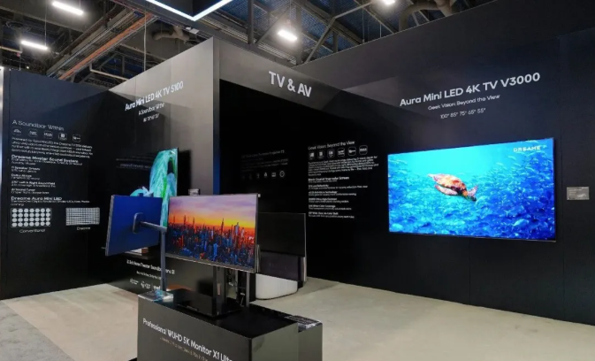
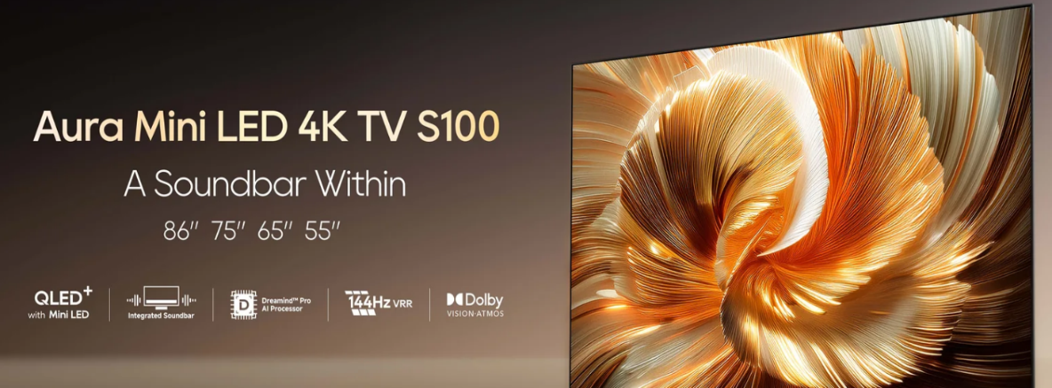
Dreame: New player in the TV market
Dreame, a company that initially specialized in floor-cleaning robots, has now expanded its operations into the TV industry. For the first time at CES, Dreame held a product launch event in North America and unveiled its V3000 and S100 series, all of which are mini LED TV. Additionally, the company continues to offer the Q100 and K100 series, which have been introduced to the global market. Dreame TV is currently available for purchase in regions such as the Chinese mainland and the United Arab Emirates.
Source: Dreame
Source: Dreame

Slide 35
Platform: Key takeaways

Slide 36
Whale TV is expanding its global presence and feature set
Whale TV is an independent TV operating system with 45,000,000 monthly active TVs around the world, helping consumers discover, find, and watch their favorite entertainment. With its easy-to-use TV OS, the company connects consumers, TV brands, content providers, and advertisers. Whale TV is headquartered in Singapore.
Whale TV made several major announcements at CES 2026, focusing on expanding its global presence and enhancing its feature set to compete with larger operating systems.
Key announcements at CES 2026
  Whale TV announced a strategic partnership with Boosteroid, one of the world’s top three cloud gaming services. This allows users with 4K Whale TV models to stream high-performance PC games directly to their televisions at up to 4K resolution and 120 FPS without needing a console. Boosteroid will be available on all 4K Whale TV models, including brands such as Philips, RCA, Sharp, Telefunken, and JVC, across Europe, North America, and South America. Boosteroid is the world’s largest independent cloud gaming provider with more than 8 million users in Europe, North America, and South America. It provides easy and secure cloud-based access to 1,700-plus video games.
  The company announced five new major licensing partnerships with Aiwa, Blaupunkt, EFL, ONVO, and JVC. These brands will begin shipping TVs powered by Whale OS 10 in markets across Europe, Brazil, and Australia.
  Moka was introduced as a new turnkey ODM (original device manufacturer) partner. This collaboration is designed to provide TV brands with a ready-to-use hardware and software solution to speed up their time to market.
  Whale TV enables manufacturers to unlock new recurring revenue streams while delivering a great consumer experience. Whale TV also partners with retailers to drive value creation by connecting retail media networks with its media platform.

Slide 37
Roku is expanding its content ecosystem beyond its own hardware
Roku CEO Anthony Wood announced that Howdy, the company’s $2.99/month ad-free streaming service launched in 2025, will be distributed “everywhere.” This marks a major shift as Roku moves to place its standalone streaming brand on mobile, web, and rival connected-TV platforms.
Amazon and Roku expanded their partnership to bring 50 free channels from The Roku Channel to Amazon Fire TV devices.
Roku predicts five key trends will shape 2026:
  AI-driven personalization is predicted to significantly reduce the time viewers spend finding content, reversing the trend of increasing discovery times. Streaming platforms are expected to become more responsive, utilizing sophisticated algorithms and conversational search to offer content tailored to individual preferences directly on the home screen. This advance is also expected to enhance personalized advertising by leveraging first-party data and programmatic integrations to deliver ads that are more relevant to viewer interests.
  The “ad-free” viewer is becoming rare as platforms such as Prime Video adopt ad-supported models. Free ad-supported streaming (FAST) channels are driven by audience preference and improved content. Though ads are becoming universal, the industry is focusing on less intrusive formats to avoid excessive ad loads.
  There will be a shift toward CTV as generative AI (GenAI) disrupts search and social channels with “AI slop” and “zero-click” summaries. Streaming advertisers are expected to subsidize CTV budgets with funds from search and social media.
  The creator economy will fully merge with streaming as top influencers move beyond social media into licensed CTV content and dedicated “creator” tabs. Major platforms including Tubi and Samsung TV Plus are already following YouTube’s lead by launching creator-led channels, which have seen a surge in viewership. This shift allows brands to leverage high-engagement, shoppable activations featuring popular talent on the biggest screen in the home.
  Hyperlocal advertising on streaming platforms is expected to be driven by the US midterm elections and AI-generated creative. Local businesses are expected to shift budgets to CTV for precise targeting and self-serve ad tools.

Slide 38
Xperi’s TiVo focused on new advertising formats and hardware
The TiVo OS has new features and discovery capabilities. Partner Picks Carousel is a dedicated home screen row that displays curated recommendations from content providers. For the first time, live programs (such as sports and special events) are surfaced alongside standard VOD and streaming content. Upgraded voice navigation now features improved accuracy and expanded support for multiple languages and regional dialects.
TiVo has announced expanded content and more sports. It added new streaming partners such as global anime brand Crunchyroll, the film platform Cineverse, and the audio giant iHeartRadio to its native app lineup. Their deeper sports lineup now includes an official NBA app and dozens of free streaming channels for NASCAR, Tennis TV, and Red Bull TV.
TiVo confirmed continued growth of its OS, powering TVs from brands such as Sharp, Vestel, and Panasonic across European markets.
TiVo Ads introduced high-impact formats including full-screen video ads during home screen navigation and shoppable QR codes that allow users to purchase products via their smartphones.
  TiVo’s “shoppable TV” initiative at CES 2026 introduced new advertising formats designed to create a direct path from viewing content to purchasing products. Shoppable QR codes are the primary mechanism for purchasing. These appear on-screen during high-impact ad formats, allowing users to scan the code with their smartphone to complete a purchase.
  Implemented during home screen navigation, full-screen video ads can feature the shoppable QR codes.
  The goal is to create engaging high-impact ad formats within the platform that lead directly to a call-to-action (purchasing), leveraging TiVo’s ability to target specific audiences.
TiVo confirmed that its operating system is expanding to power a broader range of device categories in 2026. In addition to smart TVs across various sizes, ranging from 24″ HD models to 75″ 4K QLED models, the Tivo OS platform will now include set-top boxes and soundbars and will bring the OS into the PC/gaming monitor space.

Slide 39
At CES 2026, VIDAA OS underwent a major transformation
The operating system is transitioning to a new name, V Home OS, to reflect its broader role beyond just televisions.
A significant partnership with Microsoft was announced to integrate Copilot’s generative AI capabilities directly into the platform, enhancing the user experience with advanced AI services.
The new platform now supports Xbox Cloud Gaming, allowing users to stream high-end game titles directly on their TVs without needing a console.
Moving beyond TVs, the OS is being integrated into other home appliances, such as smart refrigerators and washing machines, acting as a central hub for connected devices.
The platform was showcased as the foundation for Hisense’s “full-scenario” smart home ecosystem, featuring tools such as smart voice assistants and automatic energy-saving modes.
Key 2026 TV models featuring V Home OS
  116UXS (Flagship RGB mini LED evo): This 116″ monster features the new RGB mini LED evo technology, which adds a cyan fourth LED to improve color precision and lifelike transitions. It reaches 5,000 nits of peak brightness.
  163MX (RGBY Micro LED): A massive 163″ display that utilizes an industry-first four-primary RGBY (red, green, blue, yellow) architecture. By adding yellow sub-pixels, it achieves 100% of the BT.2020 color space.
  UR9 Series: Designed to bring RGB mini LED technology to more mainstream consumers, this series ranges in size from 55″ to 100″.
  UR8 Series: Another range utilizing RGB mini LED technology to deliver enhanced color saturation and tonal separation.
  Refreshed ULED & Canvas TV Series: The 2026 lineup includes updated U7, U7 Pro, and U8 models. The Canvas TV range returns, combining display technology with an artwork-style design for interior aesthetics.

Slide 40
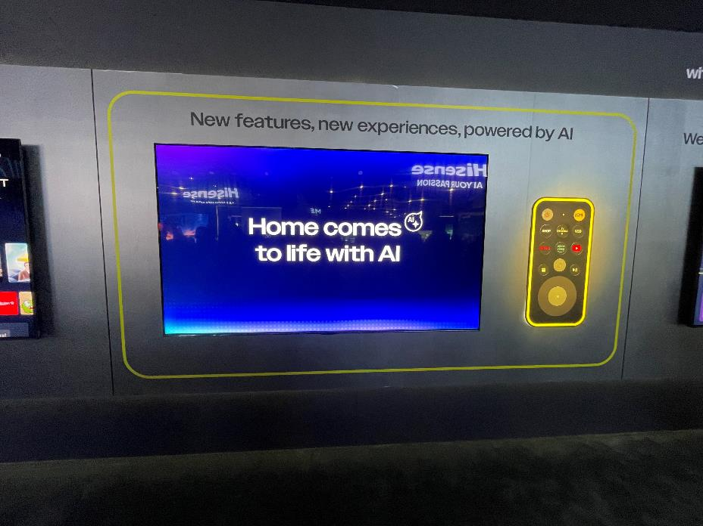
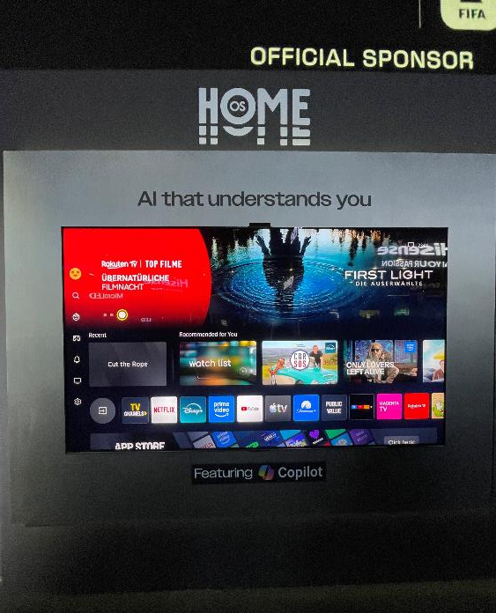
Vidaa OS rebranded as Home OS
Home OS
Home AI
At CES 2026, Vidaa announced its operating system is being rebranded as Home OS, and the company will also change name to just V.
The name change is part of the wider push by the company to be an operating system that not only encompasses AI but that also, eventually, acts as a shopping portal.
The OS currently has minimal presence in the US, but it has plans to grow, primarily via smaller retailers.
Source: Omdia analyst / CES 2026
© 2026 Omdia
Source: Omdia analyst / CES 2026
© 2026 Omdia

Slide 41
At CES 2026, Google integrated its Gemini AI into Google TV
Key features and announcements
Google has shifted to AI-driven discovery. A new framework provides visually rich responses to queries, including real-time sports updates and “deep dives:” narrated, interactive overviews of complex topics designed for family viewing.
Users can adjust TV settings using conversational language. For example, saying “The dialogue is lost” will prompt Gemini to automatically optimize sound settings without leaving the content.
These features will roll out first to select TCL devices, followed by other partners such as Hisense, Sony, and Philips.
The Xbox Game Pass app is officially coming to Google TV devices in 2026, also debuting first on TCL models.
Google introduced interactive shoppable video. AI-driven “shoppable” prompts are tied to on-screen content. Shoppable prompts on Google TV bridge the gap between watching and buying by using AI to identify items on screen. At CES 2026, Google emphasized “direct paths” from discovery to checkout without leaving the interface.
Examples of shoppable prompts
During some YouTube and TV ad segments, an interactive sidebar feed appears on the right side of the screen. Users can use a remote to browse a carousel of products featured in the video.
While travel or home decor content is being watched, AI-driven prompts may appear as “clickable hotspots” over specific items, such as a blender in a cooking show or a hotel in a travel documentary. This allows users to view details or “send a link to phone” for later.
Users can engage in conversational shopping. Just ask questions such as "Where can I buy those sneakers?" while watching; the TV identifies the brand and provides a QR code or an option to add it to a Google Shopping cart.
TV commercials now include dynamic QR codes that link to product pages on the brand’s website.

Slide 42
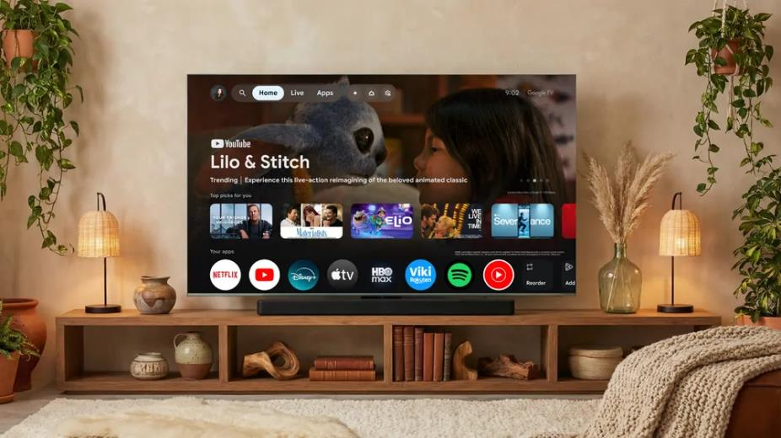
Google TV
Google announced a few improvements to its TV operating system at CES this year, including
  Explore favorite topics through a new visually rich framework that adapts Gemini’s responses to queries with imagery, videos, and real-time sports updates. For complex topics, “deep dives” provide narrated, interactive overviews simplified for the whole family.
  Use Gemini to search the Google Photos library for specific people or moments. Instantly apply artistic styles with Photos Remix or transform memories into cinematic immersive slideshows.
  Use Nano Banana and Veo to reimagine personal photos or create original media directly on the TV.
  Skip complicated settings menus by using natural language to optimize settings. Simply tell Gemini “The screen is too dim” or “The dialogue is lost” to adjust picture and sound without leaving the movie or show.
The ability to use natural language to adjust audio and picture quality in particular is a major step toward making AI useful with everyday tasks.
Source: Google

Slide 43
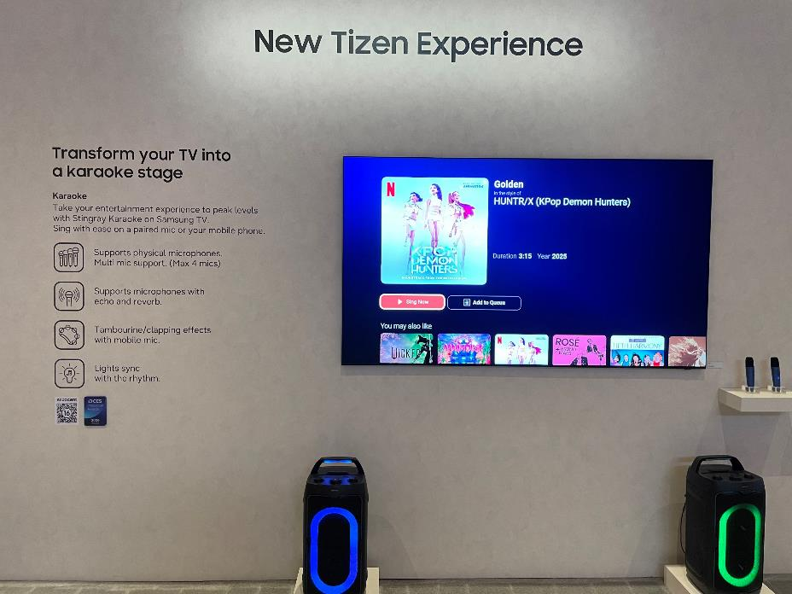
Samsung Tizen
New Tizen experience
Updates at CES for Tizen were limited, with “expanded content discovery” being the most notable improvement, enabling viewers to access curated programming based on viewing trends and seasonal themes through a simple, intuitive interface.
The Samsung booth highlighted another new development, which enables the TV to turn into a karaoke stage.
  With microphone connectivity, tambourine effects, and applause sounds, the TV transforms into a karaoke system, while features such as echo, reverb, and voice tuning recreate the feel of a professional performance.
  Available in 30 countries, Samsung TV Plus brings a wide range of entertainment programming—including sports, music, and creator content—across more than 3,500 channels and 66,000 video-on-demand titles.
Source: Omdia analyst / CES 2026
© 2026 Omdia

Slide 44
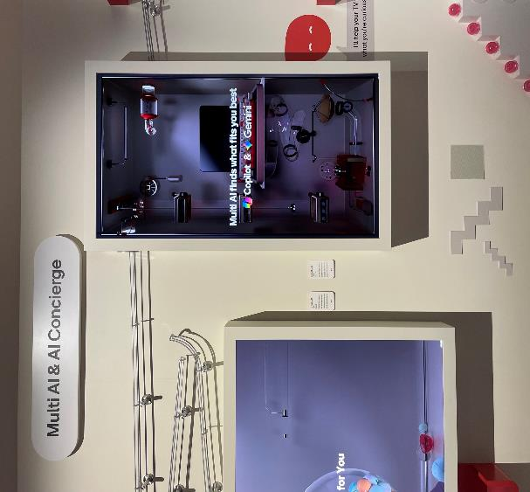
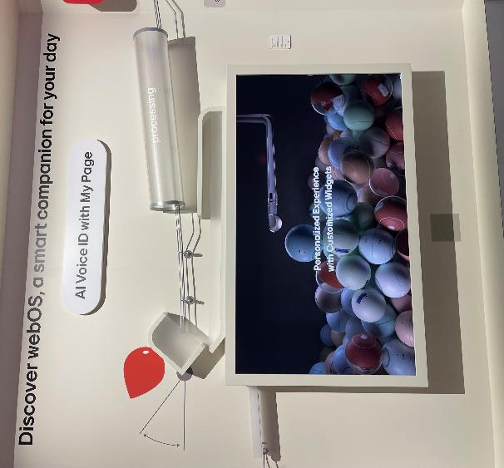
LG webOS
LGE showcased its “Multi AI” approach at CES, with Microsoft’s Copilot and Google’s Gemini highlighted.
Interactive demonstrations of webOS AI features—including AI Search, AI Concierge and AI Voice Control—showed how natural-language processing and recommendation systems are used to manage content and device settings.
Additionally, the company also introduced LG Gallery+, a webOS-based service that displays curated art and imagery based on user preferences.
LG webOS: Multi AI & AI concierge
LG webOS: AI Voice ID
Source: Omdia analyst / CES 2026
© 2026 Omdia
Source: Omdia analyst / CES 2026
© 2026 Omdia

Slide 45
TV start to support with “Dolby Vision 2” at CES 2026
TV brands with “Dolby Vision 2” support in 2026
 | Hisense | TCL | Philips (TP Vision)
TV support models & brands in 2026 | RGB mini LED TV series | X QD-Mini LED TV series | OLED TV Series
 | - UX | - X11L | - OLED 811
 | - UR9 | C Series | -OLED 911
 | - UR8 | (Plan to OTA update in the future) | -OLED 951
 | Mini LED TV series |  | (Plan to OTA update in the future)
 | (will OTA update in the future)
TV content support in 2026 | NBA MLB Both NBA and MLB content will be broadcast in Dolby Vision 2
Key feature | - Brighter - More vivid picture - Better audio - First content to play in the new standard is Peacock’s streaming content, including live sports
Source: Omdia
© 2026 Omdia

Slide 46
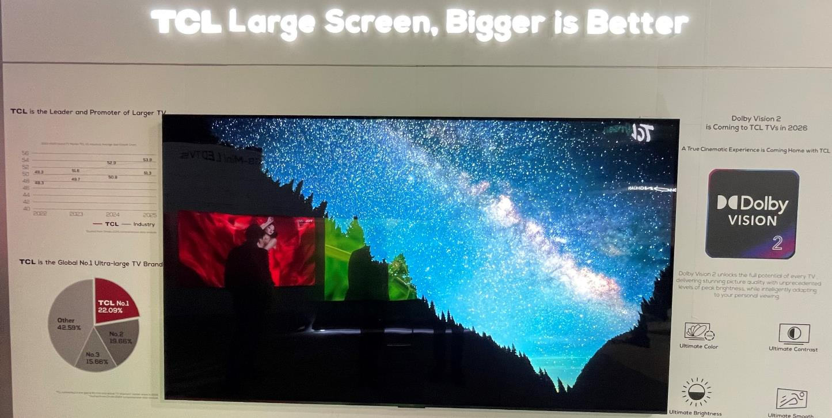
TCL is the key launch partner for Dolby Vision 2
TCL promoting Dolby Vision 2
Source: Omdia analyst / CES 2026
© 2026 Omdia

Slide 47
Appendix

Slide 48
Appendix
Further reading
“TV memory price increases present a challenge for TV brands in 2026” (December 2025)
TV Sets (Emerging Technologies) Market Tracker: Forecast – 3Q25 Analysis (January 2026)
Authors
Patrick Horner, Practice Leader, TV Set Research – Consumer
Matthew Rubin, Principal Analyst, TV Set Research – Consumer
Kelly Lee, Principal Analyst, TV Set Research – Consumer
Bing Zhang, Senior Principal Analyst, TV Set Research – Consumer
Ken Park, Research Director, TV/ProAV - Consumer
  askananalyst@omdia.com
  Omdia consulting
  We hope that this analysis will help you make informed and imaginative business decisions. If you have further requirements, Omdia’s consulting team may be able to help you. For more information about Omdia’s consulting capabilities, please contact us directly at consulting@omdia.com.
  Citation policy
  Request external citation and usage of Omdia research and data via citations@omdia.com.

