Slide 2
Fire Detection and Suppression - 2024
Complete examination of the fire detection and suppression equipment industry, including competitive analyses of the top equipment suppliers.
askananalyst@omdia.com

Slide 3
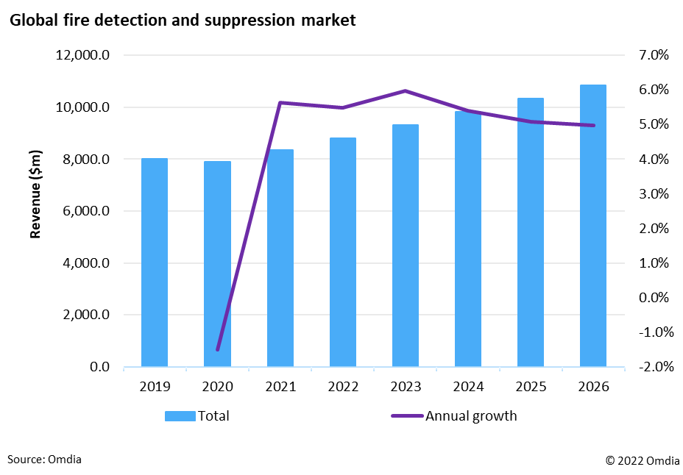
Fire Detection and Suppression Equipment Report 2024
Sub-regions and vertical markets –Publishing March 2024​
This document outlines the proposed scope for the 2024 edition of this report on the market for fire detection and suppression equipment. ​
The report provides an in-depth analysis of the fire detection and suppression market. ​
Estimates and forecasts are provided for fire detection and suppression equipment revenues across 11 vertical markets and 3 sub-regions. ​
Market share data is provided for fire detection and suppression equipment. ​
The report aims to provide equipment manufacturers, service providers and systems integrators with an in-depth understanding of market sizes, growth forecasts, market trends and the competitive landscape. ​
The report will also evaluate the development of key market trends in fire detection and suppression. ​

Slide 4
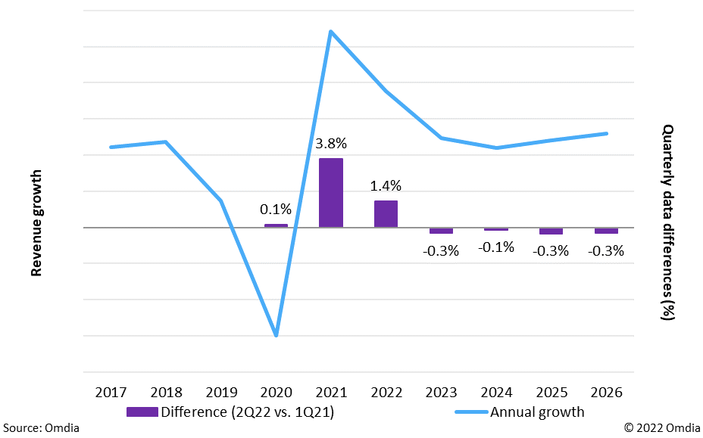
Machinery ​Production Market Viewpoint Service​
How Omdia helps you
Key questions addressed
Growth forecasts for 51 equipment markets to 2027 in terms of US dollar revenues, unit shipments, and average selling price.​
Global and regional market share estimates of leading suppliers for total automation, motor & motor controls, and power transmission equipment. ​
Analyse of the IAE market's past and current performance, and the key drivers influencing the IAE market. ​
Quarterly updates provided by various Omdia analysts, representing continued coverage of the market.​
How large was the market for industrial automation equipment in 2021, and what is the growth forecast from 2022 to 2027?​
How the major regions performance for industrial automation equipment in 2021 and forecast years? ​
How the vertical industries performance for industrial automation equipment market in 2021 ?​
Which are the leading suppliers of the industrial automation equipment and what market share in 2021?
Quarterly Market Variance Comparison

Slide 5
Report Coverage (1/2)
KEY ISSUES ADDRESSED
COVERAGE
APPLICABLE TO
​Regions​
Americas​
EMEA ​
Asia & Oceania ​
Frequency, Time Period​
5-year forecast (2024 - 2028)​
Base year (2023)​
Measures​
Revenues ($ millions)​
Unit shipments (for associated detection and suppression hardware) ​
Average sales price (ASP) ​
Vertical Markets ​
Banking and finance ​
Commercial​
Education​
Government​
Healthcare​
Manufacturing & Industrial ​
Retail​
Sports & Leisure ​
Transportation​
Utilities, energy & mining​
Multi-family ​ ​
​
Fire detection and suppression equipment manufacturers​
Fire detection and suppression service providers ​
Systems integrators and installers ​
Physical security and life safety equipment vendors​
Component manufacturers​
Investors​ ​ With an in-depth understanding of market sizes, growth forecasts, market trends, and the competitive landscape for fire detection and suppression equipment.​
What is the total size of the global market for fire detection and suppression equipment? ​
How does market demand for equipment differ by sub-region and by vertical market? ​
Which end-user sectors will experience the fastest growth over the next five years? ​
How do market opportunities vary between new construction and retrofit projects? ​
Who are the leading suppliers of various product types in each region? ​
Detection Equipment​
Control Panels​
Detectors​
Manual Call Points​
Notification Products ​
Video Smoke Detection​
​
Suppression Equipment​
Portable Extinguisher ​
Gaseous Suppression ​
Sprinkler Heads​
Water Mist System​
Building Sizes ​
Small ( <50K sq. feet)​
Medium ​
Large ( >200K sq. feet)​
​
​
​
Fire Detection and Suppression Equipment Report - 2024 ​

Slide 6
Report Coverage (2/2)
By Detection Type ​
ASD ​
Beam​
Flame​
Heat​
Heat-Linear​
Multi-Sensor​
Optical ​
​
By Panel Type ​
Networked Panels​
Single Loop Panels​
2 Loop Panels​
Multi-Loop Panels ​
Non-Networked Panels​
Single Loop Panels​
2 Loop Panels​
Multi-Loop Panels ​
Conventional Panels​
​
​
​
By Detector Connection ​
Wired​
Wireless​
​
By Notification Type ​
Voice Alarms​
Visual Alarms​
Sound Alarms​
Combination Alarms​
​
By Portable Extinguisher Type​
CO2​
Dry Chemical​
Foam​
Water​
​
By Gaseous Suppression Type​
CO2​
Inert Gas​
Chemical Agents​
​
By Sprinkler Head Type​
Wet​
Dry​
​
By Water Mist Type​
High Pressure​
Low Pressure​
​
By Project Type​
(For both detection and suppression equipment) ​
New construction​
Retrofit ​
​
By Sales Channel​
Direct to End-Users​
Systems Integrators​
Distributors ​
Market Shares Tables​
All Equipment​
Detection Equipment ​
Control Panels​
Detectors​
Manual Call Points​
Notification Products ​
Aspirating Smoke Detectors ​
Suppression Equipment ​
Gaseous Suppression Agents​
Portable Fire Extinguishers ​
Sprinkler Heads​
Water Mist Systems ​
Fire Detection and Suppression Equipment Report - 2024 ​

Slide 7
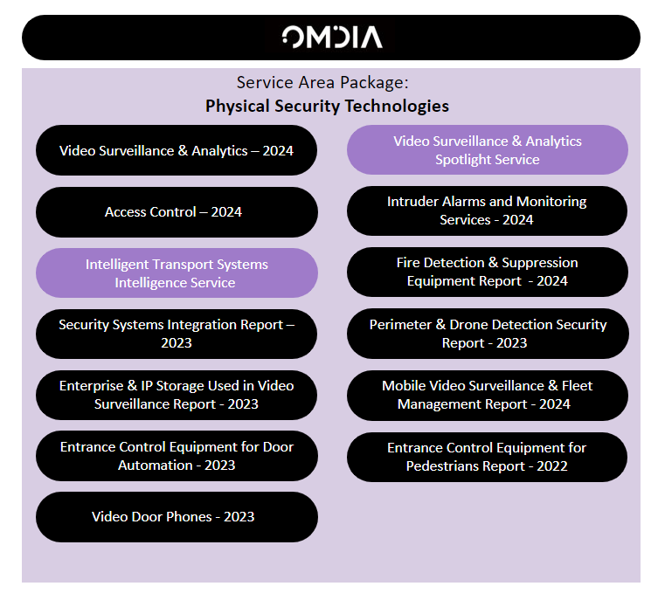
Related Content: Physical Security Technologies Service Area Coverage
About Omdia’s Physical Security Technologies Research
Omdia is the world’s leading provider of market intelligence to the security industry, with an impressive customer base that includes ten of the largest suppliers of electronic physical security products. We provide complete coverage of the electronic security market, with dedicated reports on a variety of markets, including: video surveillance, security AI, physical security as a service, access controls, intruder alarms, fire detection, entrance control, drone detection and explosives, weapons & contraband detection equipment.
The level of detail is unmatched. Our reports can have as many as 200 data tables that analyze the market by product type, industry sector, country and sales channel. With analysts based in Europe, the US and Asia, we are also able to provide global coverage with local market insight.
Our range of products and services includes detailed annual market reports, quarterly market trackers and customer surveys. As well as the off-shelf studies, we also offer custom research and strategy consultancy services, and have successfully completed projects for some of the world’s largest security firms.

Slide 8
Physical Security Technologies: Our Expert Analyst
Amir Boubaker
Senior Analyst, Physical Security

Slide 9
Our “Ask an Analyst” Service Provides Best in Class Customer Support
Whether you need guidance to navigate the service, information regarding our methodologies or you want to better understand a data trend, Omdia’s support team is here to help.
Draw on our expertise
Make the right decisions
Sanity-check your own findings
Get the most out of your subscription
Understand more about our methodologies
Our Ask an Analyst service gives you direct contact via telephone, email or face-to-face session with our expert analyst team:
96%
of our customers rate our service as Excellent or Very Good
Kâren Dyer
Customer Success Manager

Slide 10
Disclaimer
Get in touch!
customersuccess@omdia.com
@Omdia
@OmdiaHQ

